Slide 1
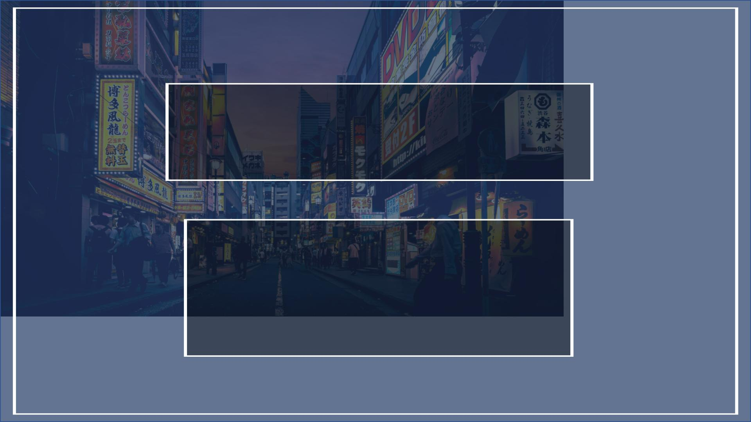
The Future of Entertainment:
Video Games, Fantasy,
and Anime
Team: Boston EquiTea Party
Valentina Vezzelli, Andres Sanchez Bruhn,
Alvaro Baigorri Pascual, Sebastian Jönsson,
Leonard Mahlberg
Hult International Business School
Cambridge, March 13th, 2022

Slide 2
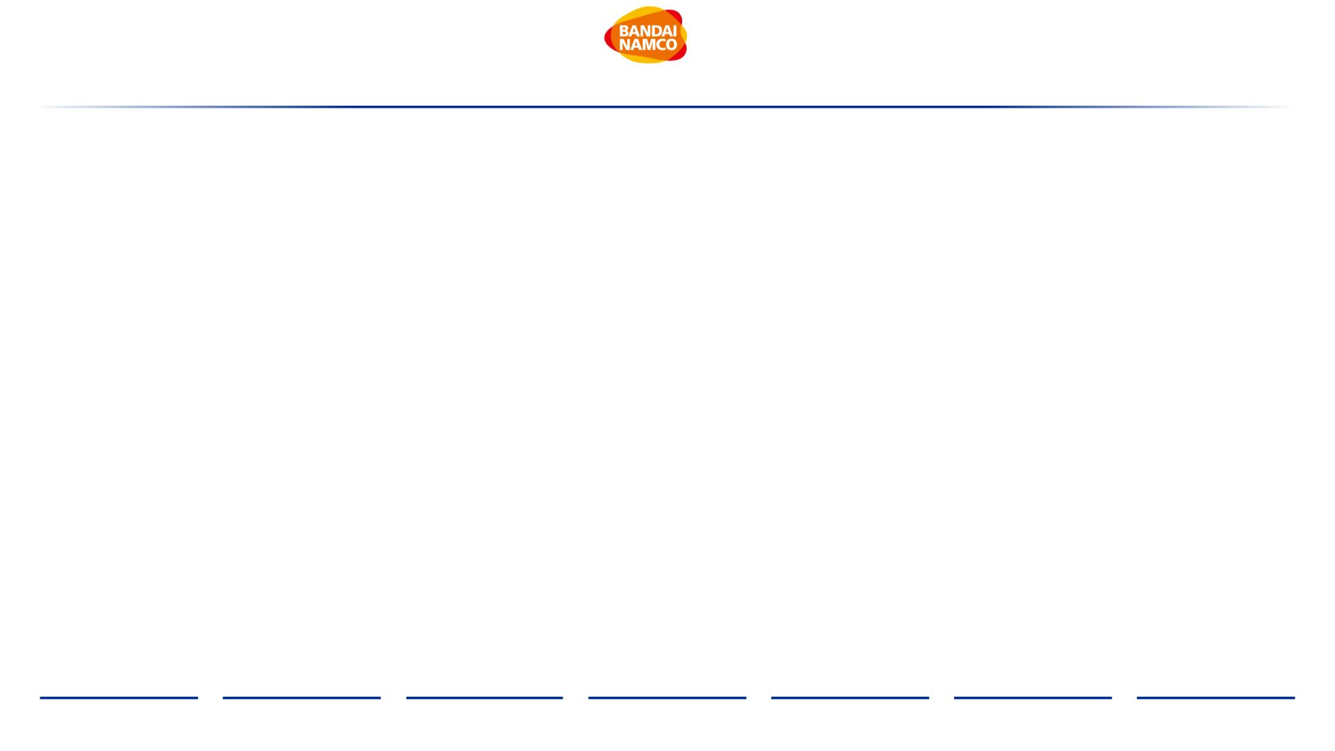
Table of Contents
Executive Summary
I. Industry Overview
4
6
II. Company Analysis
A. Bandai Namco
B. Games Workshop
C. Strategic Fit
19
III. Financial Analysis
A. Comparables
42
B. Discounted Cash Flow
C. Synergies
IV. Acquisition Feasibility
V. Alternative Solution
VI. Conclusion
Appendix
65
75
80
82
93
Bibliography
Executive
Summary
Industry
Overview
Company
Analysis
Financial
Analysis
Acquisition
Feasibility
Alternative
Solution
Conclusion
2

Slide 3

Table of Abbreviations
Abbreviation
ACJ
AR
Explanation
Abbreviation
IP
Explanation
Anime Consortium Japan
Augmented Reality
Average revenue per user
Australia
Intellectual Propriety
Japan
JP
ARPU
AU
MMORPG
M&A
mm
Massive Multiplayer Online Role Play Game
Mergers & Acquisitions
Million
BCG
BN
Boston Consulting Group
Bandai Namco
NPV
NZ
Net Present Value
New Zealand
BRL
B2B
bn
Brazilian Real
Business to Business
Billion
OPM
OTT
PC
Operating Profit Margin
Over the Top
CAGR
CN
Compounded Annual Growth Rate
China
Personal Computer
Return on Assets
Return on Equity
ROA
ROE
R&D
SG&A
SVoD
S&P
t
CO2
COGS
Co.
Carbon dioxide
Cost of Goods Sold
Cooperation
Research & Development
Selling, general, and administrative expenses
Streaming Video on Demand
Standard and Poor's
Ton
DCF
EBIT
EBITDA
EV
Discounted Cash Flows
Earnings before interest and taxes
Earnings before Interest, Taxes, Depreciation, and Amortization
Enterprise Value
UK
United Kingdom
e.g.
“exempli gratia” or for example
Exception
US
United States
excl.
FX
VR
Virtual Reality
Foreign Exchange
WACC
YoY
40K
Weighted Average Cost of Capital
Year-over-year
FY
Fiscal Year
GW
Games Workshop
40,000
HR
Human Resources
~
Approximately
Executive
Summary
Industry
Overview
Company
Analysis
Financial
Analysis
Acquisition
Feasibility
Alternative
Solution
Conclusion
3

Slide 4
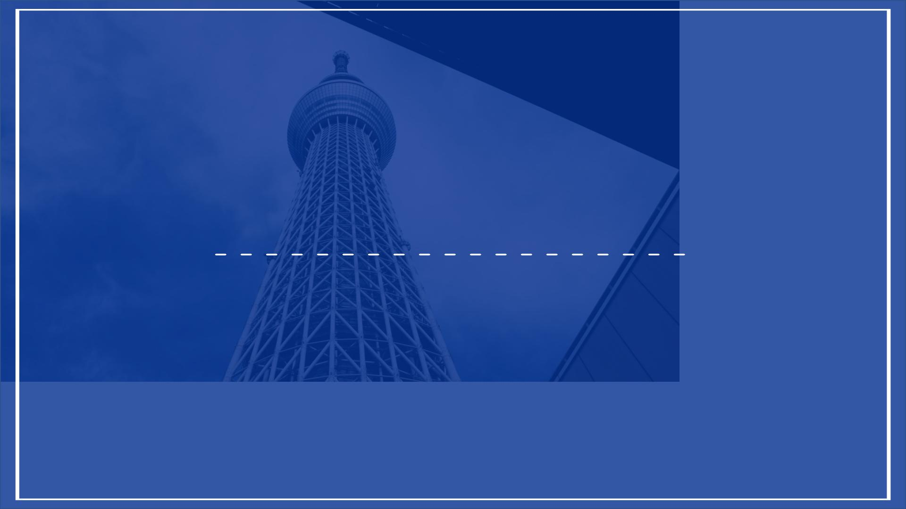
Executive Summary
Bandai Namco’s Course of Action

Slide 5
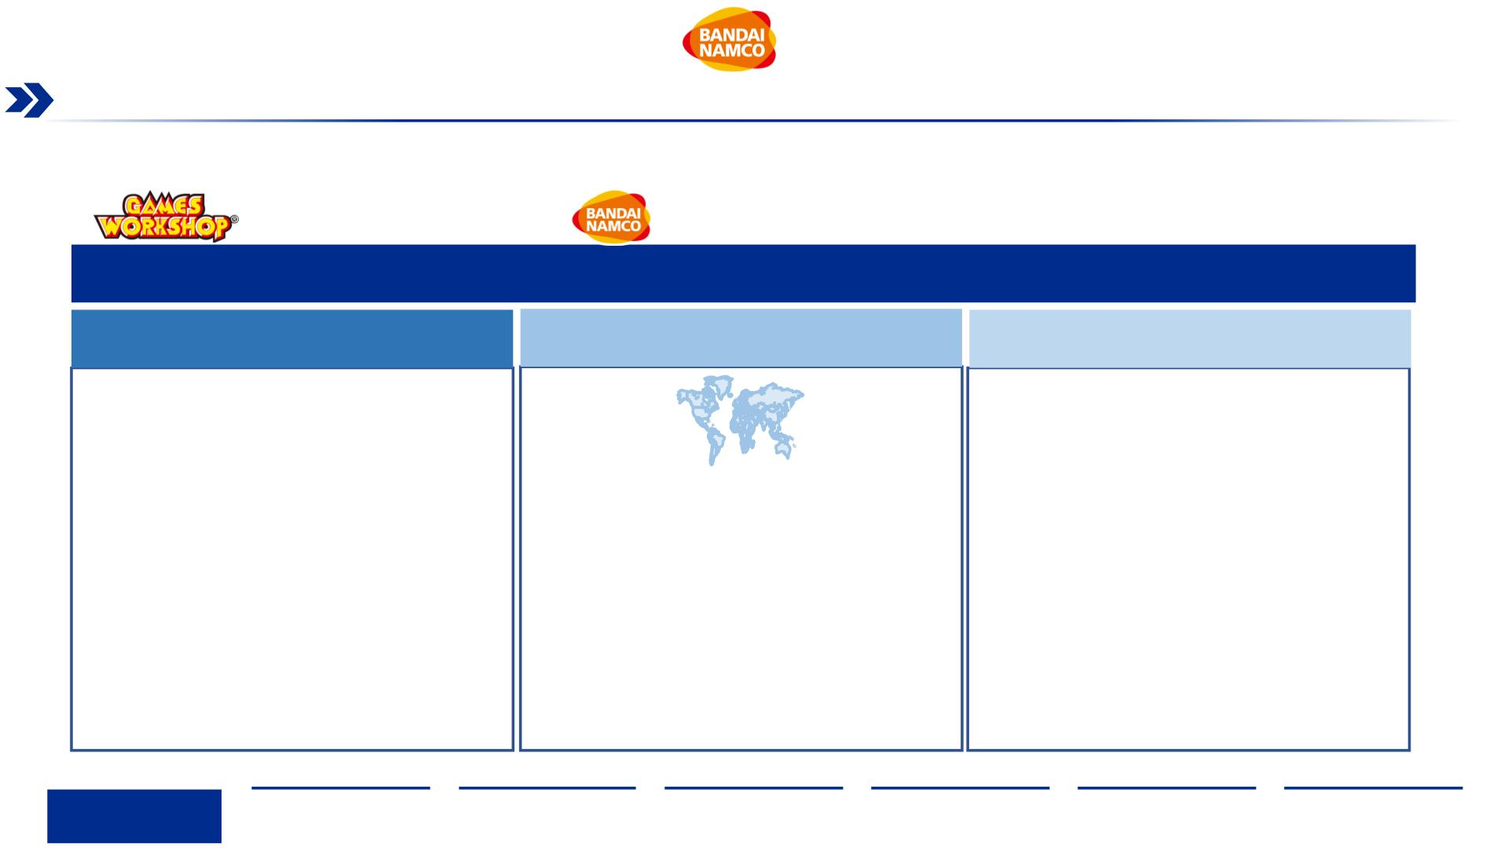
Executive Summary
Should Bandai Namco acquire Games Workshop?
Bandai Namco Holding Inc, a worldwide leading Japanese developer of entertainment-related products and services, aims to expand
its geographic footprint in the West and strengthen its IP portfolio through a potential acquisition of Games Workshop Group (UK), a
worldwide leading developer and manufacturer of miniature figures and games based on the well renowned Warhammer franchise.
Bandai Namco should fully acquire Games Workshop, on the back of the deals’…
Financial Value
Strategic Fit
Acquisition Feasibility
• As of March 3rd, 2022, the market is undervaluing
Games Workshop’s $94.04 price per share by 24%,
creating a window for an acquisition
• Games Workshop’s IP strengthens Bandai Namco’s IP • Given Bandai Namco’s EBITDA margin (15.1%), strong
axis strategy, allowing for future content creation for operating cash flow ($546 mm), and low debt-to-EBITDA
both physical and digital worlds, connecting fans around ratio (0.4x); a finance structure of ~76% debt and ~24%
• Expected synergies from cost reductions and
revenue generation amount to $270.1 mm for the next
five years
the globe
is proposed, resulting in minimum IRR of 10% and MOIC
• Bandai Namco’s overseas’ sales will increase from
of 1.4x
22% in 2021 to 28% in 2026, accelerating the company’s • Current market landscape shows no regulatory
mid-term goal to increase its western presence
impediment risk that could threaten the closure of the
• A maximum purchase price of $4,102.9 mm is
suggested, which includes a premium range of up to
33% to current market value
• An acquisition would result in an immediate addition to
deal
the in-house IP revenue mix of 53.4%, a fit that cannot • A full buyout approach enables the biggest immediate
be achieved by other identified alternatives value creation for Bandai Namco
Executive
Summary
Industry
Overview
Company
Analysis
Financial
Analysis
Acquisition
Feasibility
Alternative
Solution
Conclusion
5

Slide 6
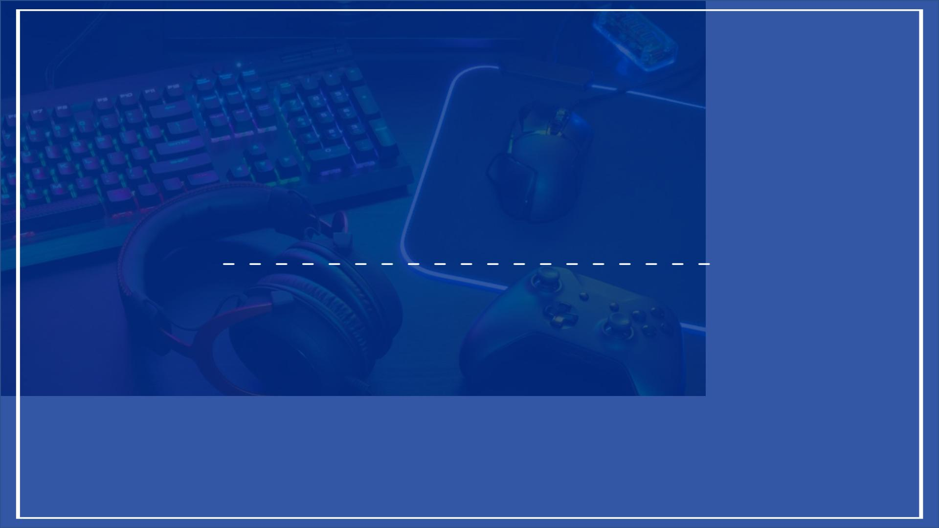
I. Industry Overview
Defining and Shaping the Industry
6

Slide 7
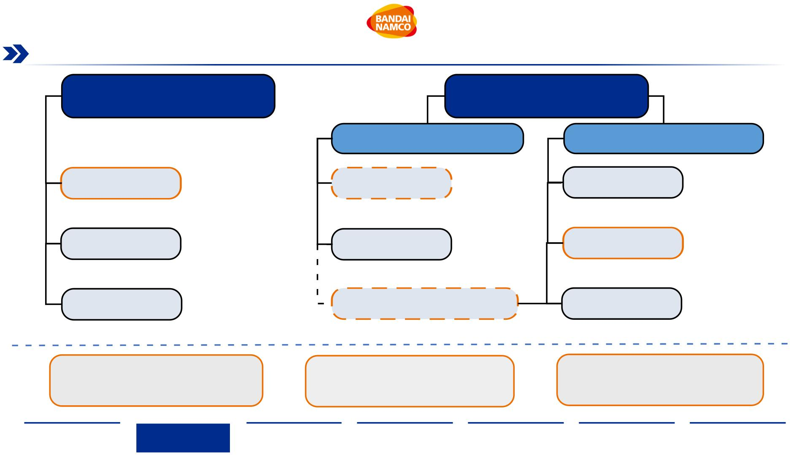
Industry Breakdown
Bandai Namco is operating in three industries, namely Toys & Hobby, Video Games and Video Entertainment & Media
Toys & Hobby Industry
Global Entertainment
& Media Industry
Video Game
Industry
Video Entertainment
& Media Industry
• Plastic Toys
• Puzzles
• Card Games
• Stuffed Toys
• Construction Sets
• Toddler Toys
• Scripting
Toys & Games
Sports Equipment
Musical Instruments
(Digital) Software
Hardware
• Home Games
• Mobile Games
Back End Services
OTT Services
• Recording
• Production
• Distribution
• Video Game Consoles
• Streaming (SVoD)
• Multichannel
• Streaming Devices
• Video Distribution
• Video Management
• Winter Equipment
• Summer Equipment
• Others
• Home Consoles
• Handheld
Consoles
• Digital
• Acoustic
• Others
Virtual & Augmented Reality
Broadcast Media
• Television
• Cable Network
• Movie Theatres
The Toys & Games segment, valued at
$297 bn in revenues, is growing at a CAGR
of 4.62%, with plastic toys and construction
sets being two key segments of the sector
The Video Game industry, particularly the
sales of digital game software, is valued at
$155 bn in revenues, is expected to grow
strongly at a CAGR 12.84%
The OTT Services sector, in particular SVoD,
is valued at $71 bn in revenues, is experiencing
strong growth at a CAGR of 15.40%
Sources: (Yufei Han, 2020, Statista), (Shaulova & Biagi, 2020, Statista)
Executive
Summary
Industry
Overview
Company
Analysis
Financial
Analysis
Acquisition
Feasibility
Alternative
Solution
Conclusion
7

Slide 8
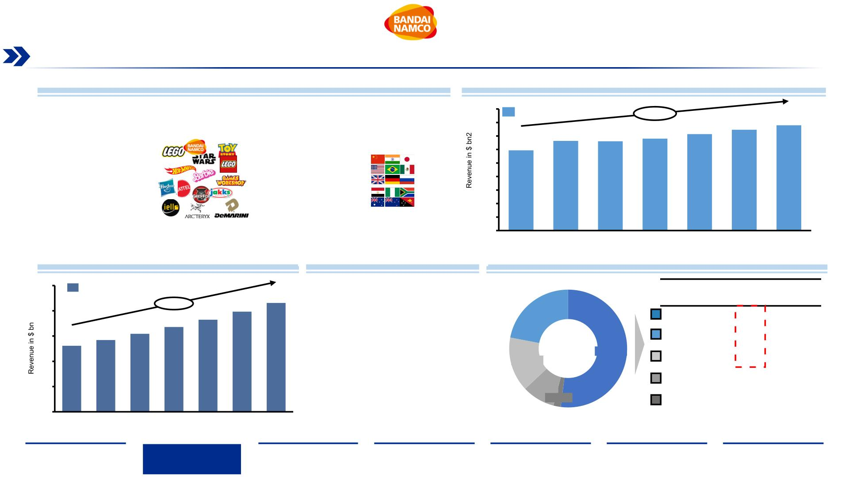
Toys & Hobby Market Overview (1/2)
The Toys & Games segment generates the highest revenue, and is expected to keep growing in the next five years especially in the
US, China and United Kingdom
Toys & Hobby Market Overview
Toys & Games Segment Revenue Forecast¹
•
•
Overall, Toys & Hobby products generated $ 452 bn in sales worldwide in 2019
450
Revenues
+4.62%
Toys & Games is the largest segment of the Toys & Hobby market with ~65% of total sales
($297 bn in revenues in 2019), excluding Board Games
400
350
300
250
200
150
100
50
357
373
390
332
330
340
•
•
Asia, is the biggest market in the Toys & Games segment with 52% of revenues and it’s expected
to grow at a CAGR of 5.5% from 2019 to 2025
297
According to Business Wire, the Card and Boards Games market by revenue is expected to grow
at a CAGR of ~9% during the period 2021-2026, impacted by an increase in popularity as a result
of the COVID-19 pandemic
•
The top 5 players of the Cards and Board Games are Games Workshop Group PLC,
NECA/WizKids LLC, IELLO USA LLC., Grey Fox Games, Disney
0
2019
2020
2021
2022
2023
2024
2025
Global Cards and Board Games Market Value²
Toys & Games Key Players/Brands
Revenues by Geographic Region in the Toys & Games Segment
25
Market Value
CAGR:
’19-’25
Key Markets
Drivers of Growth
+8.70%
20
22
20
15
10
5
18
22.00%
Asia
5.5%
2.8%
15
17
13
14
Americas
15.00%
52.00%
Europe
Africa
2.1%
7.4%
3.6%
9.00%
2.00%
Oceania
0
2019
2020
2021
2022
2023
2024
2025
Note: ¹Value in billion $, ²Value in billion $ based on 2019
Source:(Shaulova & Biagi, 2020, Statista), (Business wire, 2021)
Executive
Summary
Industry
Overview
Company
Analysis
Financial
Analysis
Acquisition
Feasibility
Alternative
Solution
Conclusion
8

Slide 9
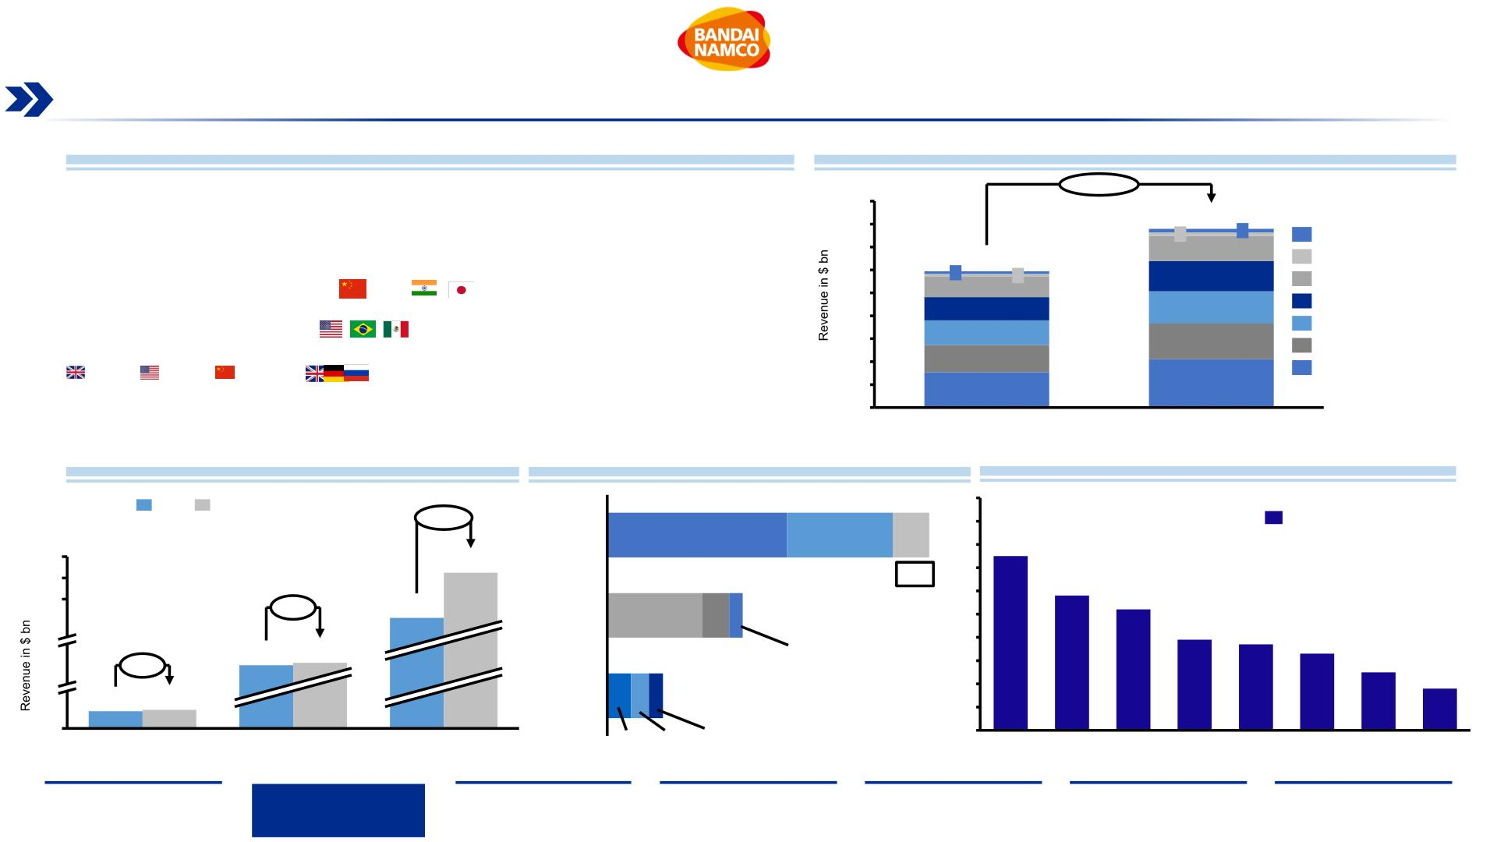
Toys & Hobby Overview (2/2)
China, United States and United Kingdom markets are positioned as major engines for growth for the Toys & Games segment
Toys & Hobby Market Overview
Revenues by Type of Product for Toys and Games segment¹
•
•
Toys & Games segment revenues are expected to grow by 31.1% between 2019 and 2025 and
reach $390 bn (CAGR of 4.62%)
450
+31.13%
400
350
300
250
200
150
100
50
390
8
Video game consoles are expected to generate the highest revenue in the Toys & Games
segment with 27% of revenues followed by plastic & other toys with 20% and construction
sets with 17%
8
55
66
Puzzles
6
45
297
Card Games
6
Dolls & Stuffed Toys
Construction Sets
Toys for Toddlers & Kids
Plastic & Other Toys
Video Game Consoles
•
Asia represents the largest market in terms of revenues for sales of Toys ($ 109 bn), followed by
the Americas ($ 46 bn) and Europe ($ 19 bn)
51
53
59
70
78
•
•
China is forecasted to grow its Toy sales by 35%, followed by the UK with 7% and the US with 3%
A global market survey shows preference in purchase channels of toy products, with retail stores
being the most popular (75%), followed by online shops (58%)
77
105
0
2019
2025
Revenue growth for Toys and Games¹
Top Toy Revenue by Market¹
Global Market Survey – Purchase Channels
2019
2025
100
90
80
70
60
50
40
30
20
10
0
+35%
82
Channel of purchase
Asia
61
36
12
90
80
70
+3%
61
Americas
32
9 5
32
34
75%
+7%
58%
52%
8
9
Europe 8 6 5
39%
37%
33%
25%
18%
Mail
0
Store
Online Department Second-
Shop
Flea
Market
Private Specialist
sale
Note: ¹Value in billion $, ² Data from 2020 express in million USD $ converted with a conversion rate of 110.71
Source:(Shaulova & Biagi, 2020, Statista), (Tighe, 2019), (Wood, 2021)
Store
hand
websites
toy storeOrder/Catalog
Executive
Summary
Industry
Overview
Company
Analysis
Financial
Analysis
Acquisition
Feasibility
Alternative
Solution
Conclusion
9

Slide 10
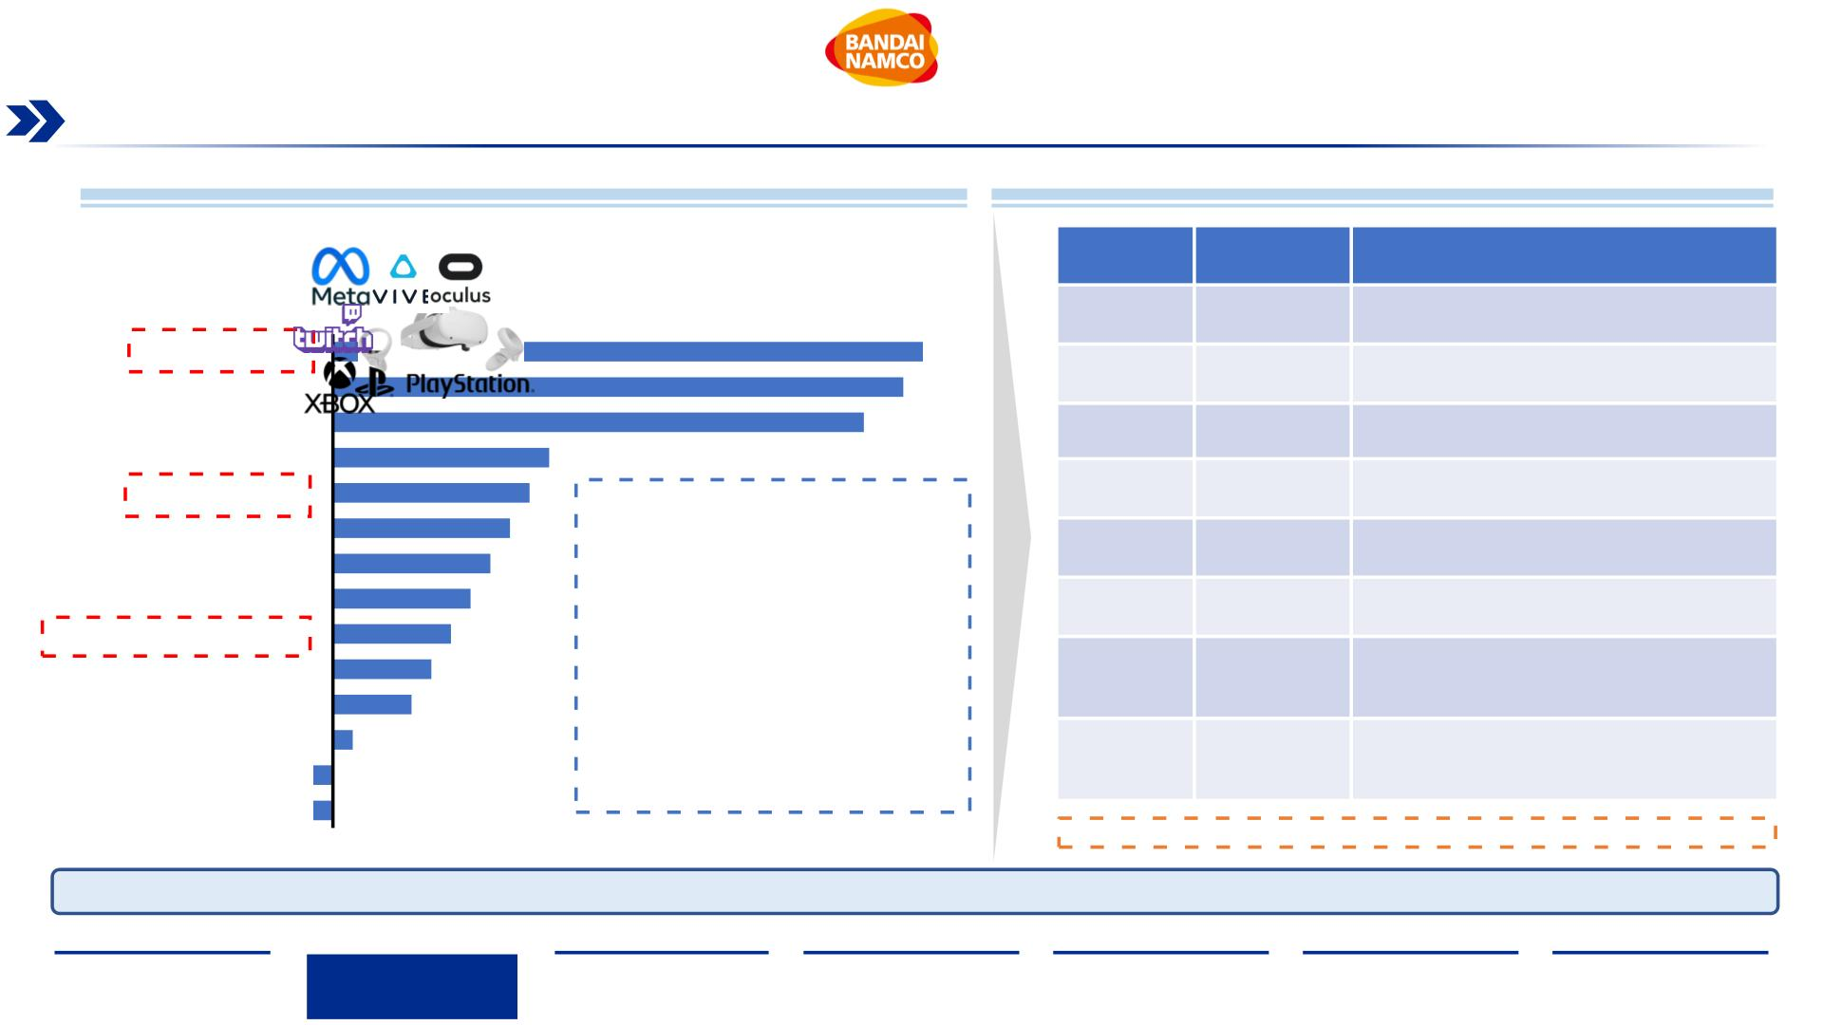
Entertainment & Media Industry Trends
Key players are positioning themselves to capitalize on ongoing digitalization trends, particularly in VR, OTT and Video game segments
Projected Global Growth in Entertainment & Media by Segment
Recent Mergers & Acquisitions in Entertainment & Media
•
PwC expects Virtual reality technology to be the fastest growing Entertainment & Media segment
with a CAGR of 30%, reach a total of $6.9 bn revenues in 2025
Date
Value of
Transaction
Deal
•
OTT and Video games/Esports are two entertainment sectors enjoying strong growth with 10%
and 6% respectively
CAGR: ’20-’25 in %
Jan 2022
May 2021
May 2021
May 2021
Mar 2021
Feb 2021
$68.7 bn
Microsoft agrees to acquire Activision Blizzard
Inc. for their IP’s and studios
Virtual Reality
Cinema
30
29
AT&T spins off and merges Warner Bros. with
Discovery
$43 bn
$8.5 bn
$5.0 bn
$7.5 bn
$1.1 bn
Data consumption
27
Amazon agrees to acquire film studio MGM
Out-of-home advertising
OTT video
11
10
Verizon
agrees
to
sell
Verizon
Media unit (Yahoo/AOL) to Apollo
Music, radio, podcast
Internet advertising
B2B
9
Microsoft acquires video game company
Zenimax
8
7
RTL
Group
agrees
to
Video games and esports
Internet access
6
sell adtech unit SpotX to Magnite
5
Sony Pictures agrees to acquire anime video-
streaming service
Crunchyroll from AT&T
Dec 2020
Nov 2020
$1.2 bn
$2.0 bn
TV advestising
4
Consumer books
Newspapers -1
Traditional TV -1
1
Penguin
Random
House
agrees
to acquire Simon & Schuster
publisher from ViacomCBS
More information in Appendix Slide 83: Gaming Industry M&A History
The race towards digitalization in Entertainment & Media industry has attracted over $130 bn of M&A transactions in the last couple of years.
Source: (Huff Eckert, 2021, PwC)
Executive
Summary
Industry
Overview
Company
Analysis
Financial
Analysis
Acquisition
Feasibility
Alternative
Solution
Conclusion
10

Slide 11
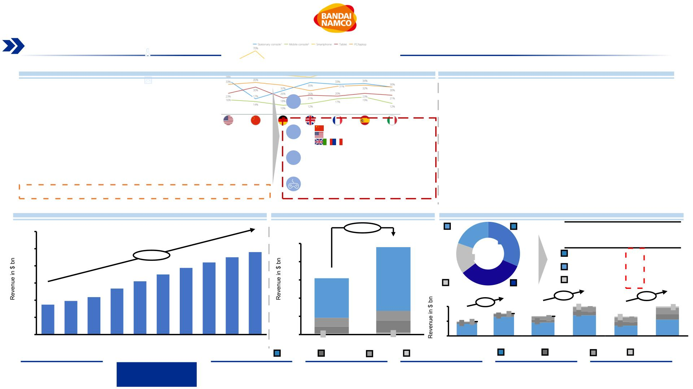
Digital Video Games Market Overview
Mobile games drive the majority of revenue within the gaming market, followed by subscription based game purchases, particularly
in China, the United States, and United Kingdom
Key Takeaways
Popularity of Devices Utilization for Playing Video Games
•
Video Game products generated $155.5 bn in sales worldwide in 2021 with
a projected CAGR of 11.94% from 20216-202
Market Composition
Mobile Games
•
•
Mobile gaming revenue makes up the majority of sales with 70.3%
Paid app-download for smartphones
and tablets
Home Video Game
China, US and Europe generate 66.8% of total revenue ($103.6 bn) of the
global digital video games market
Downloads Games
Online sales of video games for gaming
console/PCs via direct download
•
•
China is currently the biggest market with 31.4% of revenues and it’s
expected to grow at a CAGR of 9.3% from 2021 to 2026
Online Games
Subscription-based games
The US market, making up 19.6% of sales, is projected to grow with a
CAGR of 8.33%, fueled by demand stemming from the Covid-19 pandemic,
with Europe growing at a similar CAGR of 8.7% and 15.7% of sales
Gaming Networks
Subscription-based access to online
premium services
More information in Appendix Slide 84: COVID-19 impact on Technology Adaptation
Digital Video Game Total Market Revenue Forecast¹
Revenues by Type of Product¹
Revenue Split across Geographic Markets (in%)¹
300
+55.34%
US
19.6%
China
CAGR:
’19-’25
Key Markets
Drivers of
Growth
250
240
250
200
240
175
26
31.5%
+11.93%
210
225
15.7%
China
US
9.3%
8.3%
200
150
100
50
175
194
155
150
155
109
24
33.2%
Europe
8.7%
134
Europe
Others
87
98
109
100
8.3%
8.8%
100
50
0
9.3%
45
1
37
76
2
1
30
21
6
7
24
13
8
2
50
49
0
8
4
5
1
1
5
6
7
19
34
5
6
2
65
32
21
0
0
3
41
2017 2018 2019 2020 2021 2022 2023 2024 2025 2026
2021
2026
2021 China 2026
2021
US
2026
2021
Europe 2026
Note: ¹Value in billion $ related to 2021, The analysis of the Digital Video Game Industry focuses only on digital sales and excludes physical game sales
Source: (Clement, 2021, Statista), Digital Media Report (Statista, 2021)
Mobile Game
Online Game
Download
Game
Gaming
Networking
Mobile Game
Online Game
Download
Game
Gaming
Networking
Executive
Summary
Industry
Overview
Company
Analysis
Financial
Analysis
Acquisition
Feasibility
Alternative
Solution
Conclusion
11

Slide 12
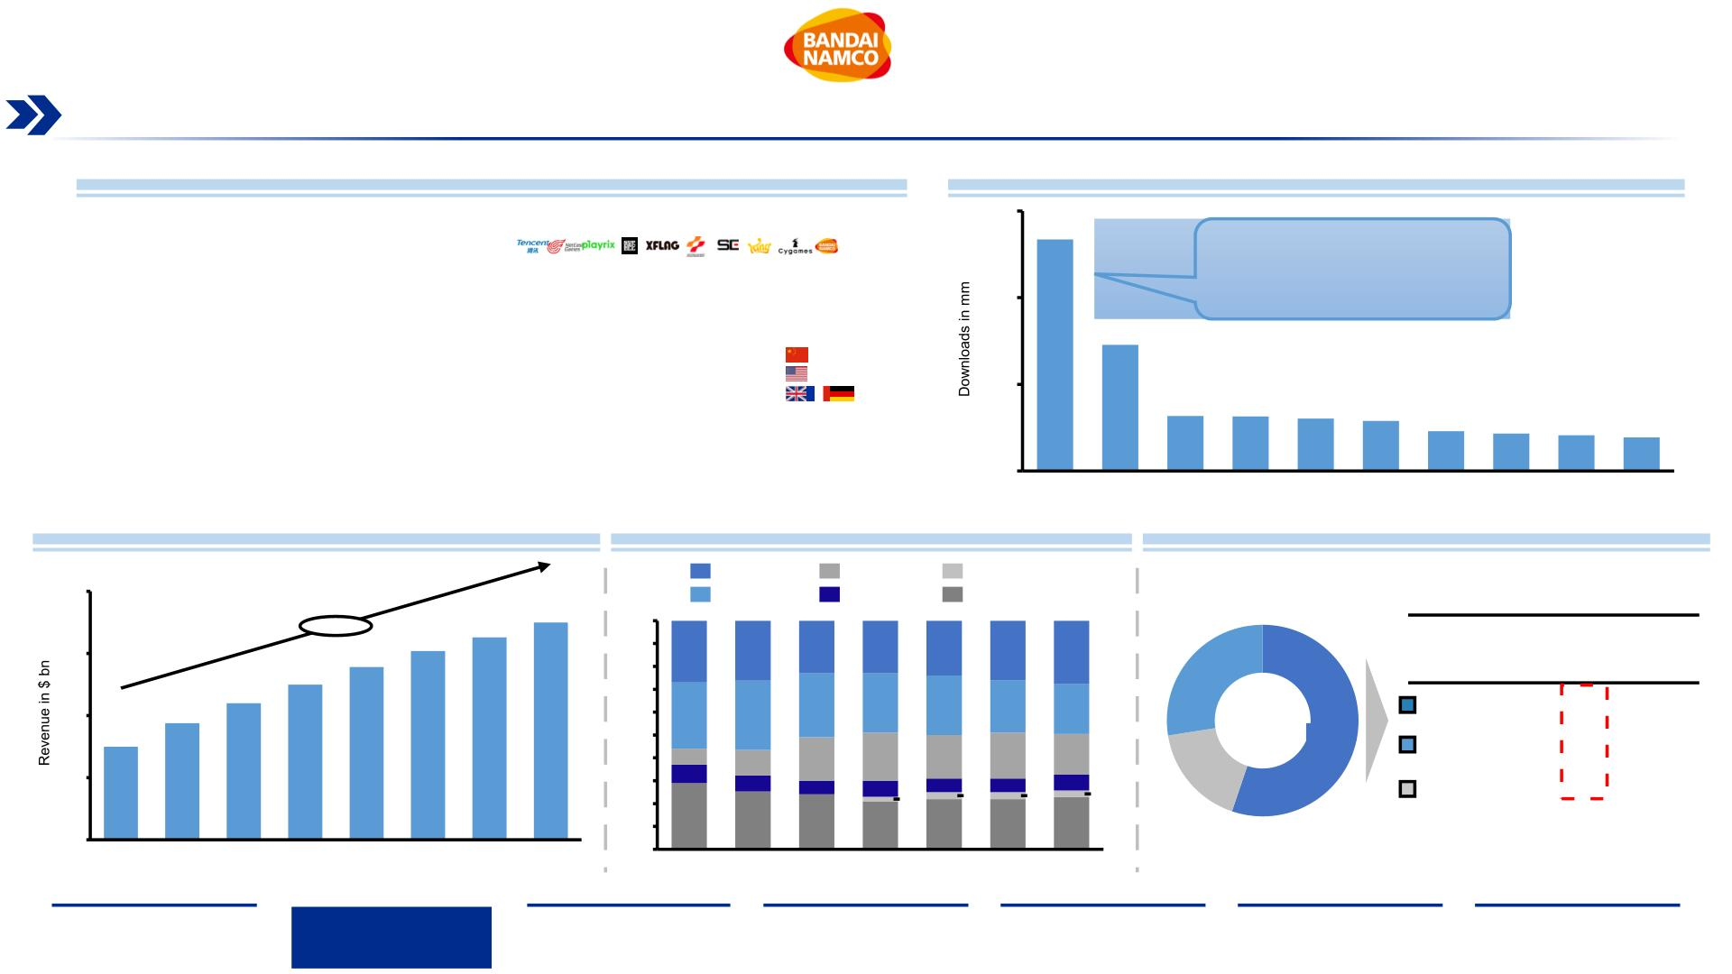
Mobile Games Segment Overview
China, the US and UK enjoy the strongest growth in the mobile gaming segment, making up over 50% of total global revenue
Mobile Games Market Overview
Leading iPhone Gaming App Publishers Ranked by Total Downloads 2021²
•
The large and rising smartphone user base and low barriers of entry via free-to play business
models are major drivers of the Mobile Game segment growth, with a CAGR of 12.87% until
2026
150
100
50
134
Tencent’s downloads is 7x the
ones of Bandai Namco, and
almost 2x of its next competitor.
•
China is one of the dominant markets for the Mobile games sector with $41.1 bn sales,
accounting for 37.4% of the total Video Game market in 2021 and generating 84.2% revenue of
the Chinese Digital Video Game market, with a projected CAGR of 9.3% until 2025
73
•
•
•
The mobile gaming revenue share for leading markets is heavily saturated by other Asian markets
such as Taiwan, Japan and South Korea
The US and European mobile gaming segments are projected to grow at a CAGR of 8.9% and
9.7% from 2021 to 2025, respectively
32
31
30
29
23
22
21
19
The mobile game market is very competitive, with Tencent leading the pack as the largest
0
company in the segment
Mobile Games Market Revenue Forecast¹
Mobile Game Revenue Share for Leading Markets
Revenue Split across Top Three Geographic Markets¹
United States
Japan
China
Taiwan
Other
200
South Korea
+12.87%
163
175
100%
90%
80%
70%
60%
50%
40%
30%
20%
10%
0%
Key Markets
Drivers of
Growth
150
139
152
27%
29%
26%
30%
23%
23%
26%
24%
26%
26%
23%
28%
22%
CAGR:
’19-’25
125
27.5%
17.3%
110
28%
China
US
9.3%
8.9%
100
50
0
94
55.2%
75
7%
8%
21%
7%
19%
6%
20%
6%
18%
7%
11%
7%
19%
6%
2%
3%
3%
3%
Europe
9.7%
29%
25%
24%
21%
22%
22%
23%
2019
2020
2021
2022
2023
2024
2025
2026
2014
2015
2016
2017
2018
2019
2020
Note: ¹Value in billion USD $ related to 2021; ²Data in million USD $ and refer to revenue of the leading iPhone gaming app publishers
Source: (Clement, 2021, Statista), Digital Media Report (Statista, 2021), (Statista, 2020) (Statista, 2022), (Mordor intelligence. 2021), (All Top Everything. 2022.)
Executive
Summary
Industry
Overview
Company
Analysis
Financial
Analysis
Acquisition
Feasibility
Alternative
Solution
Conclusion
12

Slide 13
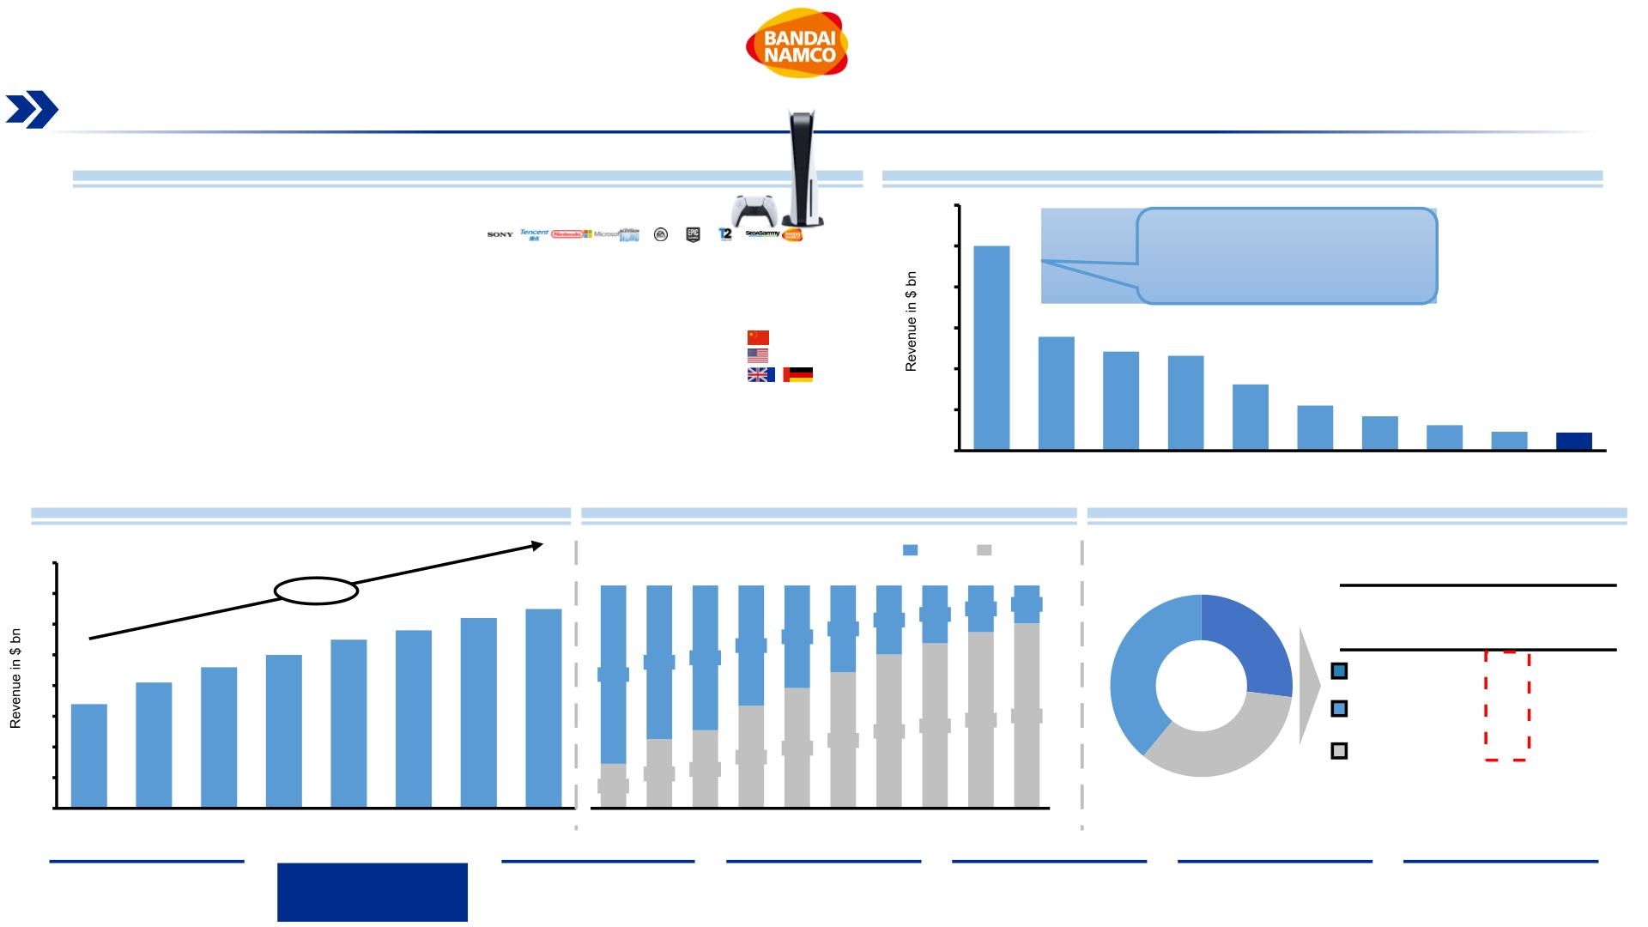
Home Video Games Segment Overview
A shift to digital consumption has disrupted the home video games segment, with Sony, Microsoft and Nintendo paving the way with
their popular Gaming Consoles and IP driven growth
Home Game Market Overview
Major Player of the Market Ranked by Revenue 2022¹
•
•
The Home Video Game segment is expected to grow to $65 bn with a CAGR of 9.7%
30
The increase of the number of gamers and technological advancements over the years resulted in
a continue increase of the Home Video Game demand, with a popularity surge during the COVID-
19 pandemic
25
SONY’s popular Playstation
25
20
15
10
5
consoles shifted the Gaming
Market in its favor, with over 100
mm consoles sold.
•
•
~41% of the total home video game market revenue stems from Online Games, showing an
interest in games that host a large community
14
12
New Virtual Reality technology is a novel key driver to increase the number of gamers by 2025,
for that reason investors believe that 59% of gaming will dominate the investment directed to the
development of this technology
12
8
6
4
•
In the previous decades the consumption of Home Video Game has shifted to from physical to
3
2
2
digital from 20% in 2009 to 83% in 2018, a trend that will only grow in the years to come
0
Home Video Game Market Revenue Forecast¹
Home Video Game Shift to Digital
Revenues Split by Top three Geographic Markets¹
80
Physical
Digital
70
60
50
40
30
20
10
0
+9.70%
62
65
17%
Key Markets
Drivers of
Growth
55
58
31%
26%
21%
CAGR:
’19-’25
50
54%
46%
46%
54%
39%
61%
27%
41
46
69%
31%
65%
35%
39%
China
US
7.2%
6.4%
34
80%
20%
69%
74%
79%
83%
34%
Europe
7.7%
2019
2020
2021
2022
2023
2024
2025
2026
2009 2010 2011 2012 2013 2014 2015 2016 2017 2018
Note: ¹Value in billion USD $ related to 2021
Source: (Clement, 2021), Digital Media Report (Statista, 2021), (Mordor intelligence. 2021)
Executive
Summary
Industry
Overview
Company
Analysis
Financial
Analysis
Acquisition
Feasibility
Alternative
Solution
Conclusion
13

Slide 14
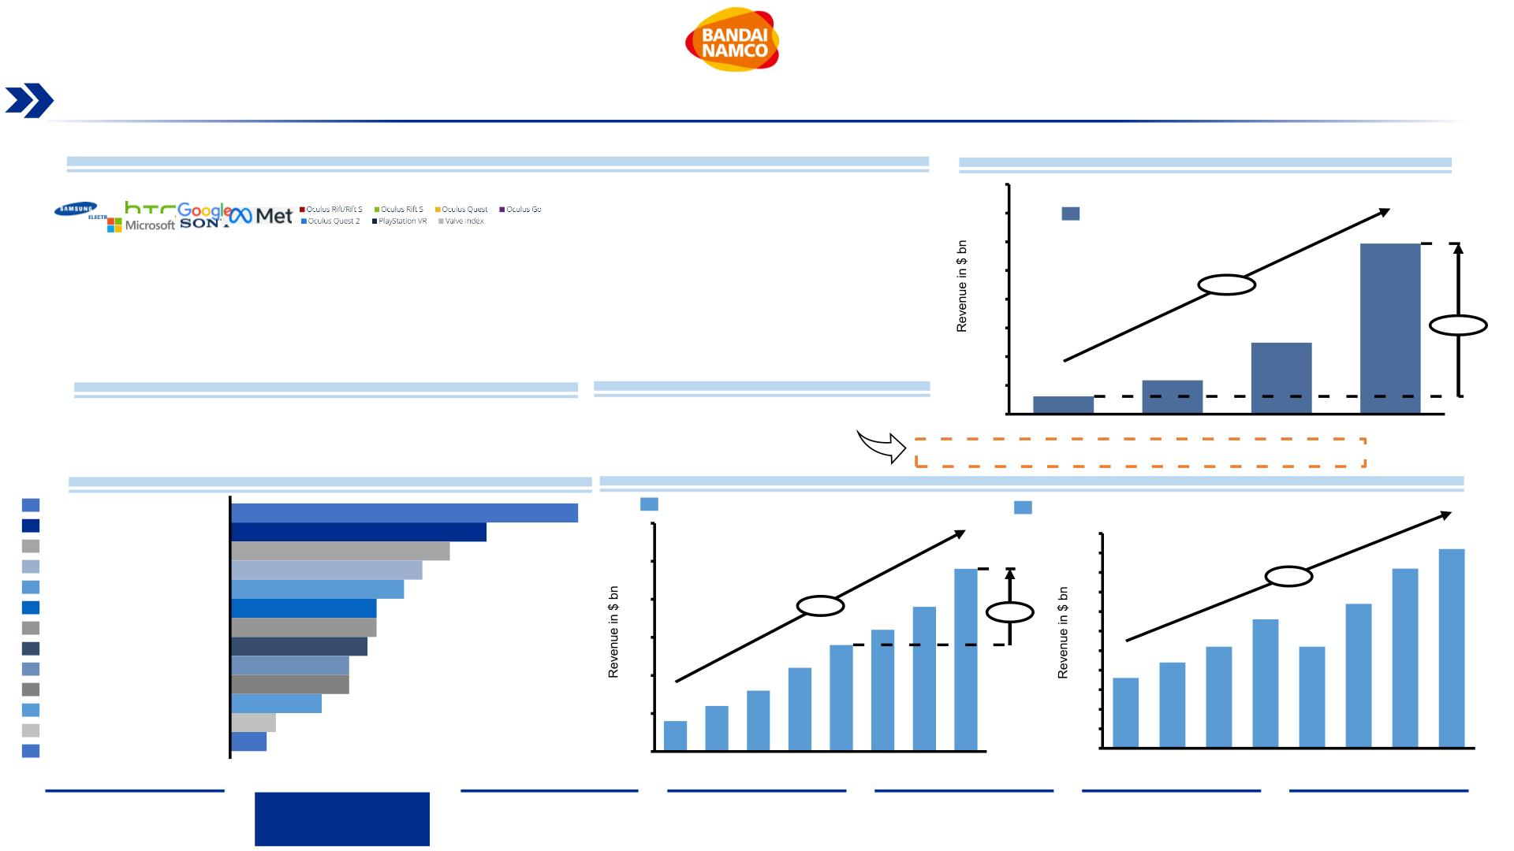
Virtual Reality & Metaverse Market Overview (1/2)
VR has matured into a technology that is experiencing increasing demand in the Entertainment and Media sectors, with other
sectors following the more sophisticated the technology will become
Market Overview
Market Size of AR, VR and MR
•
•
•
Virtual reality has enjoyed strong interest from both consumers and companies as one of the technologies of the future
400
The VR market is expected to grow by 867% from 2021, with a CAGR of 113%
350
300
250
200
150
100
50
AR, VR, MR market size worldwide
Sales of VR hardware and software is seeing a projected CAGR of 16% from 2016-2023, while VR gaming revenue
takes half of the total $5.1 bn revenue with a projected CAGR of 29%.
297
•
•
Many renowned companies such as Microsoft and Facebook/Meta are heavily investing into VR technology in order
to be ready for the Metaverse, a concept that combines VR and AR technology for users to connect in a virtual space
+113%
After the disruption of the gaming and entertainment market, multiple other industries will be impacted with the rise of
sophisticated and reliable VR technology, especially healthcare and education
124
+867%
Key Virtual Reality Players
Key Hardware Providers
59
31
0
2021
2022
2023
2024
Further sectors expected to witness disruption
VR Revenue by Sector
More information in Appendix Slide 85: VR/AR Application Trends
Healthcare/medical devices
Education
38%
Virtual reality (VR) gaming revenue worldwide
Consumer virtual reality (VR) hardware and software market revenue worldwide
5.5
28%
3.0
2.5
2.0
1.5
1.0
0.5
0.0
5.1
Workforce development/training
24%
2.4
5.0
4.5
4.0
3.5
3.0
2.5
2.0
1.5
1.0
0.5
0.0
4.6
Manufacturing
21%
19%
+16%
3.3
Automotive
1.9
3.7
Marketing and advertising
Logistics/transportation
Retail/ecommerce
Military and defense
Commercial real estate
Residential real estate
Tourism
16%
16%
+29%
1.4
1.6
+71%
15%
13%
13%
2.2
2.6
2.6
1.1
1.8
0.6
0.8
10%
0.4
5%
4%
Other
2017 2018 2019 2020 2021 2022 2023 2024
2016 2017 2018 2019 2020 2021 2022 2023
Sources: (Grand View Research, 2021), Virtual Reality Report (Statista, 2021)
Executive
Summary
Industry
Overview
Company
Analysis
Financial
Analysis
Acquisition
Feasibility
Alternative
Solution
Conclusion
14

Slide 15
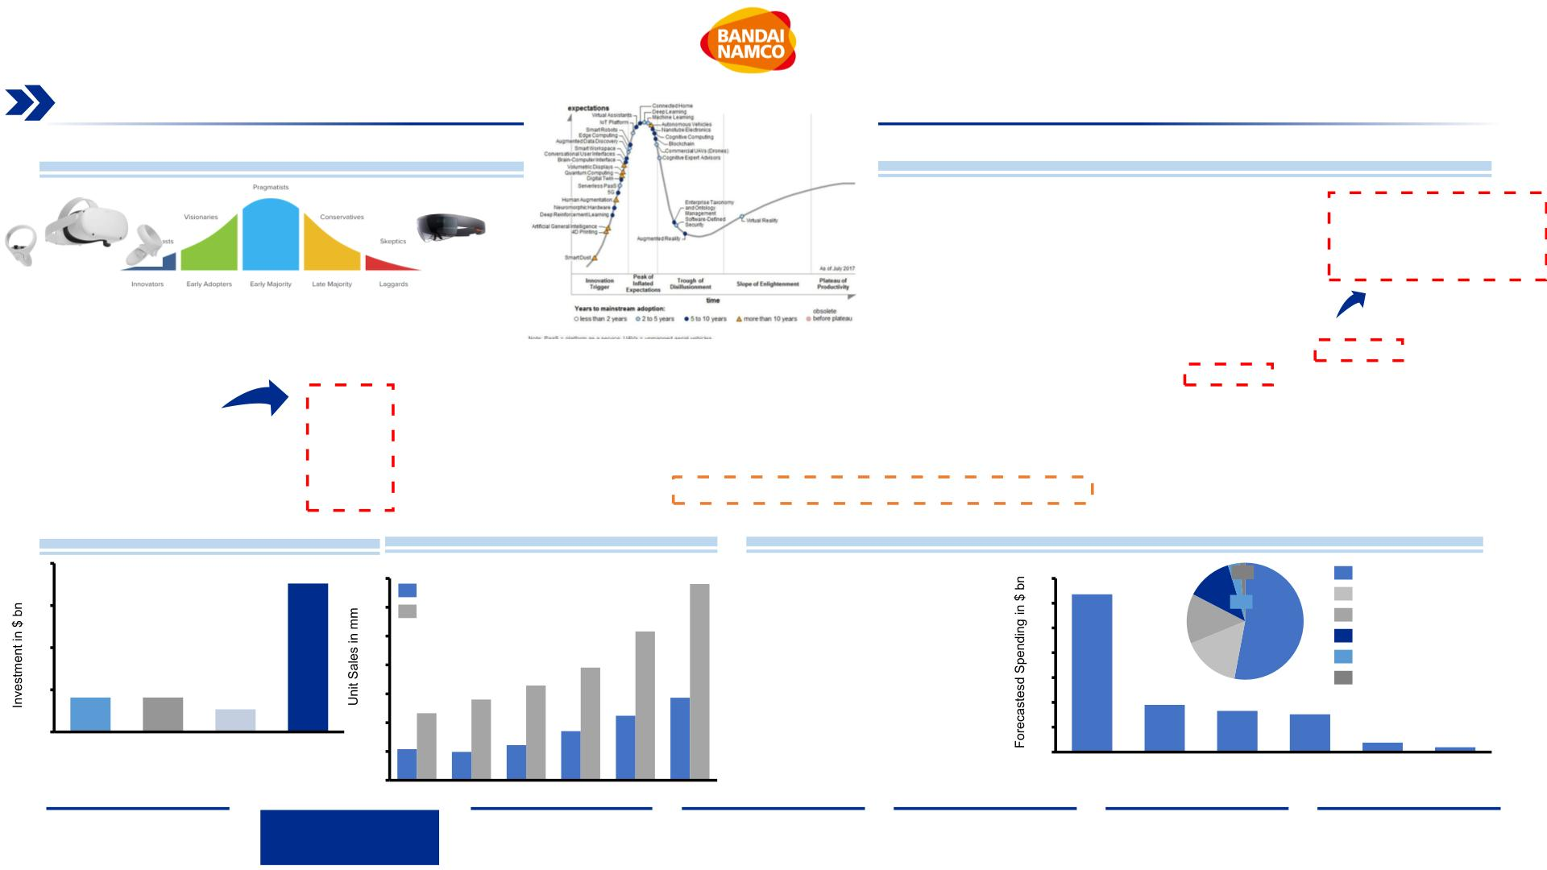
Virtual Reality & Metaverse Market Overview (2/2)
Rising investment into consumer VR technology will give the Metaverse concept room to grow and prosper in the coming
years, particularly with demand in gaming and entertainment adaptations at its core
Trends Overview
Gartners Hype Cycle for Emerging Technologies (2018)
•
Virtual reality has been thriving and seen strong investments, especially in the
consumer segment
These investments stem from a promise of the “future of entertainment”,
including a new way to consume and enjoy video games and shows/movies,
or connect to people around the world
The rise of the “Metaverse” has initiated a new trend and kicked off the race
into building robust and intuitive VR infrastructure and technology
Currently, VR is still not mainstream and can be regarded as a visionary
product on the product adoption curve:
•
2017 placed VR/AR technology as an emerging
technologies with 2-5 and 5-10 years on the
maturity development timeline, respectively
In 2022, this places VR theoretically ready for
mainstream and mass distribution
However, barriers for entry are high and
adoption rates are low, currently slowing down the
efforts and promise of the Metaverse future
With VR/AR technology reaching
maturity in the last 1-2 years, the
current key challenge lies in
mass market approaches and
streamlining barriers of entry
•
•
•
•
•
•
It is likely to see AR take a stronger hold in the next
2-3 years as it holds less financial and physical
barriers for direct use (e.g. Microsoft Hololens)
More information in Appendix Slide 85: VR/AR Application Trends
Investment in AR/VR technology
VR headset unit sales worldwide (mm)
AR and VR forecast spending worldwide ($bn), 2020
20
15
10
5
17.6
35
30
25
20
15
10
5
34
7
6
5
4
3
2
1
0
2%
3%
Consumer
Annual unit sales
•
•
With over 50% of forecasted
spending, consumer content
will be the main focus of VR
technology, with gaming at its
core
6.4
13%
14%
16%
Distribution and services
Manufacturing and resources
Public sector
Cumulative Unit Sales
26
53%
20
Infrastructure
4.1
4.1
14
16
14
Services is a second with 16%
of total spending, with the aim
Others
2.7
12
11
1.9
1.7
1.5
0
9
to
streamline
the
VR
0.4
Training
Industrial
maintenanceshowcasing
5
5
6
experience
0.2
Retail
VR gaming,
video
viewing,
and AR
gaming
Consumer DistributionManufacturing Public Infrastructure Others
Sources: (Grand View Research, 2021), (Gartner,
2017), Virtual Reality Report (Statista, 2021)
0
2019
2020
2021*
2022*
2023*
2024*
and
services
and resources sector
Executive
Summary
Industry
Overview
Company
Analysis
Financial
Analysis
Acquisition
Feasibility
Alternative
Solution
Conclusion
15

Slide 16
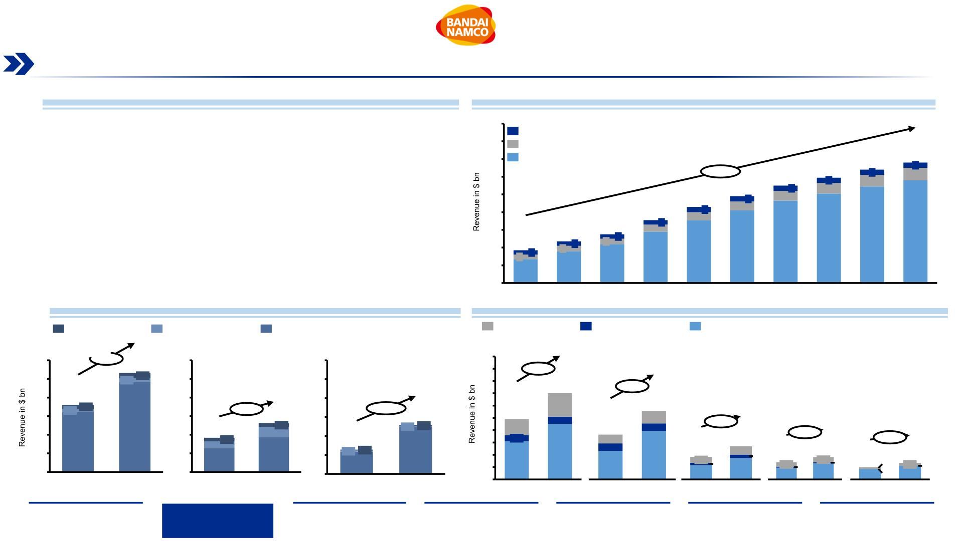
OTT & Subscription Video on Demand Market (1/2)
Increasing popularity of SVoD drives majority of revenue in the OTT market, with the US as the major market followed by EU and China
SVoD Market Overview
Global Revenue forecast SVoD market¹
•
•
SVoD is part of the OTT market, which offers audio and video content bypassing cable
(and hence over the top!), broadcast television or telecom channels. It also includes Live
and Game Streaming.
180
160
Video Downloads (EST)
Currently valued at $101.42 bn , OTT market is expected to reach $223.07bn by 2026,
with a CAGR of 13.87%, during the period of 2021 - 2026
Pay-per-View (TvoD)
140
120
100
80
Video Streaming (SVoD)
128
6
136
6
14
•
•
•
SVoD appeal has risen through its unlimited access subscription model
+15.4%
110
119
6
13
Revenue in the SVoD segment is projected to reach $71.2bn in 2021
98
6
11
6
12
Revenue is expected to show an annual growth rate (CAGR 2021-2025) of 11.04%,
resulting in a projected market volume of $108.3 bn by 2025
86
10
71
9
6
60
55
8
5
116
•
•
•
•
User penetration will be 14.3% in 2021 and is expected to hit 18.2% by 2025
The average revenue per user (ARPU) is expected to amount to $66.29
In global comparison, most revenue will be generated in the US ($32 bn in 2021)
China shows the biggest growth of all markets with a forecasted CAGR of 15.2%
47
6
5
93
101
109
40
37
5
6
5
71
82
20
5
36
44
58
27
0
2017
2018
2019
2020
2021
2022
2023
2024
2025
2026
SVoD Market sizes, regional comparison¹
European Market Breakdown
Source: Statista Digital Media Report 2021
Pay-per-View (TvoD)
Video Downloads (EST)
Video Streaming (SVoD)
Pay-per-View (TvoD)
Video Downloads (EST)
Video Streaming (SVoD)
United States
Europe
China
United Kingdom
Germany
France
Italy
Spain
60
+8.1%
53.2
2.8
60
60
10
9
8
7
6
5
4
3
2
1
0
50
40
30
20
10
0
50
50
40
+7.4%
2.1
7.0
+9.3%
36.1
2.1
40
+15.2%
1.9
5.5
1.0
0.6
1.9
30
20
10
0
+7.3%
26.2
2.0
30
20
10
0
25.8
0.6
4.9
0.6
48.3
18.4
1.9
0.6
1.3
0.5
3.6
0.7
0.6
+8.1%
+5.8%
32.1
5.5
12.8
0.5 0.5
2.8
0.7
+5.8%
3.7
18.7
24.6
4.5
3.9
1.9
0.5
2.1
0.5
12.8
11.8
3.1
0.2
0.3
1.6
0.4
1.1
0.1
1.0
1.4
2.3
1.2
1.8
0.1
1.5
0.2 0.3 0.0
2021
2026
2021
2026
2021
2026
0.9
0.0 1.1
Note: ¹Value in billion USD $ related to 2021
Sources: Digital Media Report (Statista, 2021), (CNBC, 2021), (The Verge, 2021), (PWC, 2021), (GlobeNewswire News Room, 2021), (Market research future, 2020), (CNBC, 2021)
2021
2026
2021
2026
2021
2026
2021
2026
2021
2026
Executive
Summary
Industry
Overview
Company
Analysis
Financial
Analysis
Acquisition
Feasibility
Alternative
Solution
Conclusion
16

Slide 17
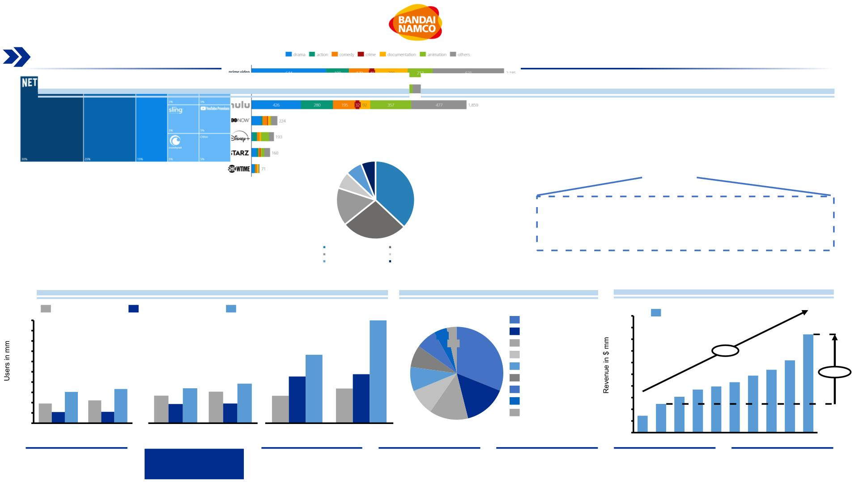
OTT & Subscription Video on Demand Market (2/2)
Diversified content offering is key for customer growth in the SVoD market, showcased by Netflix’s, Hulu’s and Prime Video’s offering,
with a large chunk stemming from animated content, an appeal that is shown in Japan’s growing SVoD revenue numbers
Key Players and Global Subscriber Count
Range of Genres of SVoD Providers in the US in 2019
• Market is primarily dominated by Netflix, Amazon Prime Video and Hulu
• Diverse cast of genres and exclusive content are the main drivers of
subscriber count growth across all services
Global Subscribers 2021 (mm)
38
33
39
204
87
The Japanese animation industry is strongly growing in
the west and becoming more mainstream through
exposure in popular services such as Netflix and Prime
Video.
150
Netflix
Disney Plus
HBO Max
Amazon Prime
Hulu
Peacock
Source: (2021, Statista Digital Media Report)
Number of users forecasted (mm)
Most used SVoD services Japan 2021
SVoD Anime revenue Japan¹
Pay-per-View (TvoD)
Video Downloads (EST)
Video Streaming (SVoD)
454
1,000
Sales Revenue
500
450
400
350
300
250
200
150
100
50
Europe
Netflix
900
840.9
United States
China
4%
Hulu
800
302
7%
3%
31%
DAZN
700
+22%
8%
8%
9%
U-Next
600
538.0
488.3
619.4
206
216
dTV
500
432.2
395.1
368.9
+242%
152
166
170
153
192
153
dAnimeStore
WOWOW On Demand
Disney+
400
96
111
134
93
96
121
300
245.9
307.4
54
55
15%
200 144.7
100
13%
YouTube Premium
0
2021
2026
2021
2026
2021
2026
0
Note: ¹Value in mm $
Sources: (CNBC, 2021), (The Verge, 2021), (CNBC, 2021), Digital Media Report (Statista, 2021)
2011 2012 2013 2014 2015 2016 2017 2018 2019 2020
Executive
Summary
Industry
Overview
Company
Analysis
Financial
Analysis
Acquisition
Feasibility
Alternative
Solution
Conclusion
17

Slide 18
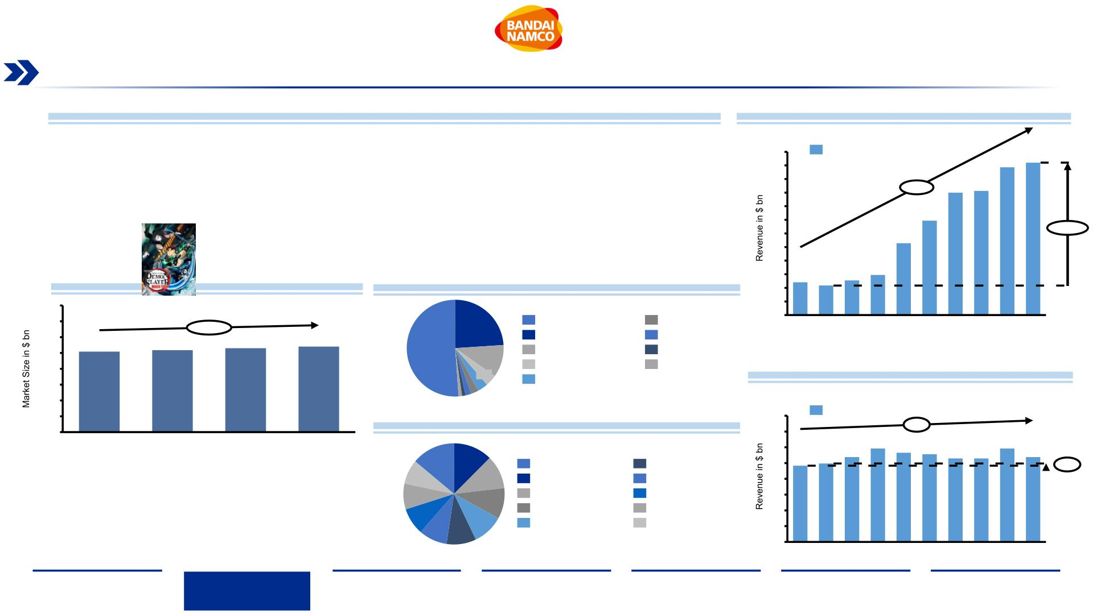
Animation Market Overview
Growing popularity and mainstream appeal of animated shows and franchises out of Japan creates opportunity for global expansion
Animation Market Overview
Overseas revenue of Japan Animation industry¹
• The global animation market has seen small growth over the years, with a CAGR of 2.06% from 2017 – 2020, while
the Japanese segment has grown strongly with a 19% overseas CAGR
12
11
10
9
Overseas sales revenue
+19%
11.2
• Animation content can be segmented into Japanese Anime, and Western Animation, e.g. Disney/Pixar
10.9
• Merchandising and overseas sales in Japan have seen the strongest increase in the domestic animation
9.0
9.1
production sector, with 21% and 20%, respectively
8
6.9
• Overseas sales in particular have grown 415% since 2012 with a CAGR of 19%, now taking 51% of total sales in
7
+415%
Japan
6
5.3
5
Revenue animation industry in Japan, 2020, by segment (%)
4
3.0
Animation Global Market Size¹
3
2.4
2.2
2.6
2
400
350
300
250
200
150
100
50
1
24%
Overseas
Movie
0
2011 2012 2013 2014 2015 2016 2017 2018 2019 2020
+2,06%
270
Merchandising
Amusement
Videogram
Live entertainment
Music
254
259
265
51%
11%
4%
Internet distribution
Television broadcasting
Domestic revenue of the Animation industry in Japan¹
Most popular animation characters Japan 2020, Survey
16
14
12
10
8
Domestic Sales
0
+1%
2020
10.8
11.8
11.3 11.1
10.6 10.6
11.8
10.8
Highest box-office record 2020:
Demon Slayer Mugen Train,
$ 364.5 mm, 12x than the second
highest grossing Anime movie in 2020
14%
12%
My Neighbor Totoro
Doraemon
Sazae-san
9.7
9.9
+3%
8%
8%
11%
10%
Let’s Go! Anpanman
Detective Conan
Dragon Ball
Kiki’s Delivery Service
Demon Slayer
Lupin III
6
9%
10%
4
9%
Chibi Maruko-chan
2
9%
0
Note: ¹Value in bn $,; Conversion Rate from Bandai Namco Capital IQ FY 2021 with YEN/USD = 0.009041673
Source: (Statista, 2020), (Capital IQ, 2022), (Kimetsu, 2022)
2011 2012 2013 2014 2015 2016 2017 2018 2019 2020
Executive
Summary
Industry
Overview
Company
Analysis
Financial
Analysis
Acquisition
Feasibility
Alternative
Solution
Conclusion
18

Slide 19
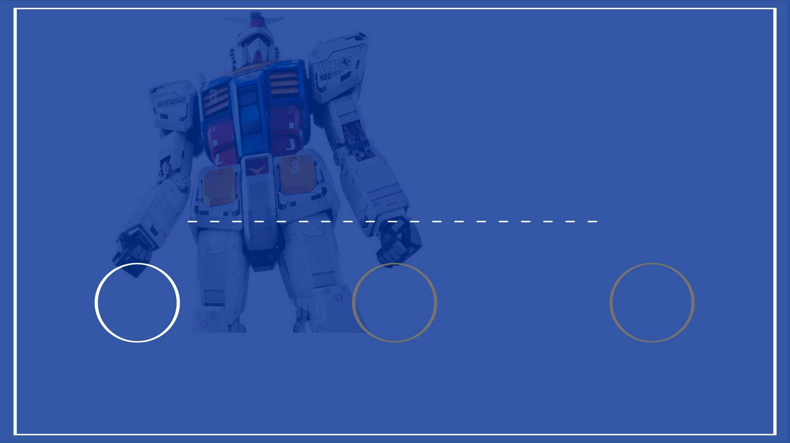
II. Company Overview
1 2 3
BANDAI NAMCO
GAMES WORKSHOP
STRATEGIC FIT
19

Slide 20
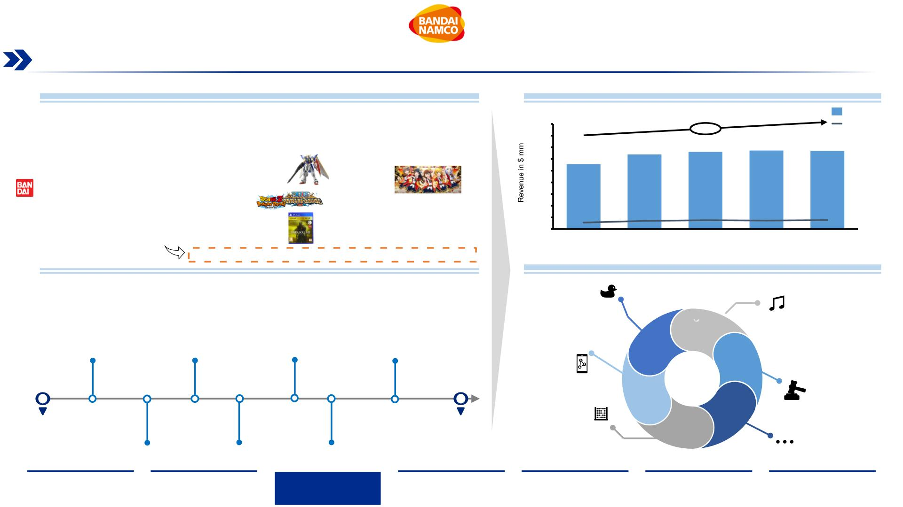
Bandai Namco Overview (1/2)
With 70+ years of experience, Bandai Namco continues to be a global leader in the Toys & Entertainment industries
Bandai Namco Overview
Financial Revenue Per Year¹
•
Bandai Namco Holdings, Inc. (BN) engages in the development, manufacture, and sale of
entertainment-related products and services, including toys and media, with total revenueof $6.7
bnand a 5.12% CAGR from 2017 to 2021
Revenues
9,000
8,000
7,000
5.12%
Operating Profit
•
•
•
•
Headquartered in Tokyo, Japan, most revenues stem from the Toys/Hobbies and Entertainment
segments across 8 subsidiaries (e.g., Bandai)
6,387
6,609
6,728
6,699
6,000
5,000
4,000
3,000
2,000
1,000
0
5,561
The brand utilizes more than 300 IP per year to roll out products and services. Major IP include
Pac-Man, Dragon Ball, One Piece, and Suit Gundam, with the latter being an in-house IP
Bandai Namco’s aims to become the Leading Innovator in Global Entertainment through the
group's greatest strength, its IP-Axis Strategy business model
561
706
758
732
765
A new three-year plan aimed to start April 2022 will consolidate the companies’ structure
2017
2018
2019
2020
2021
Bandai Namco History
More information in Appendix Slide 86: Bandai Namco CSR/ESG Overview
Financial Performance Segment Sales Ratio, 2021
Toys &
•
•
•
In 1950, Bandaiya (BANDAI) was founded, selling rubber and metal toys in Japan
Hobbies
12.9% OPM
Visual &
Music Production
In 1955, Nakamura Manufacturing Ltd. established as an amusement company in Japan
In 2005, NAMCO BANDAI Holdings Inc. was established after an announcement of management
integration between NAMCO and BANDAI.
3.5%
3.5% OPM
Network
37.3%
NAMCO BANDAI Holding
Inc. listed on the Tokyo
Stock Exchange
Launched the Restart Plan
and announces IP axis
strategy to transform
company
NAMCO BANDAI Holdings
was changed to BANDAI
NAMCO Holdings.
Reorganization of internal
units from 5 to 3 core
pillars: Entertainment, IP,
Amusement
Entertainment
BANDAI
NAMCO
products
3.6%
4.3%
16.7% OPM
2005
2010
2014
2021
43.3%
Intellectual
Property Creation
9.7% OPM
2005
2007
2012
2018
2022
Real
Entertainment
N/A% OPM
Management integration
between NAMCO and BANDAI
and established NAMCO
BANDAI Holdings Inc.
Namco Bandai Holdings
acquired part of shares of
Fujiya Co., Ltd
First Mid-Term Plan
strategy is initiated with
3-year time horizon
Start of mid-term plan
focused on IP-Axis
strategy / Acquisition of
Bluefin
Start of new Mid-Term Plan,
doubling down on IP-Axis
strategy, combining physical
with digital products
8.0%
Others
Note: ¹Value in million USD $,Conversion Rate from Bandai Namco Capital IQ FY 2021 Statements with YEN/USD = 0.009041673
Source: (Integrated Report (Bandai Namco, 2021)), (Fact Book (Bandai Namco, 2021))
4.2% OPM
Executive
Summary
Industry
Overview
Company
Analysis
Financial
Analysis
Acquisition
Feasibility
Alternative
Solution
Conclusion
20

Slide 21
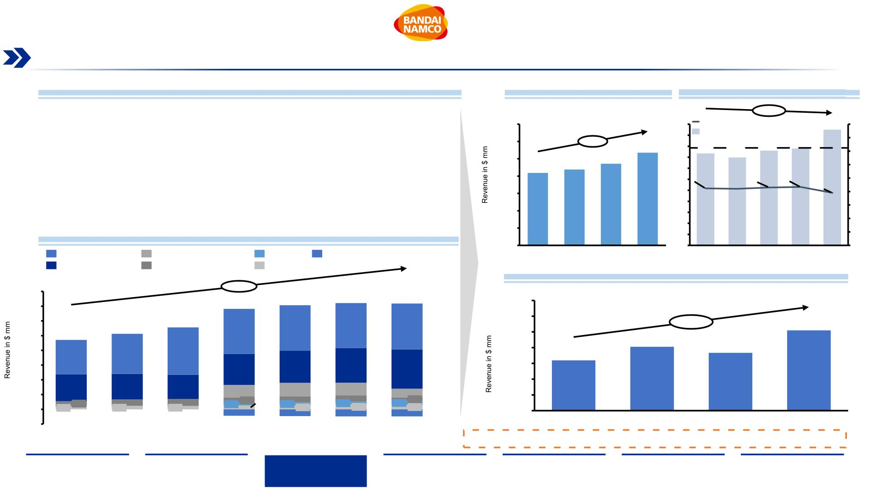
Bandai Namco Overview (2/2)
The companies’ main revenue drivers lie in its toys, hobby and digital business segments, making up ~80% of sales
Business Segment Overview
Toys & Hobby Sales Per Year¹
Plastic Model Market in JPN¹
•
•
Bandai Namco’s strongest growing sections are its Toys & Hobby and its IP creation segments,
with its Networking Entertainment segment contributing another large majority of sales
-1.62%
3,500
550
500
450
400
350
Bandai Spirits Share
Market scale
525
100
90
80
70
60
50
40
30
20
10
The Toys & Hobby segment grew at a CAGR of 8.52% from 2018 to 2021, with BN owning 49%
of its domestic plastic model market, while the IP creation unit grew at a CAGR of 16.87% during
the same period
3,000
2,500
2,000
1,500
1,000
500
8.52%
2,358
430
440
2,676
417
399
•
•
Shift in consumer habits to a more digital world has directly impacted Bandai Namco’s business,
with a stronger focus on IP creation in the animation market
2,094
2,192
52%
53%
53%
300
250
200
150
100
50
52%
49%
New organizational structure implemented in 2021 will consolidate segments into units to bolster
IP axis strategy efforts
Revenues by Segment¹
Network Entertainment
Toys & Hobby
Real Entertainment
IP Creation
Other
Elimination and Corporate
0
2018
2019
2020
2021
0
2017
2018
2019
2020
2021
Visual and Music Production
IP Creation Revenue Per Year¹
8,000
7,000
6,000
5,000
4,000
3,000
2,000
1,000
0
+6.04%
6,387
6,609
3,077
6,728
3,049
6,699
350
300
250
5,122
5,561
3,075
3,112
2,676
16.87%
255
4,713
2,336
203
2,709
3,221
200
150
100
50
160
184
2,094
2,192
916
2,358
853
1,819
1,742
1,637
477
853
383
578
255
345
232
439
227
160
260
203
-457
411
269
184
-483
436
332
254
308
213
2015
-438
-484
0
2018
2019
2020
2021
-1,000
2016
2017
2018
2019
2020
2021
Note: ¹Data expressed in million USD $ Conversion Rate from Bandai Namco Capital IQ FY 2021 Statements with YEN/USD = 0.009041673
Source: (Integrated Report (Bandai Namco, 2021)), (Fact Book (Bandai Namco, 2021))
More information about BN’s financial history in Appendix Slide 87: Bandai Namco’s Ratio Overview
Executive
Summary
Industry
Overview
Company
Analysis
Financial
Analysis
Acquisition
Feasibility
Alternative
Solution
Conclusion
21

Slide 22
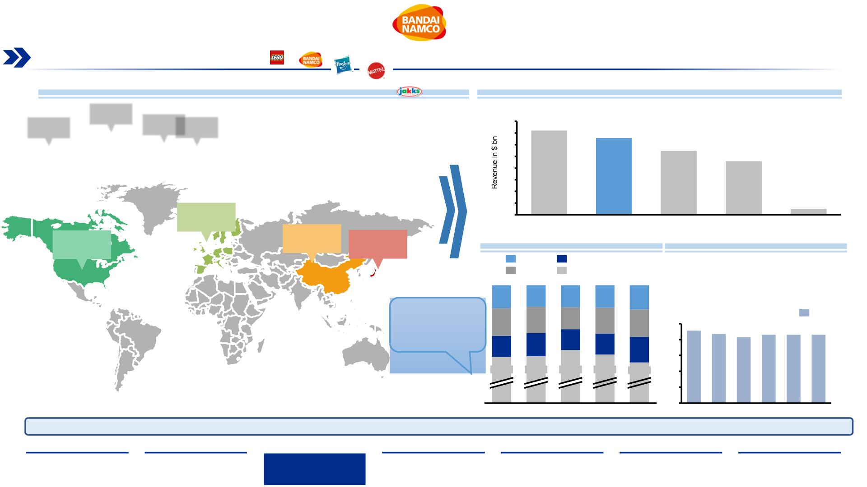
Bandai Namco’s Market Position
Asia is representing ~85% of the companies’ total sales, manifesting BN’s position as the second largest toy manufacturer worldwide
Market Presence
Global Competitors and Company Revenues¹
•
•
•
Bandai Namco has a worldwide presence however; its local market, Japan, represents the majority
of net sales with 77.7%
8
7.2
For years, the company has tried to achieve a more diversified regional mix and gain stronger
share in the western regions
7
6
5
4
3
2
1
0
6.6
5.5
Europe is the region that has seen the greatest increase as it gained 1.3 percentage points from
6.1% in 2017 to 7.4% in 2021
4.6
0.5
7.4%
LEGO
BANDAI NAMCO
HASBRO
MATTEL
JAKKS PACIFICS
7.9%
7.0%
77.7%
Net Sales by Region in %
Plastic Toys Market Share in Japan
Asia
Europe
Japan
•
•
Bandai Namco is the biggest domestic
brand in the plastic toys business
Americas
6,2%
7,6%
6,7%
79,5%
6,3%
With 80%+ market share in last 6 years,
BN has limited room for domestic growth
6,6%
8,0%
6,5%
7,4%
6,1%
7,0%
7,9%
Recent acquisition of
two European
Market Share
86
companies has
6,4%
6,0%
100
80
60
40
20
0
91
increased market share
in western areas.
87
83
86
86
6,1%
7,4%
79,3%
81,3%
80,0%
77,7%
. %
2017
2018
2019
2020
2021
2016 2017 2018 2019 2020 2021
With a current overseas sales ratio of 22.3%, and a saturated domestic market for the entertainment unit, Bandai Namco has ample white space for growth
Note: ¹Value in billion USD $ related to 2020
Source: (Integrated Report (Bandai Namco, 2021)), (Fact Book (Bandai Namco, 2021)), (Shaulova & Biagi , 2020, Statista)
Executive
Summary
Industry
Overview
Company
Analysis
Financial
Analysis
Acquisition
Feasibility
Alternative
Solution
Conclusion
22

Slide 23
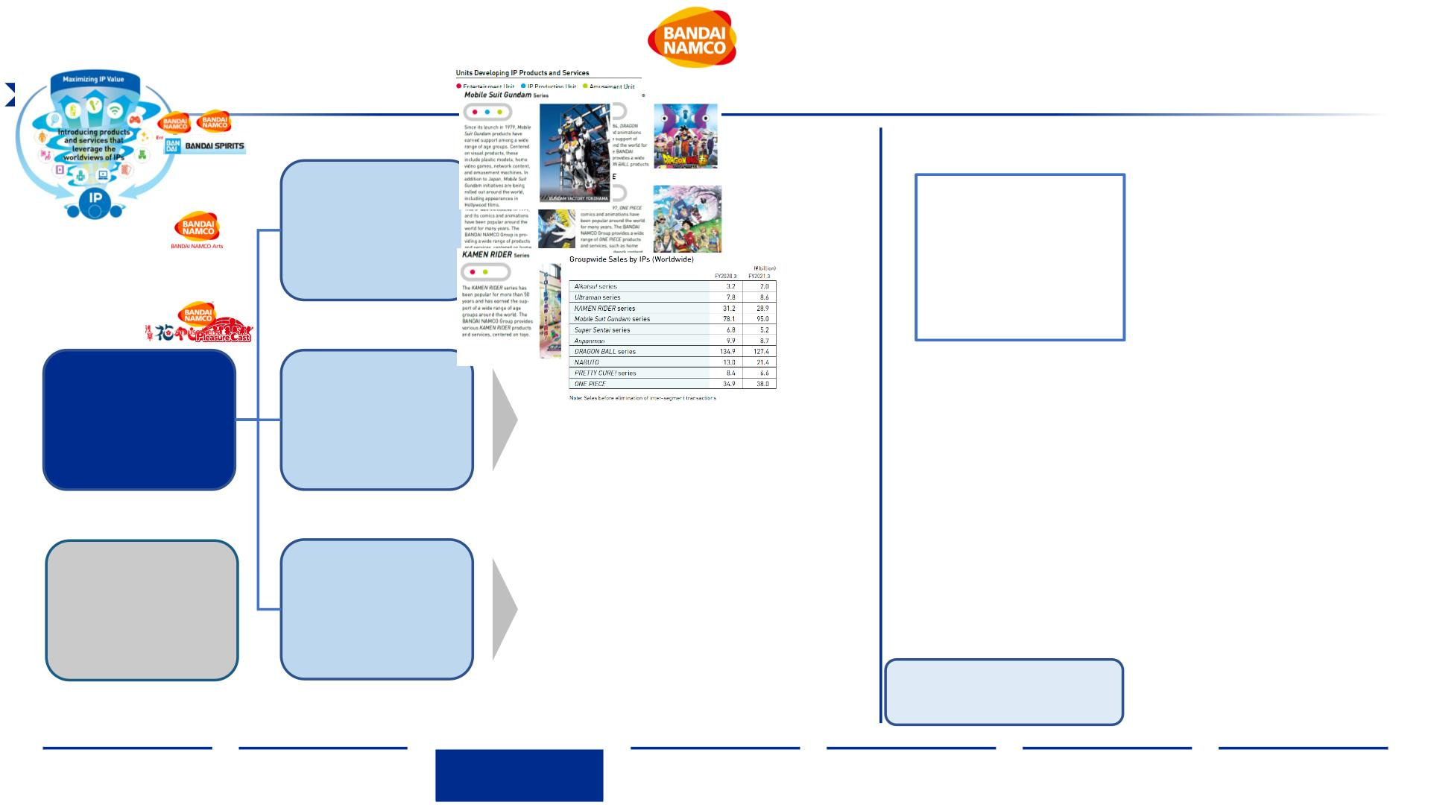
Bandai Namco’s Organizational Structure (1/2)
The company is reorganizing and consolidating its segments into three Business Units to streamline efforts to focus on an IP driven
business model starting April 2022, with 300 IPs utilized annually
Entertainment Unit
(~ 80% of Sales)
Digital Business:
. Planning, development, and distribution
of network content and video games (home
& mobile)
Toys & Hobby Business:
. Planning, development, production of
toys and other products
IP Production Unit
(~ 8% of Sales)
Visual & Music Business:
. Planning, production, and management of
visual and music content
Bandai Namco
Holding Inc.
Creation Business:
. Planning, production, and management of
animation including copyrights
Amusement Unit
(~ 12% of Sales)
Facilities:
. Planning and operation of amusement
facilities
Annual Number of
IP Utilized:
300
Machines:
. Planning, development, production, and
sales of amusement machines
Only 1 of the 5 highest
selling IPs is owned
in-house!
Source: (Integrated Report (Bandai Namco, 2021)), (Fact Book (Bandai Namco, 2021))
Executive
Summary
Industry
Overview
Company
Analysis
Financial
Analysis
Acquisition
Feasibility
Alternative
Solution
Conclusion
23

Slide 24
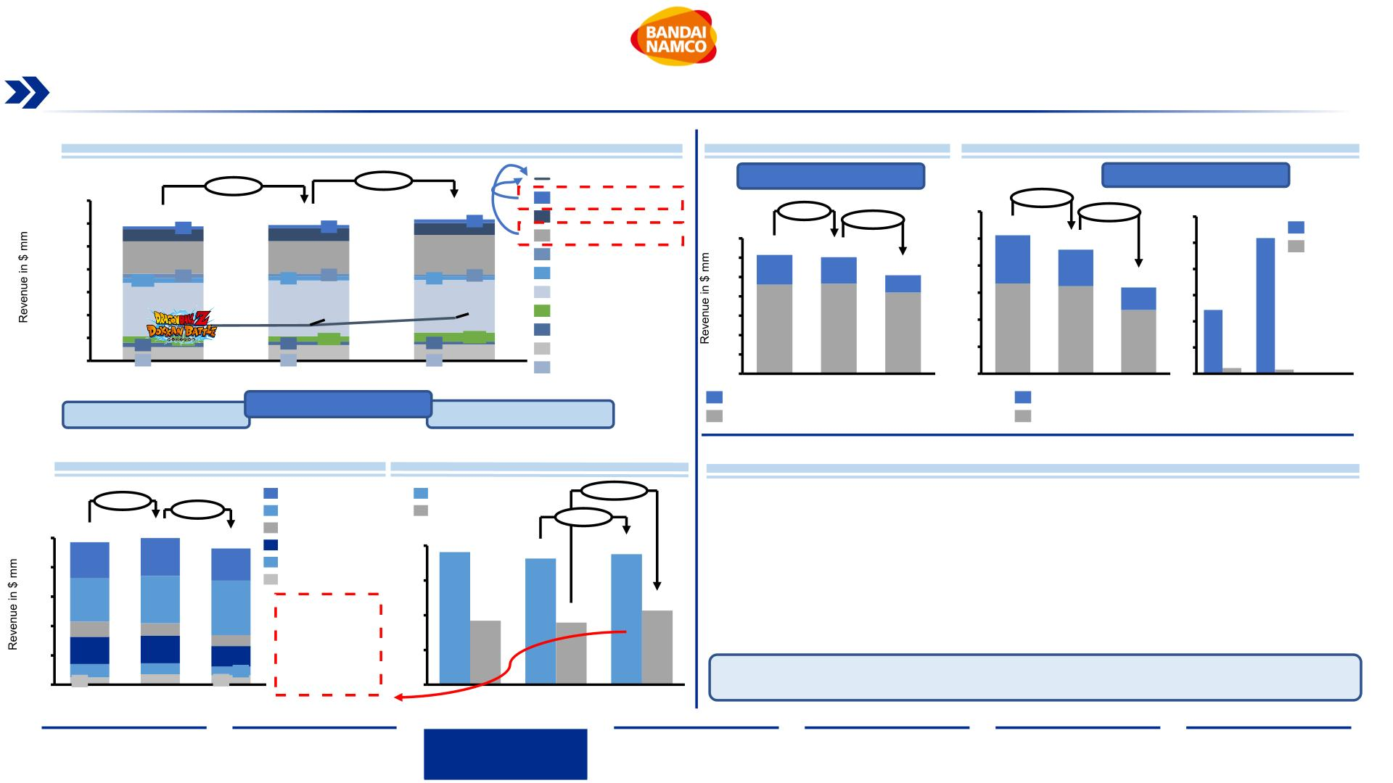
Bandai Namco’s Organizational Structure (2/2)
Gundam is the company’s biggest in-house IP that drives revenue especially in toy sales across the globe, while the licensed IP
Dragon Ball is driving mobile video games sales in the company's digital business
Groupwide Sales by IPs¹ (Global)
IP Sales by Category¹
Worldwide Facility Overview
+0.98%
+4.14%
Total In-House IP Sales
Ultraman
IP Production Unit
Amusement Unit
3,500
3,000
2,500
2,000
1,500
1,000
500
3,090
-1.77%
120
100
80
60
40
20
0
-10.35%
102
-30.50%
2,939
2,967
78
KAMEN RIDER
Mobile Suit Gundam
Super Sentai
Anpanman
-15.59%
600
500
400
300
200
100
0
265
62
282
71
261
700
600
500
400
300
200
100
0
92
27
518
Japan
706
706
859
614
154
603
137
36
Overseas
92
90
61
79
47
509
64
17
109
1,166
DRAGON BALL
NARUTO
89
769
1,220
777
118
^{1,152}937
193
244
143
275
76
29
60
18
PRETTY CURE!
ONE PIECE
460
466
420
67
65
47
93
27
316
344
22
0
Aikatsu!
16
3
0
2019
2020
2021
2019
2020
2021
2019
2020
2021
Directly Revenue- Other
managed sharing
facilities facilities
Toys & Hobbies
Entertainment Unit
Digital Business
Packaged products (Visual & Music Business)
Amusement machines
Productions, license, distribution, events (Creation)
Amusement facilities
Sales IP Toys & Hobby Unit¹
Sales by Category²
IP-Axis Strategy Impact
+2.89%
KAMEN RIDER
Mobile Suit Gundam
Anpanman
Network content
+19.29%
+3.38%
•
•
Only 1/3 of Bandai Namco’s total groupwide sales from IP stem from wholly owned IP’s
-7.06%
Home Video Games
Both the owned Gundam and Kamen Rider IP’s generate strong sales domestically, but only
the former meets demand internationally
1,000
800
600
400
200
0
971
247
999
258
929
220
1,909
DRAGON BALL
PRETTY CURE!
ONE PIECE
2,000
1,816
1,878
1,500
1,000
500
0
•
•
COVID-19 had severe impact on the use and demand for amusement facilities as well as
worldwide stores, with a 20x ratio for domestic to oversea facilities at the end of FY2021
294
323
371
923
895
1,068
Video game sales, both mobile and home console, have increased, with the latter enjoying a
~19% growth from 2020 to 2021
104
184
85
75
139
60
187
91
75
71
64
2021
300 mm
Downloads
The increasing shift towards a connected digital world creates demand for fully owned
51
2019
2019
2020
2021
IP’s that can be leveraged internally for product creation and international branding
2020
Note: ¹Value in million USD $, ²Value in billion USD $ Conversion Rate from Bandai Namco Capital IQ FY 2021 Statements with YEN/USD = 0.009041673
Source: (Integrated Report (Bandai Namco, 2021)), (Fact Book (Bandai Namco, 2021))
Executive
Summary
Industry
Overview
Company
Analysis
Financial
Analysis
Acquisition
Feasibility
Alternative
Solution
Conclusion
24

Slide 25
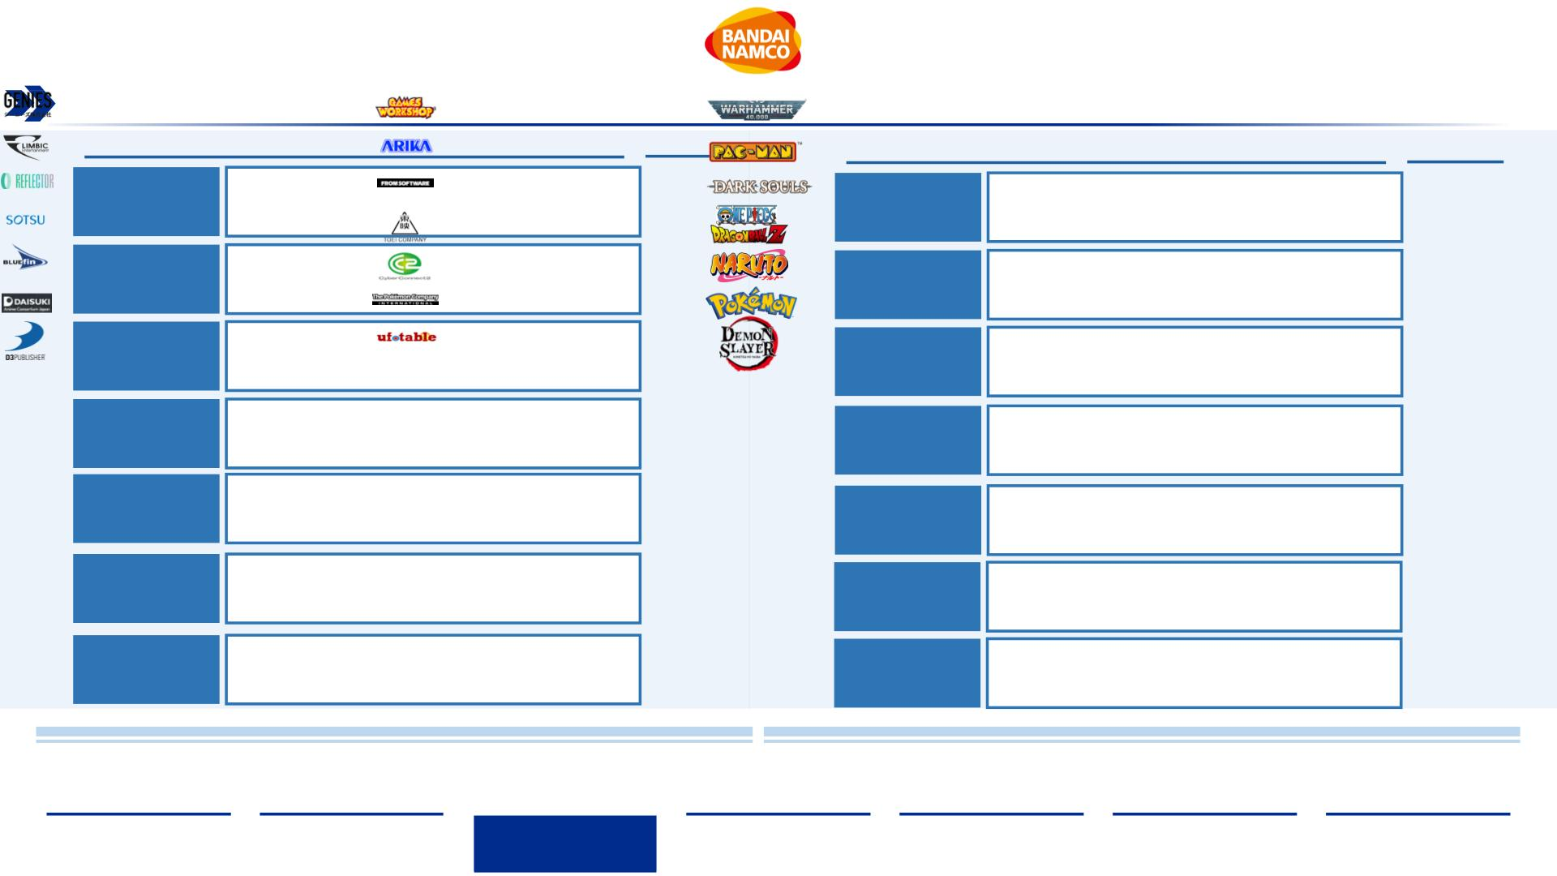
Bandai Namco’s Strategic Development
Recent M&A activity was aimed to strengthen the companies’ capabilities to produce content for its IPs worldwide
History of Mergers & Acquisitions
Date
2021
Partnerships
Licenses
Developer of personalized digital avatars to make it
convenient to communicate in social media
applications. This is a move towards the metaverse
Games
Workshop
Creators of the global phenomenon franchise
Warhammer. Partnered with Bandai for action figures
and miniature toys based on the Warhammer IP
Genies
Limbic
Bandai acquired Limbic Entertainment, a German
game developer and seller of software, with both
national and international reach
Developers of the famous Pac-Man game series,
published by Bandai Namco
Entertainment
2021
Arika
Reflector
Entertainment
Developer known for creating story driven large-scale
universes. Acquisition amount is undisclosed. Goal to
produce 50% of content out of JPN
From
Software
Creators of the popular and genre defining action role
playing game series Dark Souls and newest hit Elden
Ring, published by Bandai Namco
2020
2020
2018
Company acquired 100% of the shares of Sotsu Co.
for 35 bn Yen. The aim is to consolidate all rights
related to the Gundam franchise IP
Film, television production, distribution game developer
studio that creates most of the popular anime shows in the
world based on franchises such as Dragonball, Onepiece
and Kamen Rider (Toei Animations)
Sotsu Co.
Toei Company
Nippon
Imports /
Bluefin
Company acquired an 80% stake in Nippon Imports
the collectible toy sales Co. that owns and operates
under the brand name Bluefin, based in California
Creators of the globally popular Naruto Ultimate Ninja
Storm game series in collaboration with Bandai
Namco
CyberConnect
2
Anime
Consortium
Japan
Company acquired reminder of shares valued at $18.5 mm
of ACJ to make it a wholly owned subsidiary. The Daisuki
streaming service was shut down at the end of 2017
Recent partnership for the game development of
Pokemon Snap, a fan favorite game based on the
highest grossing media franchise in the world
2017
2009
The Pokemon
Company
D3
Company acquired 95% stake in the company in a
deal estimated to be $12.5 mm. The deal includes
American and European arms
Creation of toys based on the Demon Slayer anime
made by Ufotable, one of the fastest growing media
franchises in the world with strong reach into the west
Publisher
Ufotable
Acquisition Strategy
Partnership Strategy
•
Recent acquisitions, such as Limbic Entertainment and Bluefin, are moves to bolster foothold in • Bandai Namco is leveraging strong partnerships to deliver physical and digital goods to fans of
the western markets as well as expand capabilities for IP Axis strategy
the biggest franchises in the world, with majority of licenses in the Asian markets
Sources: (GamesIndustry, 2020), (Nikkei Asia, 2021), (Anime News Network,, 2021), (Anime News Network, 2018), (GamesIndustry, 2009), (Bandainamcoent, 2022), (Integrated Report (Bandai Namco, 2021))
Executive
Summary
Industry
Overview
Company
Analysis
Financial
Analysis
Acquisition
Feasibility
Alternative
Solution
Conclusion
25

Slide 26
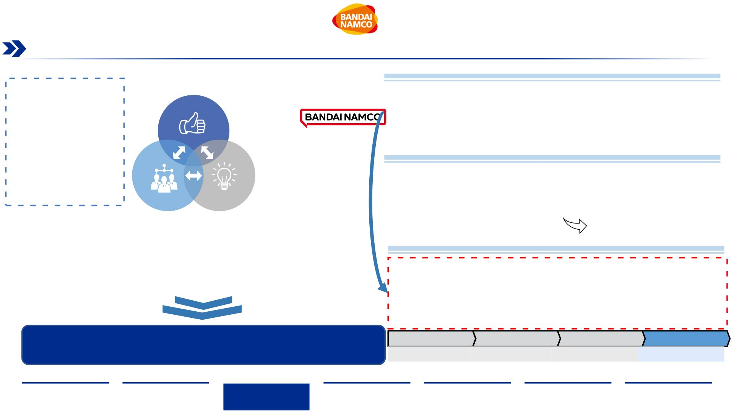
Bandai Namco’s Strategic Direction
The start of a new 3-year midterm plan in April 2022 aims to create and cultivate new and existing IP both physically and digitally,
with the goal to connect new and existing fans around the world
Entertainment
Mid-term plan 2022-2025
“To maximize the value
of IP and achieve growth
in global markets, we
will continue to take on
challenges under the
ALL BANDAI NAMCO
concept.”
•
Maximize IP Value
through diverse content
outlets
•
•
•
•
Vision: Connect with Fans
IPxFan: Developing metaverse framework for each IP
IPxValue: Accelerating evolution in the IP axis strategy with strategic investment
IPxWorld: Building business under ALL BANDAI NAMCO concept across the globe
•
•
Strengthen worldwide
collaboration
Integrating digital and
physical entertainment
elements
New Company Branding
•
•
Starting April 2022, Bandai Namco is introducing a new corporate logo
Bandai Namco President
Masaru Kawaguchi
The new logo will be used on all products by Bandai Namco and other companies, under the
ALL BANDAI NAMCO concept
Amusement
IP Creation
•
Aimed to express new purpose and spirit of the company and unite products under one
brand to maximize global presence
•
•
•
Create new customer
touchpoints
•
•
Creation and production of new IP
IP Investment Strategy ’22-’25
Leveraging and combining
studios
Leveraging and maximizing
use of Bandai Namco IP
Bandai Namco plans to invest ¥40 bn, ~ $350 mm between FY 2022 and FY 2025:
• Strategic investment to maximize IP value (¥ 25 bn, ~ $219 mm):
-> New IP creation, Groupwide IP projects, open innovation
•
Strengthening the foundation of
IP-Axis Strategy
Creation of new types of
experiences
• Investment to develop IP metaverse (¥ 15 bn, ~ $131 mm):
-> Establishment of data foundation, development of content
Purpose: “Fun for All into the Future”
FY2019.3
¥6.0 bn
FY2020.3
¥9.0 bn
FY2021.3
¥10.5 bn
Three-year total
¥25.5 bn
Source: (Integrated Report (Bandai Namco, 2021)), (Fact Book (Bandai Namco, 2021)), (Mid-term Plan (Bandai Namco, 2021)), (GamesIndustry, 2022), (Nikkei Asia, 2021)
Executive
Summary
Industry
Overview
Company
Analysis
Financial
Analysis
Acquisition
Feasibility
Alternative
Solution
Conclusion
26

Slide 27
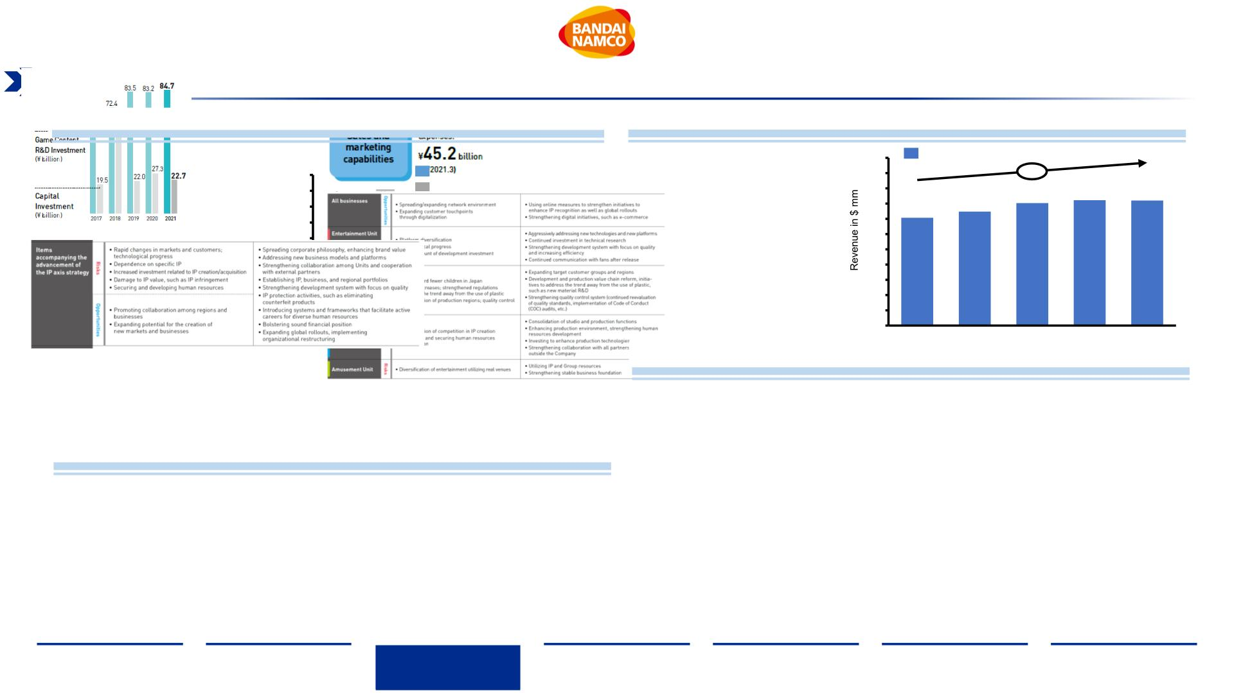
Bandai Namco’s Capabilities and Opportunities
An increase in R&D investment into game content matches Bandai Namco’s strategic direction to bolster content portfolio
diversification based on IP within its Entertainment Unit
Research and Development
Advertising Expenditure¹
Number of new home video game titles released by region
•
Overall spending on
550
500
450
400
350
300
250
200
150
100
50
Advertsing Expenses
374
100
90
80
70
60
50
40
30
20
10
0
Japan
91
advertisements is $410 mm for
2021 and has increased by a
CAGR of 4%
+4%
Americas
Europe
401
411
410
66
Group Total (excluding localized versions)
59
353
57 57
51
37
39
45
44
34
25
0
2017
2018
2019
2020
2021
2019
2020
2021
Business Unit’s Risk and Opportunities
•
•
Investment into Game Content R&D
increased by 43.5% within two years
•
BN is gearing up for more home video game
releases worldwide
BN’s recent acquisitions strengthen their
game content creation capabilities
•
Elden Ring will be major launch of a new
brand/IP in 2022
Business Strategy Risk and Opportunities
Note: ¹Data expressed in million USD $ Conversion Rate from Bandai Namco Capital IQ FY 2021 Statements with YEN/USD = 0.009041673
Source: ( Integrated Report (Bandai Namco, 2021)), (Fact Book, (Bandai Namco 2021)), (Mid-term Plan, (Bandai Namco,,2021)),
Executive
Summary
Industry
Overview
Company
Analysis
Financial
Analysis
Acquisition
Feasibility
Alternative
Solution
Conclusion
27

Slide 28
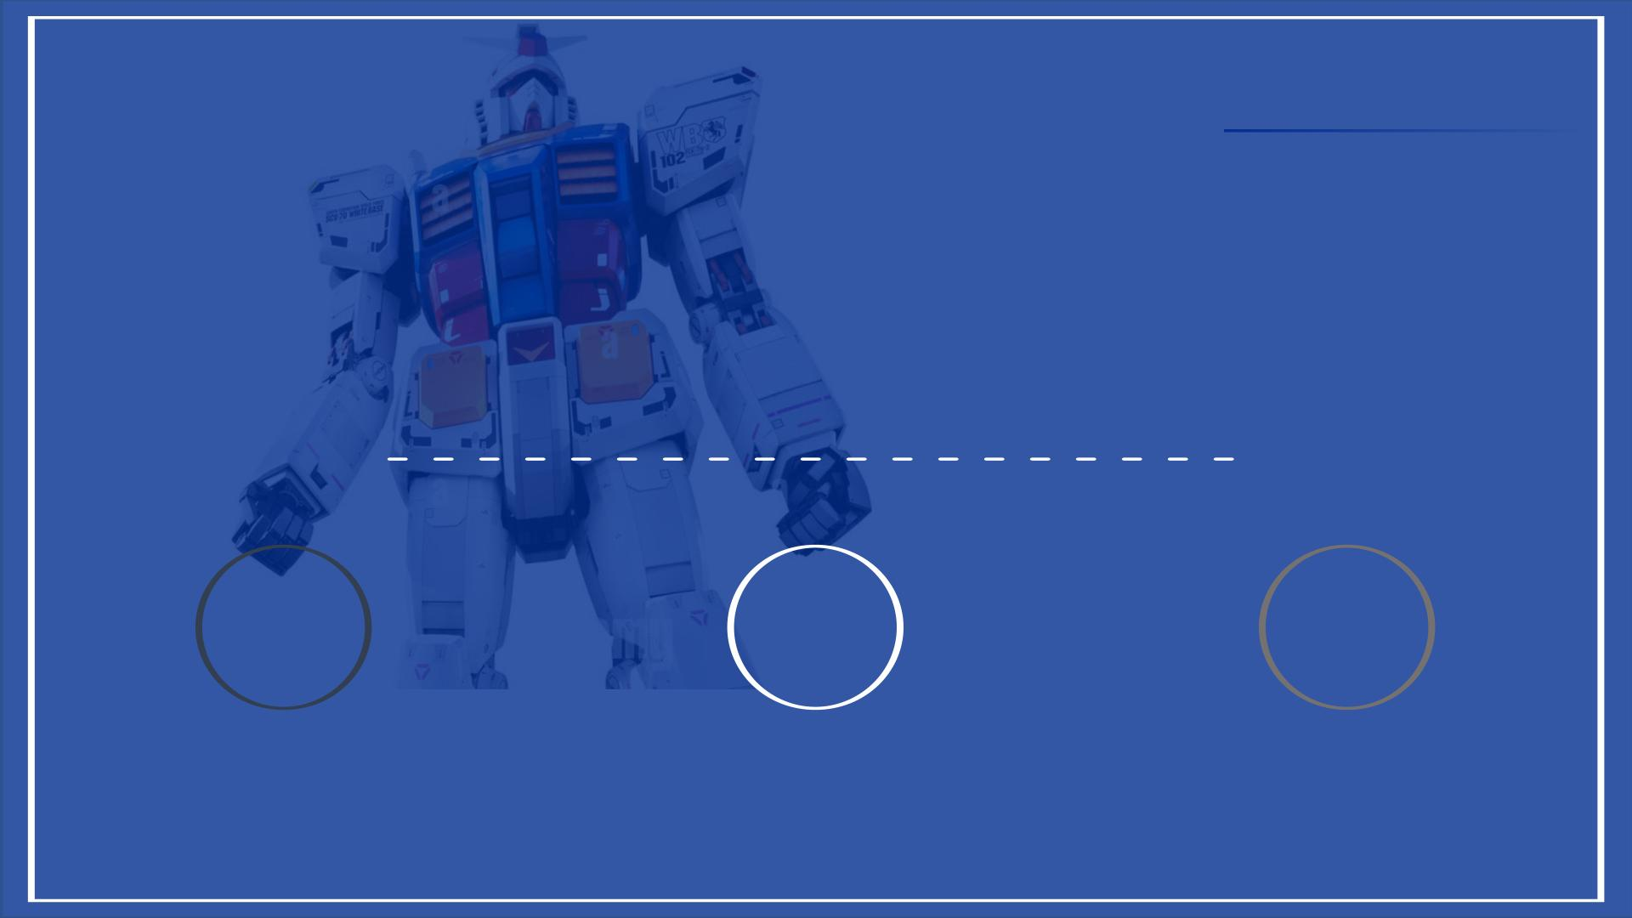
II. Company Overview
1 2 3
BANDAI NAMCO
GAMES WORKSHOP
STRATEGIC FIT
28

Slide 29
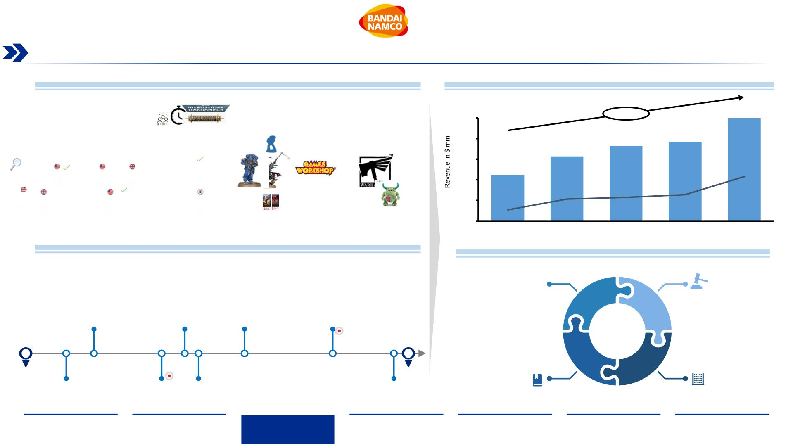
Games Workshop Overview
With 50 years of experience, Games Workshop continues to be a global leader in the war miniature industry
Games Workshop Overview
Financial Revenue Per Year¹
•
•
•
Games Workshop (GW) is the prime and most successful hobby miniatures company in the
world, engaged in designing, manufacturing and selling miniature, toys, books based on its IP
500
400
+41.39%
499.8
Its major brands are Warhammer and Warhammer 40,000 but it also holds a license for
The Lord of the Rings/the Hobbit tabletop battle game
364.9
383.4
Game Workshop makes the “best fantasy miniatures” in the world and sells products globally at a
profit. It intends to keep it its core business, focusing on long-term success instead of short-term
gains.
313.8
300
200
100
0
224.4
215.8
•
•
•
Miniature & Figure core business is inhouse – full control of the value chain, vertical integrated
Company set worldwide with a strong presence in Great Britain, Continental Europe and US
Strong community engagement and long-lasting loyalty of its customer base.
106.5
2018
115.0
2019
127.8
2020
54.0
2017
2021
Games Workshop History
Business Segment Overview
•
•
•
Games Workshop was created in UK in 1977
Company went from board game manufacturer to multi-verse hobby empire
Miniature & Figure
IP – Licenses
Originating from the physical tabletop gaming focus, it made numerous strategic partnerships to
expand in the video game sector as well as enter the book sector, founding Black Library
•
•
Video Games
Mobile Games
Ended
Focus
next slide
Sabretooth
Game
THQ
Sega & Creative
Assembly
Bandai
1997
2005
2008
2021
2001
2007
2012
2019
1977
Black
Library
Namco
Fantasy Flight
Games
NEXON Co.
2022
Book/ Audiobook
Toys
(non-gaming)
Sources: (Sturrock, 2021) (DNB, 2020) (Warner, 2019) (Games Workshop, 2021), (Games Workshop, 2022)
Note: ¹Value in million USD $ All GW numbers are translated from £ -> $, Rate: 1->1.42 (Annual Report 2020/2021)
Executive
Summary
Industry
Overview
Company
Analysis
Financial
Analysis
Acquisition
Feasibility
Alternative
Solution
Conclusion
29

Slide 30
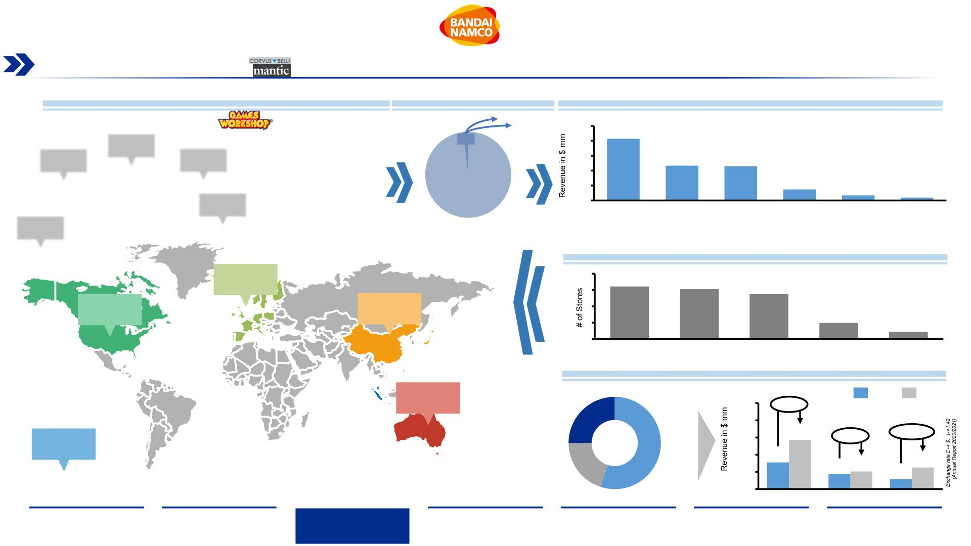
Games Workshop Market Overview
A strong presence in Europe and North America with 87.2 % of sales drives the foundation for Games Workshop’s global operations
Market Presence Overview
Market Share
Revenue per region¹
•
Games Workshop started in UK, and it spread around the world with
500 retail stores in 23 countries across AMERICAS, EMEA & ASIA
PACIFIC
250
207
2%
•
•
•
Strong presence in UK and Europe, followed by US and Australia
150
50
117
114
UK
Expansion focus pre-COVID has been on German & US markets
37
17
10
No significant competitors in its war gaming market, due to its niche
nature
98%
GW
North
America
Continental
Europe
Australia
& New
Zealand
Asia
Rest of
world
•
Biggest competitor Corvus Belli: <2% market share
Stores per region in 2021
46.0%
161
153
138
UK
41.2%
3.4%
49
22
North America Continental
Australia
Asia
Sales per segment¹
7.4%
Online
500
400
300
200
100
0
+83%
285
2020
2021
25%
2.0%
+18%
+119%
55%
Trade
155
20%
87
102
126
57
Other sales
Retail
Note: ¹Value in million USD $
Sources: (Games Workshop Group PLC, 2021), (DNB, 2020)
Trade
Retail
Online
Executive
Summary
Industry
Overview
Company
Analysis
Financial
Analysis
Acquisition
Feasibility
Alternative
Solution
Conclusion
30

Slide 31
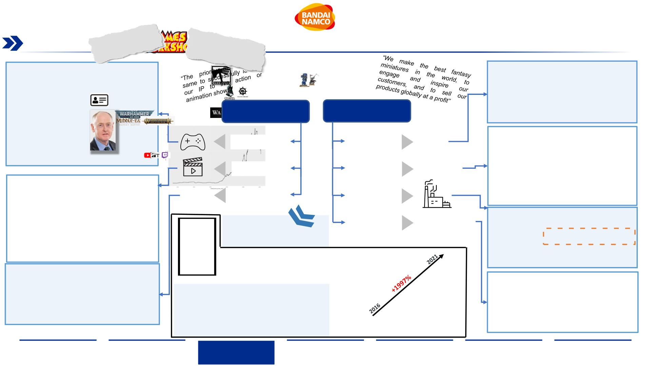
Games Workshop Organizational Structure
Divided between its core business, focused on Tabletop Wargaming, and its non-core business, focused on IP licensing, Games
Workshop has capitalized on its brand and community touchpoints to multiply its company value
Home Video/Mobile Games:
Lore & Storyline driver:
.
Increasing the video game activity and
revenues
.
Own IP & Content creators to expand
universe development
.
Focus on efforts surrounding key
franchises, specifically parts of the IPs,
typically driven by video game or media
projects, for example the Vermintide and
the Total War series of games
Inventions:
Symbols, Names, Artwork, Literacy,
Logos
Non-core Business
Core Business
~ 95% of Revenue
.
~5% of Revenue
IP Creation
Design
Figures:
. Development, new designs of miniature
Online community:
.
Video Games
Entertainment
License Income
Establishing the IPs use in widely
distributed entertainment projects
assemblies, and
necessary accessories
Paint:
Streaming Services / Animated content:
.
.
Equipment & tools for figure painting
Entertainment spectrum from Hollywood
to the Japanese animation industry.
Recently recruited an industry veteran
who is overseeing the development in this
area. Further invested in licensing
business with the recruitment of more
senior staff to the team including
Manufacturing
Sales
Books:
.
Black Library, novel publishing division
Facilities:
.
Manufacturing & recycling facilities in
Stores
Nottingham
More info in Appendix Slide 88:
marketing
expertise
from
the
Warehouses:
GW’s ESG & CSR Overview
entertainment industry
CEO
Kevin Rountree
“Games Workshops turnaround”
Share price leap 2016-2021
Games Workshop
Group PLC (GMWKF)
.
.
Storage of hobby articles.
Distribution centers for storage
£171.90
Brand awareness & engagement:
Stores:
.
Engagement of various marketing
agencies to ensure maximization of the
return on key franchises by reaching the
largest possible market
Engaging Customer:
.
Customer experience and interface for
new releases and high-volume products
.
.
Creating touchpoints with customer
Bringing Warhammer online
Exhibition centers:
Painting master classes, figure & table
top terrain exhibition, tournament location
Low threshold for new customers:
£8.61
.
.
Start Collecting boxes concept, simpler
rules, painting tutorials
Sources: (Johnson & Adams, 2017), (Games Workshop Group PLC, 2021)
Executive
Summary
Industry
Overview
Company
Analysis
Financial
Analysis
Acquisition
Feasibility
Alternative
Solution
Conclusion
31

Slide 32
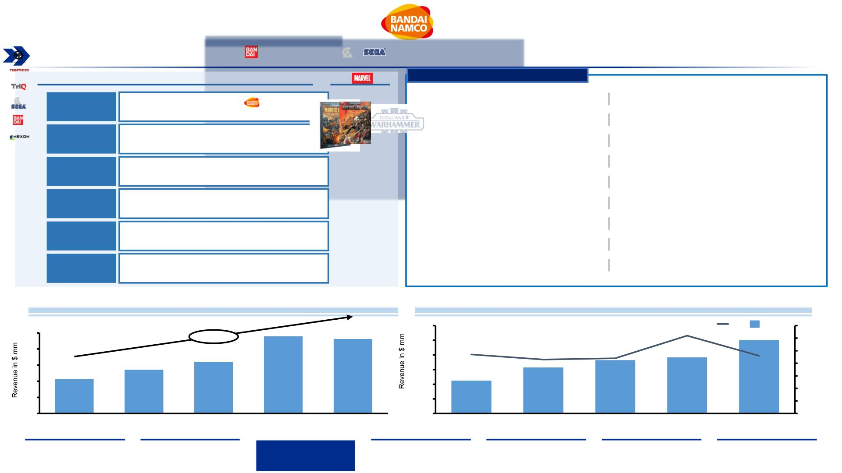
Games Workshop’s IP Leverage
Utilizing its renowned IP, Games Workshop is forging partnerships and collaborations to further expand its brand and audience
On-Going Partnership
Start date
1997
Collaborations
Other
&
Black
Library
Creation of a publishing to produce fiction literacy
set in Warhammer world
✓
✓
Collaborations with Bandai to create
Warhammer 40K collectible action figures
✓
✓
Single and multiplayer real time strategy game
Release date February 2022
Namco
THQ
Partnership to create video games based on
Warhammer setting
2005
2007
2012
2019
2021
All the figures were sold out in the pre order
✓ First collection pre order September 2020
Video game license agreement related to
Warhammer 40,000
✓
Second collection pre order March 2021
✓
Collaboration with Marvel in the release of a
series of comic books telling the tales of the lore
of Warhammer 40K
✓ Third collection pre order August 2021
Sega, Creative Multi-title licenses agreement to create video-
Assembly
game based on Warhammer universe
✓
Licensing agreement for creation of video
games announced in 2005
Bandai
Collaboration to produce two figures worldwide
• Warhammer: Battle of Atluma
• Warhammer: Mark of Chaos
• Warhammer: Battle March
NAXON Co.
License agreement to produce and publish a new
Virtual World based on the Warhammer world
✓
Launch of Warhammer 40K: Eternal Crusade in
2016. servers closed in 2021
Royalty Revenues generated by IP-Licenses¹
+21,22%
Weight of partnerships over company revenues¹
25
20
15
10
5
600
6,2%
%
Revenue
7
6
5
4
3
2
1
0
500
400
300
200
100
0
4,7%
4,6%
4,3%
4,4%
23,9
23,1
501,5
2021
13,6
16,0
314,2
2018
364,4
2019
383,0
2020
10,7
224,5
2017
0
2017
2018
2019
2020
2021
Note: ¹Value in million USD $ converted with a conversion rate of 1.42
Sources: (Annual Report (Games Workshop, 2021)), (Press Release Bandai Games Workshop, 2019), ((PREMIUM BANDAI, 2022), (Businesswire. 2012), (Marvel Entertainment, 2019)
Executive
Summary
Industry
Overview
Company
Analysis
Financial
Analysis
Acquisition
Feasibility
Alternative
Solution
Conclusion
32

Slide 33
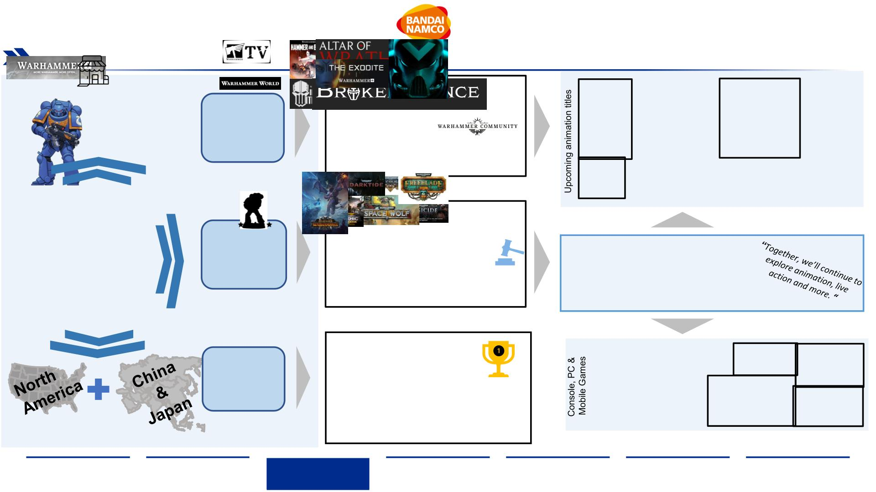
Games Workshop Strategic Development
“More Warhammer. More Often“ – Increasing universe exposure through both digital content and geographical reach
Two main tools to reach customers:
Digital Business:
digital content (Warhammer +) and retail chain
.
Entertainment
Channel
Strong online
community
Customer
Interaction/
Experience
.
Face to Face experience:
. Event Center
Company focus beside core business:
. Assigning Global IP development director
Entertainment
Stricter IP-guidelines:
Strong IP protection since July 2021
Aiming for Strong Partnerships:
. 125 ongoing licenses
IP
.
Development
Growth Engine:
Increased Licensing income using IP in
other markets
.
. Major video game titles in development
. Animations collaborations
Video/Mobile games
Miniatures, worldwide:
.
.
World best miniature figures
Engage more hobbyists into
core business
Global
Distribution
Heart of the business:
.
Side business to do no
harm on core miniature
business
Geographical focus markets
Source:(Games Workshop Group PLC, 2021), (Games Workshop, 2022), (Warhammer Community, 2022), (SteamDB, 2022)
Executive
Summary
Industry
Overview
Company
Analysis
Financial
Analysis
Acquisition
Feasibility
Alternative
Solution
Conclusion
33

Slide 34
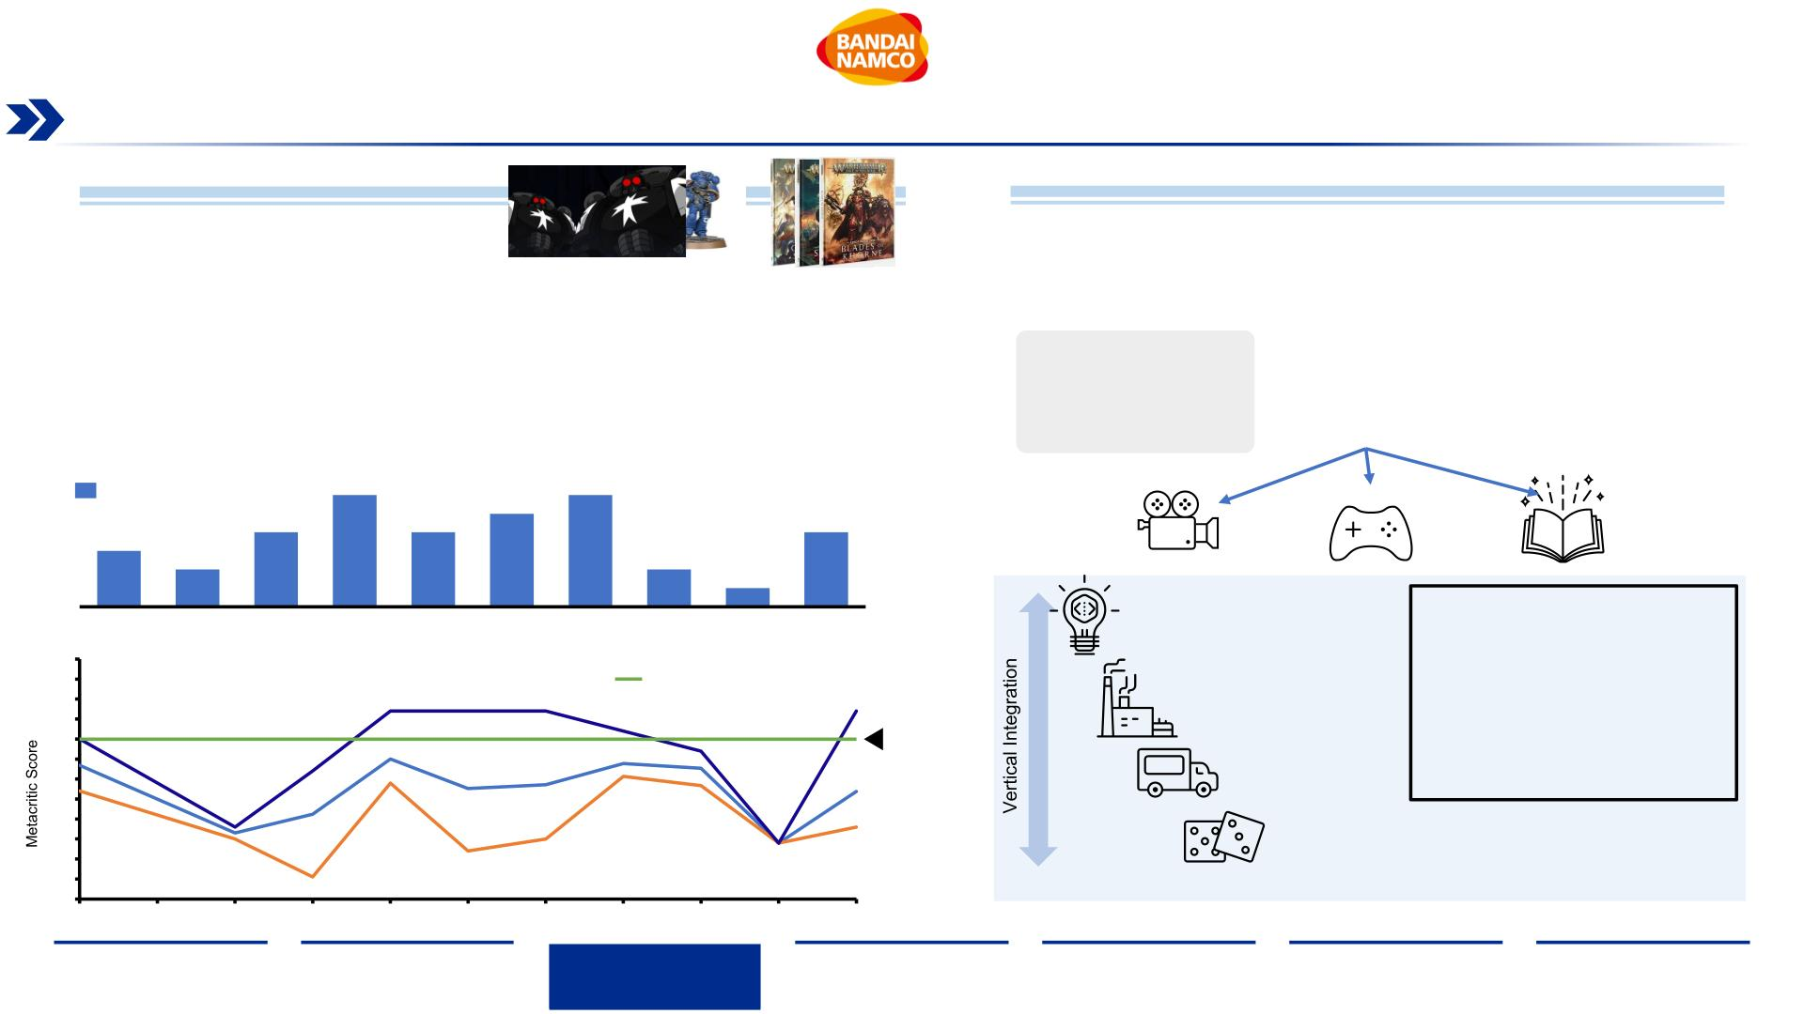
Games Workshop’s Capabilities and Opportunities
The rise of novel manufacturing technologies and handling of IP could lead to either brand damage or new major opportunities
Possible Future Threats and Weaknesses
Major Future Opportunities
3D Printing:
Brand and recognition:
•
•
3D printing technology is rapidly getting more sophisticated, increasing in quality & speed, thus
reducing its cost and barrier of entry, reeling in more mainstream consumers
•
•
Extensive universe with unlimited room for growth and endless possibilities
Very strong IP suitable for exploitation in all the main platforms, from books, to
videogames and movies
Designs for miniatures could be copied and printed illegally, potentially causing loss in sales
Brand burn out:
•
The brand has been using its IP to launch multiple games per year on different platforms
(XBOX, PS, PC, MAC), with mixed quality results
•
This use of the IP in a mass production level could harm brand image in the long run, as
consistent mediocre quality could disappoint consumers
Home game releases
6
5
6
3
4
4
4
2
2
1
2011
2013
2014
2015
2016
2017
2018
2019
2020
2021
.
IP Creation
Full Control of Value Chain
100
95
90
85
80
75
70
65
60
55
50
45
40
. Games Workshop has high
influence and impact on
their core business to respond
to market fluctuations
. IP Creation scalable into other
markets
Industry’s rating threshold
for good quality
.
Manufacturing
Max
80
.
Distribution
Avg. Score
Min
.
Interaction with community
2011
2012
2013
2014
2015
2016
2017
2018
2019
2020
2021
Sources: (Zastrow, 2020), (Metacritic. 2022), (Games Workshop, 2022)
Executive
Summary
Industry
Overview
Company
Analysis
Financial
Analysis
Acquisition
Feasibility
Alternative
Solution
Conclusion
34

Slide 35
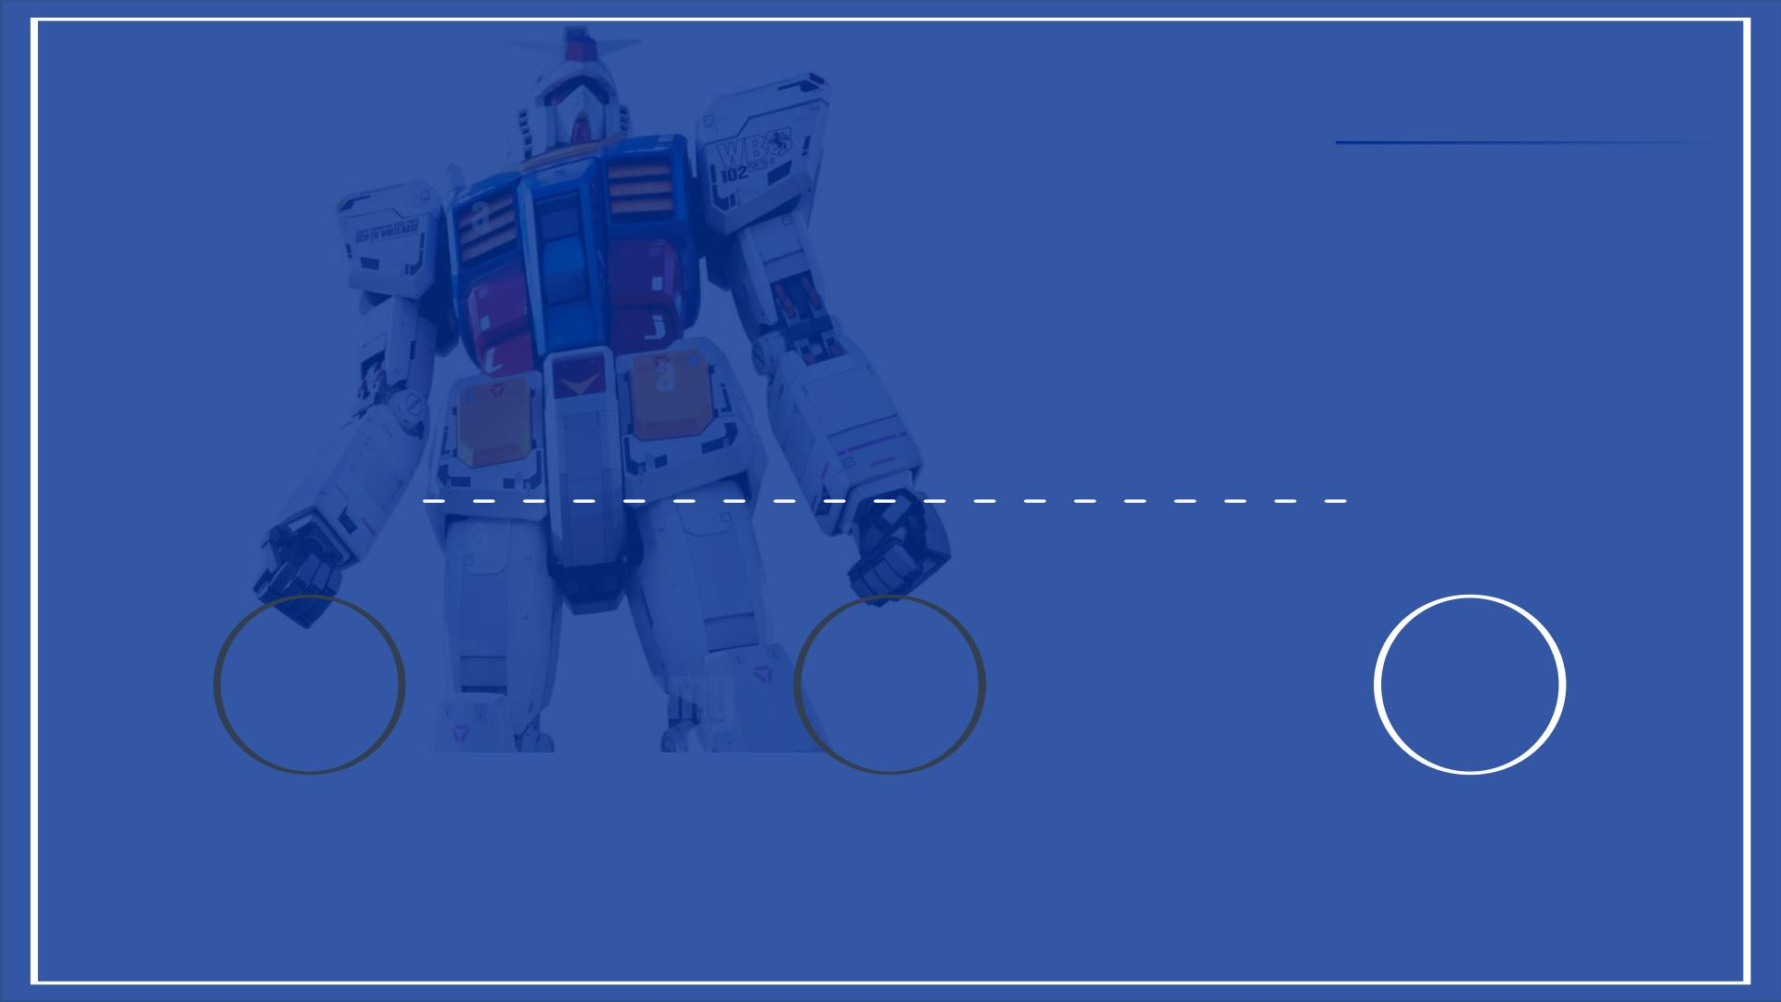
II. Company Overview
1 2 3
BANDAI NAMCO
GAMES WORKSHOP
STRATEGIC FIT
35

Slide 36
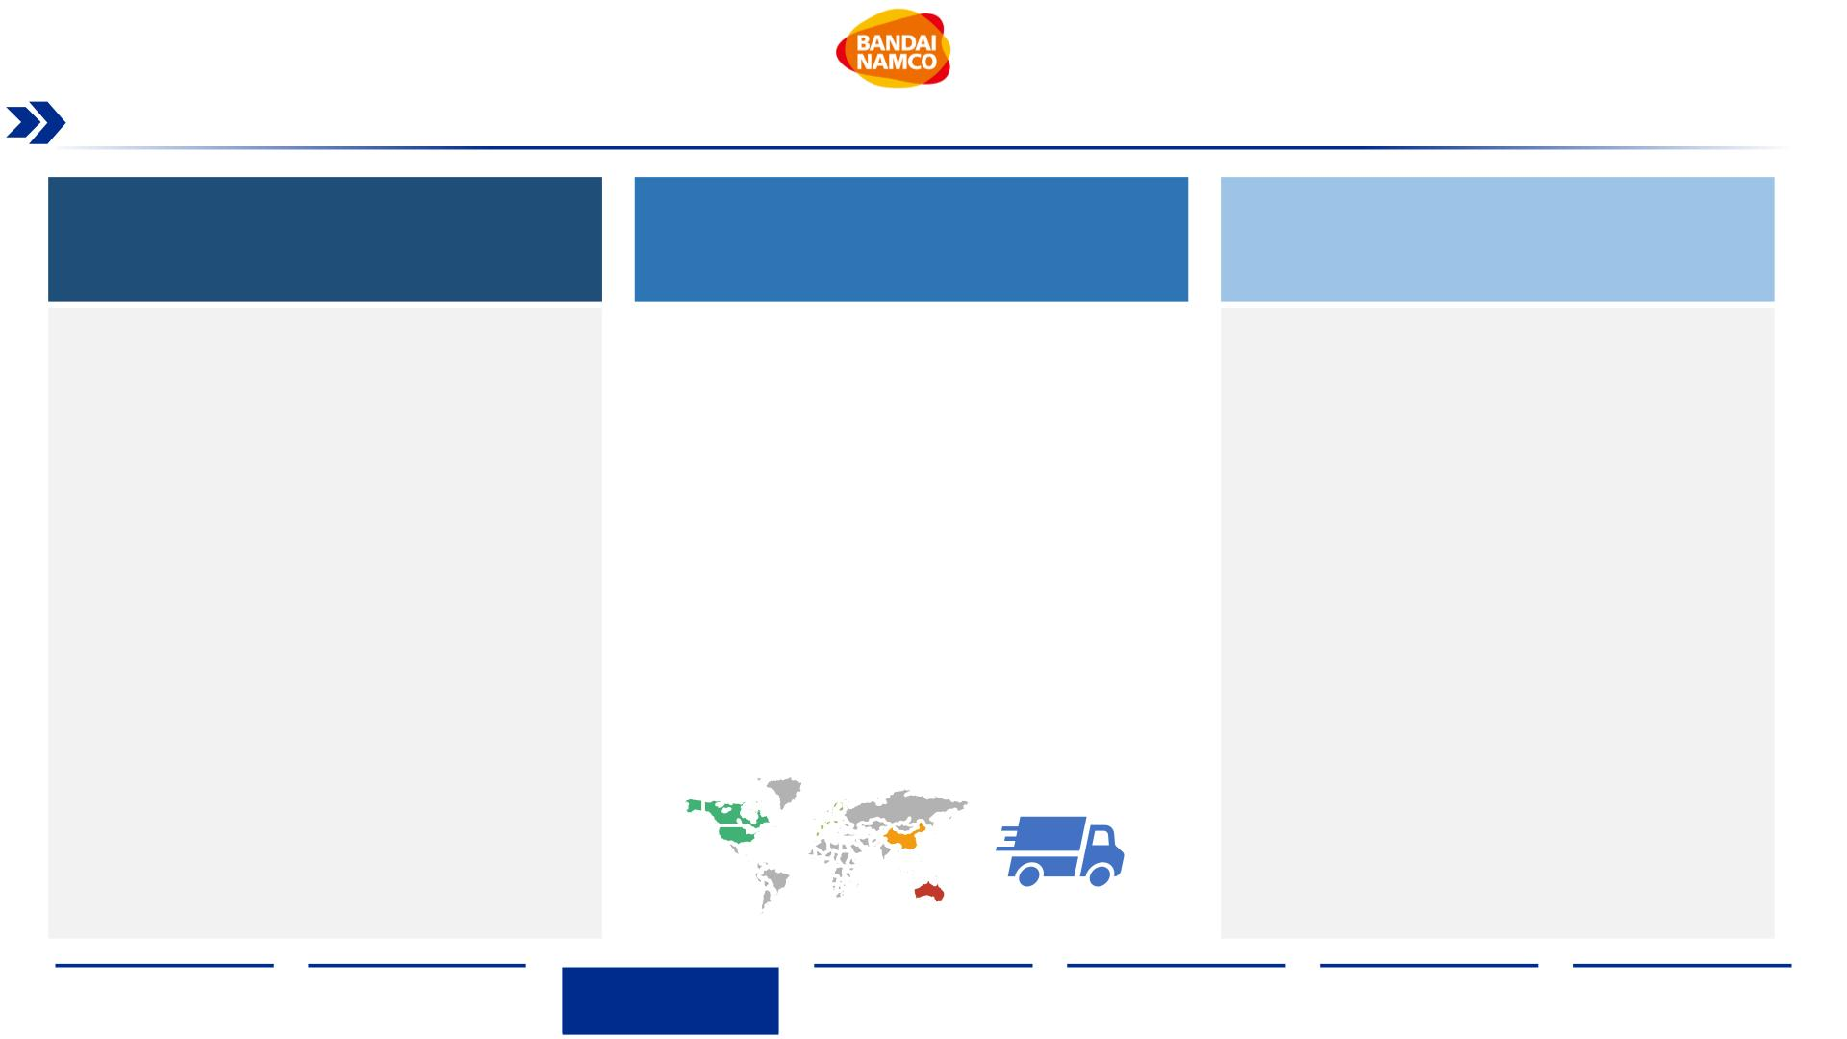
Strategic Fit Overview
Three key areas have been identified in which BN and GW are able to draw from each others’ resources, expertise and capabilities
BUSINESS UNITS
NETWORK & FOOTPRINT
INTELLECTUAL PROPERTY
Toys
Network
IP Expansion
•
The introduction of Warhammer figures in their portfolio
will consolidate Bandai Namco’s position in the toy
industry and broaden their global customer base
•
Bandai Namco’s majority of stores are in Japan, while
majority of Games Workshop’s stores are in North
America and Europe, creating great overlap
•
Bandai Namco mid-term investment plan aims to acquire
foreign IP to capitalize on
•
•
Games Workshop has a fitting rich IP to exploit for BN
•
Drawing from BN expertise, GW will be able to expand
their figure lineup to target new customer audiences
•
•
Joining their store network will be mutually beneficial
Stacked IP of both companies would increase current in-
house IP revenues by 53%
Increase the reach of both companies in their respective
Video Game & Entertainment
target markets without requiring new infrastructure
•
Games Workshop has a full control of the vertical
integrated value chain, from creation of IP to customer
interface
•
Warhammer IP licensed sales numbers are stronger than
most of Bandai Namco’s game sales
Footprint
•
Potential gain of new clients as they get more exposure
to Bandai Namco’s products through Warhammer
platforms
•
Main warehouses for Games Workshop are in North
Metaverse
America, Europe and Australia, assets that Bandai
Namco can use to distribute their products across the
world at a lower cost
•
Bandai Namco uses the biggest part of their investment
•
•
Exposure of customers to different range of IPs could
increase total sales volumes
budget to create the foundation for its digital
infrastructure, with the goal of establishing a metaverse
for each IP, which requires wholly owned IP’s to thrive
•
Bandai Namco’s main warehouses are located in Asia,
good opportunity for Games Workshop to increase the
sales in its target markets as the price to import the
products will decrease
Warhammer’s
growing
online
presence
shows
•
Games Workshop brings a mature customer base for the
metaverse committed to the hobby
opportunity
Amusement
•
•
•
•
Creation of new amusement machines to accommodate
Warhammer enthusiasts
Geographic Customer Coverage
Expand the overseas amusement offering to satisfy fans
across the world, e.g. Warhammer World
•
Combined inhouse IP ownership complements each other
creating a global fanbase instead of company specific
regional coverage, strengthening the community
Tournaments organized by Warhammer could be held in
all major markets
Joint events will connect fans of both sides
Sources: (Games Workshop, Annual Report 2021) , ((Integrated Report (Bandai Namco, 2021))
Executive
Summary
Industry
Overview
Company
Analysis
Financial
Analysis
Acquisition
Feasibility
Alternative
Solution
Conclusion
36

Slide 37
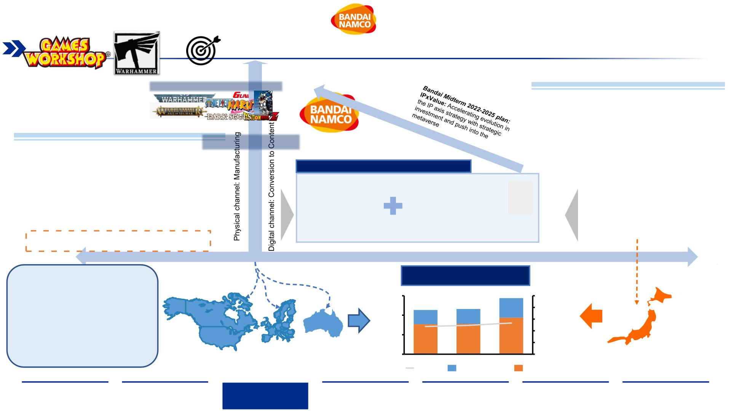
Intellectual Property Fit
The Warhammer IP is a strong addition to the Bandai Namco IP portfolio, according to their mid-term plan and strategic goals
Bandai – Horizontal distributor Expert
•
•
Few inhouse IPs to scale into new markets to
increase capitalization
Targeting strong IPs to invest in to use its
conglomerate structure to leverage products in
several industry segments
Games Workshop – Complete Vertical Chain
•
IP is well protected and provides strong platform to
capitalize on current and future IP assets
•
•
Broad licensing portfolio with partners
•
•
•
Is self-sufficient in their core business, Vertical
Integration: Design to Final distribution
Top IP content for Metaverse investment
Midterm strategy aimed to leverage IP’s for
metaverse creation
Bandai will gain more exposure to Europe and Americas,
as they are Games Workshop’s biggest markets
Games
Workshop
is
looking
for
strong
partnership to capitalize on new product ideas
More details in Appendix Slide 89:
Intellectual Property Protection
In-house IP revenue increase for
Bandai Namco in mm $
The Warhammer IP is a fitting target for
Bandai’s IP strategy, particularly to its
longevity, customer loyalty, scope and
mature appeal. It poses another universe
that can capitalize on the future metaverse
investments Bandai is driving.
Bandai offers a broad platform of
distribution channels to markets and fits to
the strong partner Games Workshop is
looking for
1,500
1,000
500
0
1,437
100
1,134
47.5
1,160
49.3
80
60
40
20
0
53.4
Providing Mature Customer Base in Western Countries
2019
2020
2021
Huge market hold and
available platform
Add in %
Games Workshop
Bandai Namco
Source:(Games Workshop Group PLC, 2021), (Games Workshop, 2022), (Warhammer Community, 2022), (Integrated Report (Bandai Namco, 2021)), (Fact Book (Bandai Namco, 2021)), (Mid-term Plan (Bandai Namco, 2021)
Executive
Summary
Industry
Overview
Company
Analysis
Financial
Analysis
Acquisition
Feasibility
Alternative
Solution
Conclusion
37

Slide 38
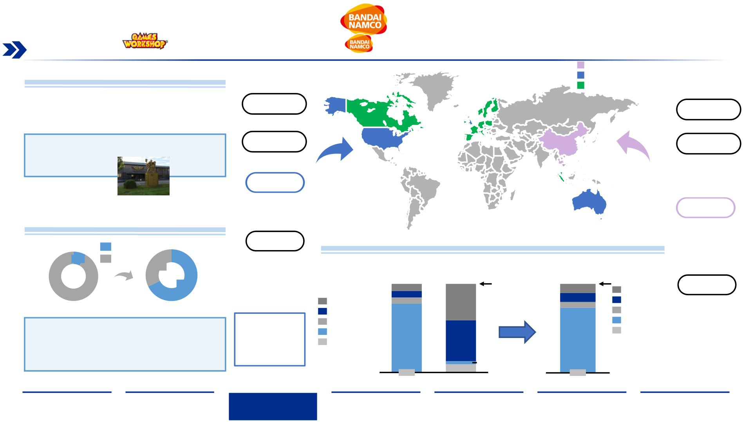
Network & Footprint Expansion
Games Workshops strong presence and distribution network in the US and European markets is attractive towards Bandai
Namco‘s expansion goal to reach 35% overseas sales by 2025
Distribution Network Overview
BN Distribution and Manufacturing
GW Distribution and Manufacturing
Total addressed markets
•
•
Games Workshop distribution hubs are located in
their biggest markets
Bandai can use these distribution hubs to expand
their global reach
Design Center
Manufacturing
Nottingham, UK
Manufacturing
Japan
Its not financially worth for the companies to open
new distribution hubs in other markets. Therefore,
sharing the existing one can benefit both.
Manufacturing
Nottingham, UK
Distribution
Japan
China
Thailand
Philippines
This will reduce the distribution costs worldwide
•
Games Workshop can use Bandai Namco’s
distribution hubs in Asia to penetrate the market
Nottingham, UK
Memphis, US
Sydney, AU
Distribution
Bandai Namco Sales Network Combination
Japan
Hong Kong
China
Sales
Revenue Ratio by Region
Overseas
8%
Japan
North America
Europe
Thailand
Philippines
32%
$6.7 bn
$0.5 bn
$7.2 bn
68%
Asia
Oceania
100%
100%
Sales
92%
7.9%
7.4%
10.2%
Americas
Americas
7.0%
41.2%
10.1%
6.5%
Europe
Asia
North America
South America
Central
Pre-acquisition
Post-acquisition
Europe
Asia (excl. Japan)
Japan
Bandai Namco’s stores are predominantly in Japan.
The addition of Games Workshop store network to
their existing one will improve the reach of Bandai
Namco’s products around the globe without new
infrastructure
Asia (excl. Japan)
Japan
+
77.7%
0.0%
Rest of World
Rest of World
46.0%
9.4%
72.5%
America
Europe
Oceania
3.4%
0.7%
Sources: Annual Report (Games Workshop, 2021) , (Integrated Report (Bandai Namco, 2021), (Games Workshop Group PLC, 2021), (BANDAI NAMCO Holdings Inc. 2022)
Bandai Namco Games Workshop
BN + GW
Executive
Summary
Industry
Overview
Company
Analysis
Financial
Analysis
Acquisition
Feasibility
Alternative
Solution
Conclusion

Slide 39
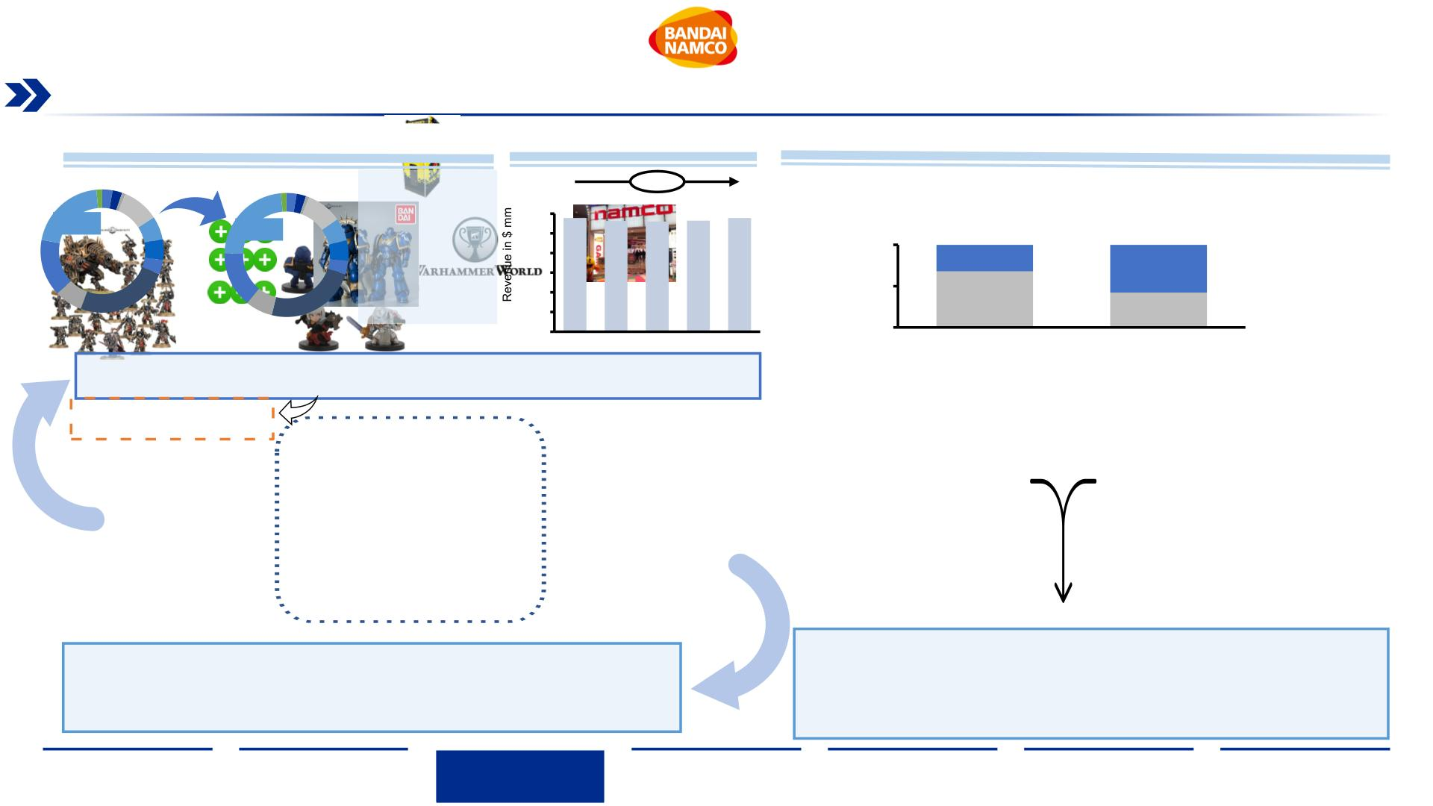
Toys & Amusement Product Fit
A direct overlap in the type of product offering, combined with differing target audiences, creates opportunity windows for market
expansion without the threat of cannibalization
Toy Product Portfolio Fit
Figure Market Trend in Japan¹
Amusement Portfolio Overlap
The addition of
Games workshop
would change the
weight of hobby
products in the
portfolio, opening
new markets to
Bandai Namco
0.00%
Integration of the Warhammer world into Bandai Namco's amusement segment:
21%
300
250
200
150
100
50
289
281 280 282
289
23%
762
244
38
22
100%
50%
0%
Directly managed facilities
Revenue-sharing facilities
518
16
Pre-acquisition portfolio
Post-acquisition portfolio
0
2016 2017 2018 2019 2020
Japan
Overseas
•
Games Workshops core business, miniature gaming, would get a major entry and acceptance in
one of their prime target markets, Japan. Evident increase of sales would be expected
•
New space in venues for machines with Warhammer IP, in all types, from capsule toys to
lottery-related machines. Exposing GW brand in Japan. Vice versa, Bandai Namco would
be able to sell their products in GW stores overseas
More details in Appendix Slide
90: Japanese Community
War gaming
sales increase
Boost in IP
exploitation
• Games Workshop holds
tournaments and exclusive
events for their community in
local stores and in big facilities
• Bandai Namco owns facilities for
Strategic goal
alignment of
BN & GW
all their amusement machines, a
place to build community around
a common theme
•
•
Preexisting collaborations in the toy segment between Bandai Namco and Games
Workshop positions both companies well within each others home markets
•
Warhammer Tournaments can be held in Bandai Namco amusement facilities,
giving access to the rich community to players from the Asian market
The mature Warhammer community is prone to buy the Bandai-products leveraging
the IP
•
•
Opportunity to showcase the brand to new potential customers
Larger access to more shelf space will allow stronger exposure of products from
both companies
Sources: (Annual Report (Games Workshop, 2021)), (Integrated Report( (Bandai Namco,, 2021))
Executive
Summary
Industry
Overview
Company
Analysis
Financial
Analysis
Acquisition
Feasibility
Alternative
Solution
Conclusion
39

Slide 40
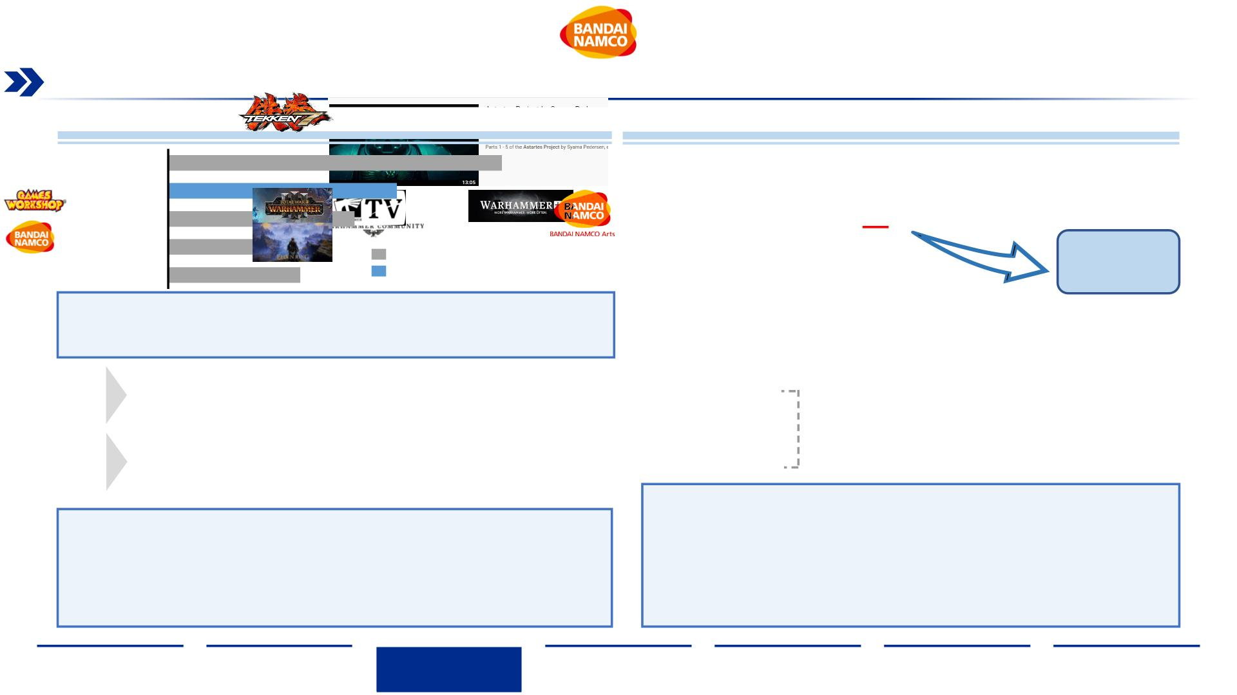
Video Games & Media Opportunity
With only ~5% of its revenue stemming from IP royalties, Games Workshop faces an immense growth opportunity in the production
of games and media in-house, made possible by the support of Bandai Namco as a parent company
Video Games Compatibility
Video Entertainment
TEKKEN Series
Total War: Warhammer
Dark Souls Series
53
•
There is a lot of demand for GW video entertainment content, best example is the
nonofficial project done by a fan and viewed over 10 million times on YouTube
36
29
Tales…of Series
25
Sales Bandai Namco (mm USD)
10 Million
Ulitmate Ninja Storm Series
21
Sales Games Workshop IP (mm USD)
views
•
Total million copies sold by these series, shows that Games Workshop IP is a very
competitive name in the industry, and outperforms many of the best series Bandai Namco
has produced, making it a very succulent addition
•
GW recently implemented subscription model for digital content as well as a
freemium version that gives access to limited content
•
•
There are 5 games in production set to be release in 2022
based on the Warhammer universe license
One game has been released so far in 2022 based on the
Warhammer license: Total War Warhammer 3
• ~600,000
Subscribers
• Over 10,000 pieces
•
•
There are 3 games announced to release this year and
another 3 coming soon without a set date
Bandai Namco has release one game earlier this year:
Elden Ring, based on the Dark Souls franchise Formula
of digital content
• 21.2 million email
lists open
New subscription-based
platform with exclusive
video content.
•
•
•
Bandai Namco’s IP Production unit would be able to leverage Warhammer IP to
create Anime shows/movies similar to their popular in-house created TV shows.
•
•
•
Leveraging Bandai Namco’s expertise and resources, such as Game Studios, Games
Workshop will be able to capitalize on their IP by creating their own games and media.
The Warhammer IP is a great fit for a Metaverse based product, as it could be used as a
tabletop AR/VR game that combines physical figures with virtual reality gameplay
Enthusiasts from across the globe could use Warhammer based online games to share
their hobby and passion in a virtual space
Taking advantage of the growing customer base in digital platforms and a great
demand for content will elevate Bandai Namco’s opportunity window
Expanding the GW universe in the Asian market and potentially increasing the video
content will lead to new stream of consumers
Sources: (Pcgamer, 2022), (Fact Book (Bandai Namco, 2021)), (Constantwarfare. 2022), (Streva, F., 2022), (Annual Report (Games Workshop, 2021)), (BANDAI NAMCO Entertainment Asia, 2022)
Executive
Summary
Industry
Overview
Company
Analysis
Financial
Analysis
Acquisition
Feasibility
Alternative
Solution
Conclusion
40

Slide 41
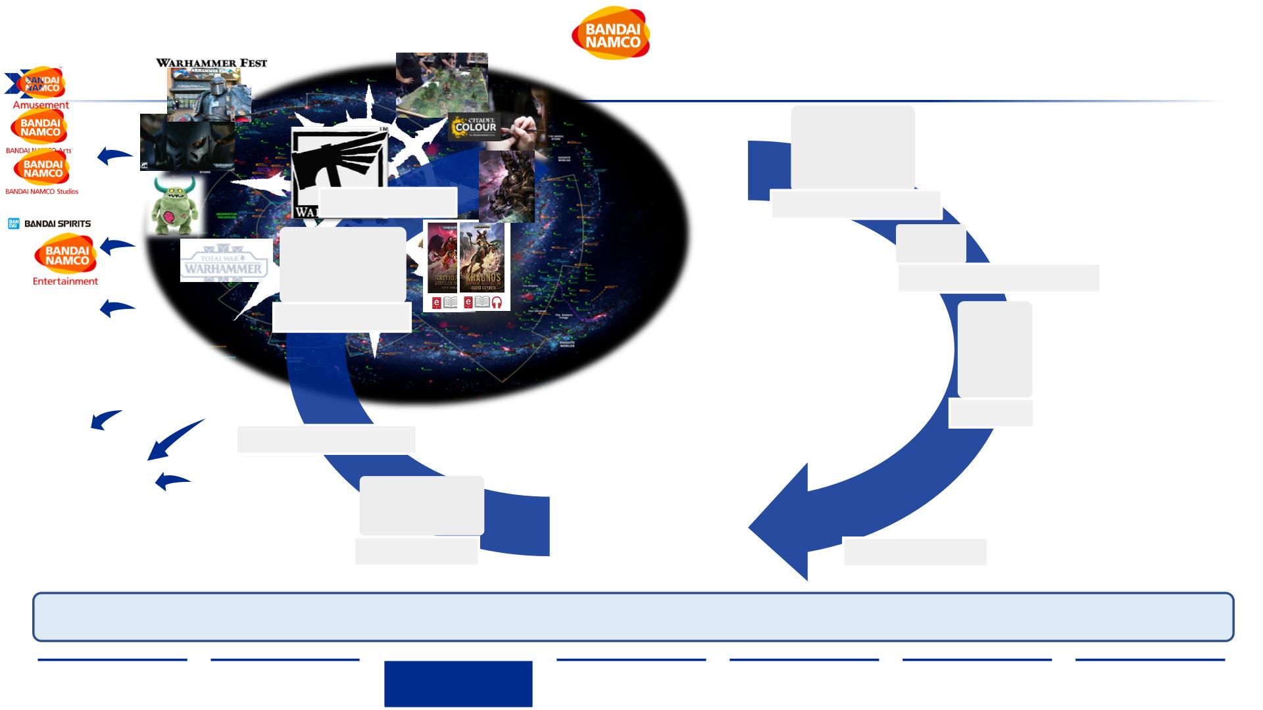
Community Driven Universe
A loyal community builds the foundation that drives storyline and engagement for the IP, resulting in high customer retention
due to several angles to the hobby
•
Touchpoint and amusement
including hobbyist exchange,
cosplay, GW major product
releases
•
Casual and Competitive scene
where collections of figures challenge
each other on a 60”x 44” battlefield
Wa
se
Fan Events
•
Customization of
collections by creative
freedom painting
Figure War Gaming
•
Series, movies, short
clips to further
assembled figures
Painting competitions
reinforce the “grim
dark” atmosphere and
enhance perception to
the hobby
•
Painting Masterclasses
Animation
•
Artwork (physical and digital)
bringing important story line
and characters to life in
spectacular sceneries
•
Complementing toys to
express connection with
the hobby
•
Merchandise
leverages
•
Generational overlap
artwork to expand product
Artwork
mix (e.g. phone cases)
Stuffed/Plastic Toys
•
•
Universe, storyline and character (IP)
development through novels
New rulebook edition released in a
three-year cycle, introducing new
components to the game and
generating hype
•
•
Universe engagement
through digital gaming
Digital platform for
exploring the universe
with other hobbyists
Video Games
Books and Lore
The Warhammer Universe has ~50 years of constant further content development. It has several angles to the hobby, and is further developed by the fan base via
Games Workshops interaction with the community. The plethora in the community activities creates strong fan loyalty and ensures a longevity of the customer base.
Sources: (Pcgamer, 2022), Fact Book (Bandai Namco, 2021), (Constantwarfare. 2022), (Streva, F., 2022), Annual Report, (Games Workshop, 2021), (BANDAI NAMCO Entertainment Asia. 2022)
Executive
Summary
Industry
Overview
Company
Analysis
Financial
Analysis
Acquisition
Feasibility
Alternative
Solution
Conclusion
41

Slide 42
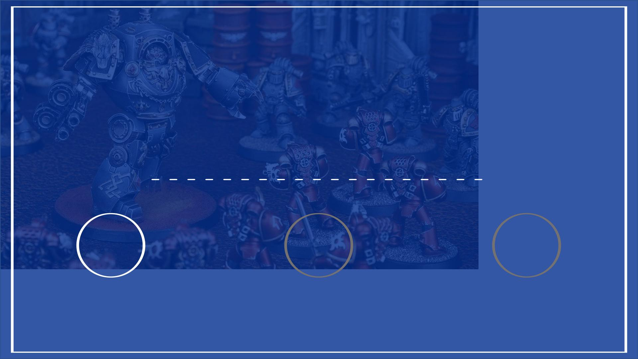
III. Financial Analysis
1 2 3
COMPARABLES
DISCOUNTED
CASH FLOW
SYNERGIES
42

Slide 43
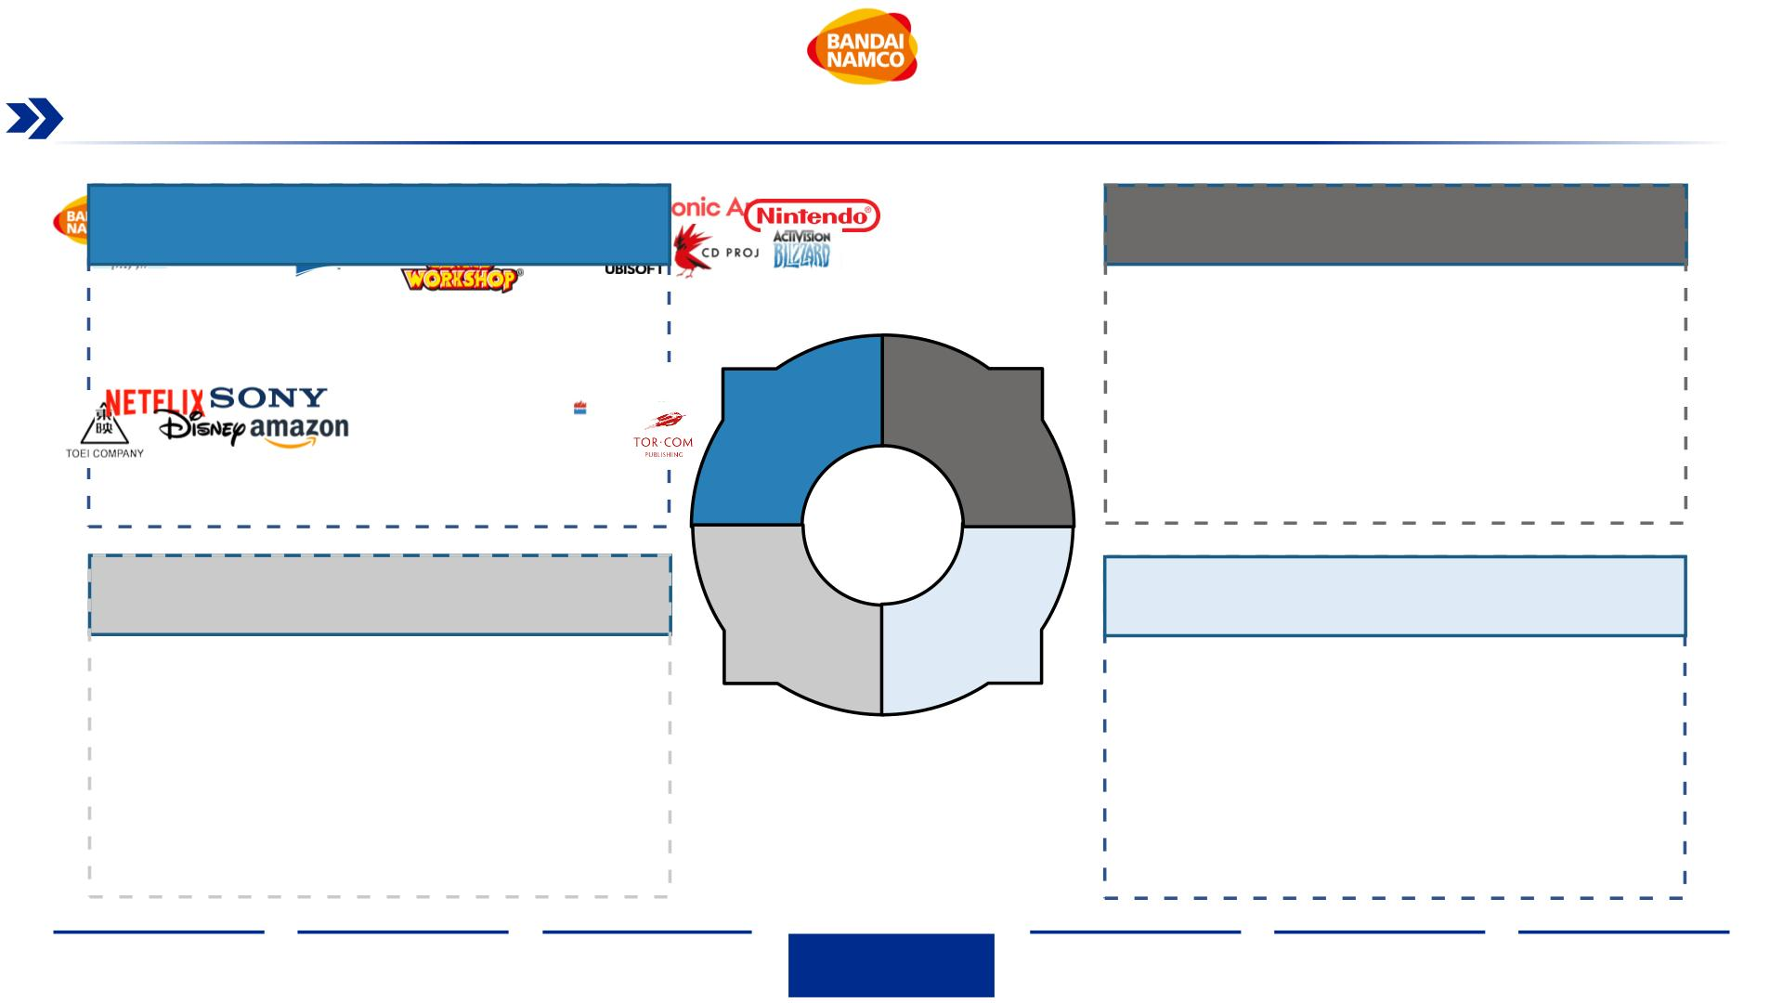
Games Workshop Potential Peer Groups
We have identified four peer groups that share touchpoints with Games Workshop, namely Toys, Video Games, Animation and Books
Toys & Games
Video Games
As GW’s main revenue driver and primary market,
the toys and miniatures segment is considered a key
peer group
Through licensing their Warhammer IP, GW is
participating in the video game industry and looking
to grow their reach and audience
Animation
Books & Audio Books
As one of their key goals of expansion, the
Animation market is a key sector for GW to consider
to boost brand exposure, community engagement
and IP usage
GW exploits its IP through the distribution of
audiobooks and books written based on the extended
universe, extending brand awareness and
community engagement
Source: Own Team Analysis, (Games Workshop, 2022)
Executive
Summary
Industry
Overview
Company
Analysis
Financial
Analysis
Acquisition
Feasibility
Alternative
Solution
Conclusion
43

Slide 44
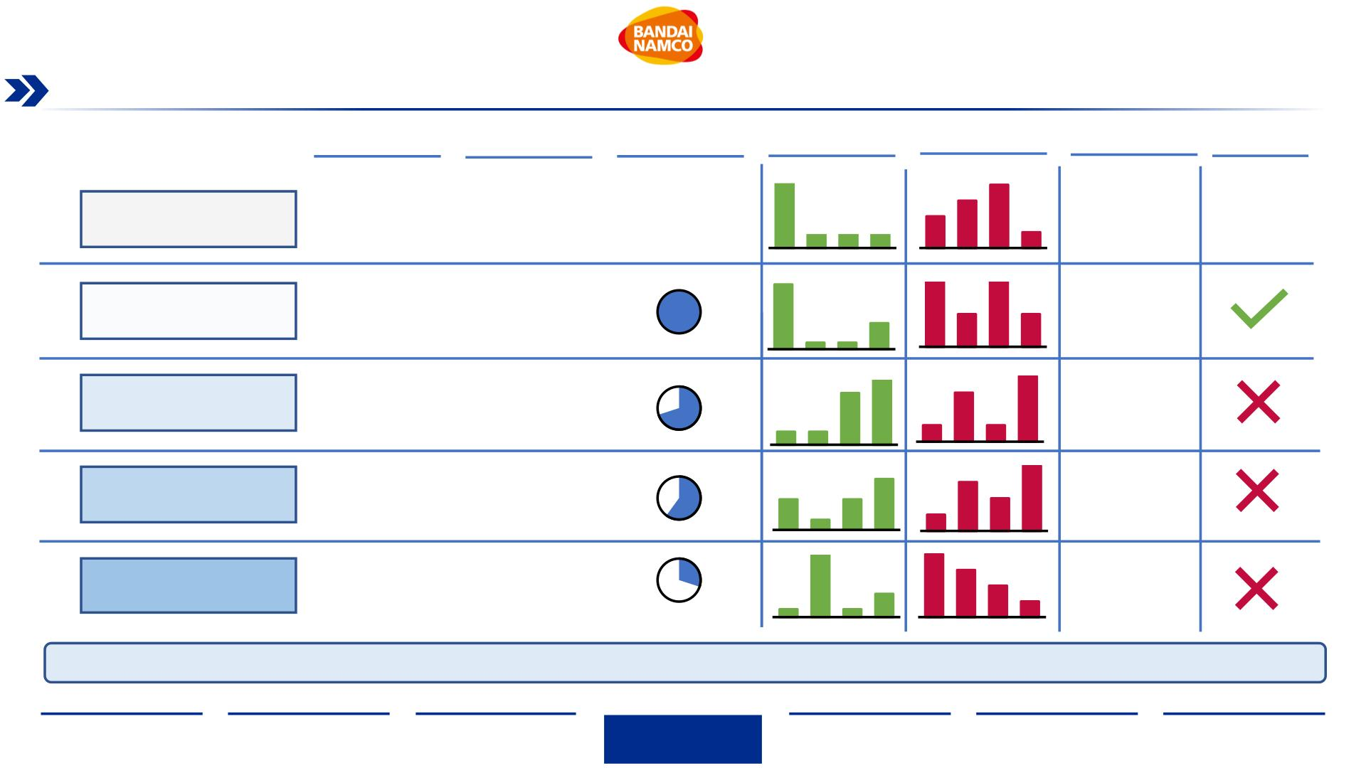
Games Workshop Peer Segment Relevance Analysis
Our peer analysis results in discarding the Video Games, Animation and Books peer groups due to a lack of relevance to Games
Workshop’s current revenue streams and impact on their brand
Market Size
Market Size
CAGR
Brand
Relevance
Revenue
Drivers
Cost Drivers
Result
Retained
1. Miniatures/Figures
2. Books
1.COGS
2.SG&A
-
9.1%
-
3. Subscription Service
4. IP Licensing
3.Manufacturing
4.R&D
-
-
Games Workshop
Toys & Games
(‘21-’26)
1
2
3
4
1
2
3
4
• Strong overlap in
revenue drivers
and cost drivers
• Highest brand
relevance
$297 bn
(’19)
4.62%
(‘19-’24)
• No strong
Digital Video Games
Animation
$155 bn
(’21)
12.84%
(‘19-’25)
revenue overlap
due to outsourced
production
• One of GW’s
target markets, but
not sophisticated
overlap yet
$270 bn
(’20)
2.06%
(‘17-’20)
• Games Workshop
only sells books for
lore and history, not
a major revenue
driver
Books / Audio Books
N/A
-
N/A
-
Games Workshop has its major revenue stream through the manufacturing and selling of Miniatures, which has the biggest overlap with the toys segment
Source: (Capital IQ, 2022), (Statista, 2021), Own Team Analysis
Executive
Summary
Industry
Overview
Company
Analysis
Financial
Analysis
Acquisition
Feasibility
Alternative
Solution
Conclusion
44

Slide 45
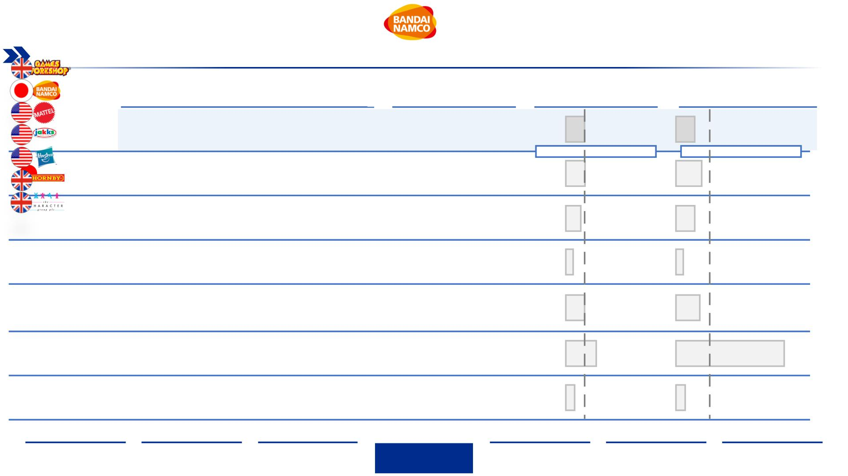
Peer Group Trading Multiples
Games Workshop’s EV/EBITDA multiple is its peer's median but slightly below the groups EV/EBIT median
Relevance and Rationale
Enterprise Value ($ mm)¹
EV/EBITDA
EV/EBIT
• Multinational Toy Miniature and Figurine company headquarter in the UK
• Global IP “Warhammer” is used for licensing and content production in
diverse areas
2,881.6
12.6x
Median: 12.6x
14.9x
13.4x
19.6x
14.4x
5.9x
• The largest toy company in Japan, and 2nd the largest Toy manufacturer
in the world
• Connections and experience in Video Game production & publishing, as
well as animated content
Median: 14.5x
15,036.5
10,745.9
228.5
• Children's entertainment company, designs and produces toys and
consumer products
• Headquartered in California, US
11.5x
4.5x
• 4th most valuable company in the world in Toys & Games
• Toy manufacturer headquartered in America
• 5th most valuable Toy company in the world, 9x smaller than its next
peer Hasbro
• 4th most valuable Toy company in the world by revenue, with brands
such as Magic The Gathering trading card game
• Headquartered in US, Rhode Island
16,125.9
88.4
13.9x
18.4x
• Hornby PLC, through its subsidiaries, engages in the design,
development, production, and distribution of hobby and interactive
products
23.6x
6.6x
83.7x
7x
• Headquartered in the UK
• The Character Group plc designs, develops, and distributes toys,
games, and gifts in the United Kingdom and internationally
107.5
Note: ¹Data expressed in mm $
Source: (Capital IQ, 2022), (Statista, 2021), (Yahoo Finance, 2022), (Mattel Inc., 2022), Own Team Analysis
Executive
Summary
Industry
Overview
Company
Analysis
Financial
Analysis
Acquisition
Feasibility
Alternative
Solution
Conclusion
45

Slide 46
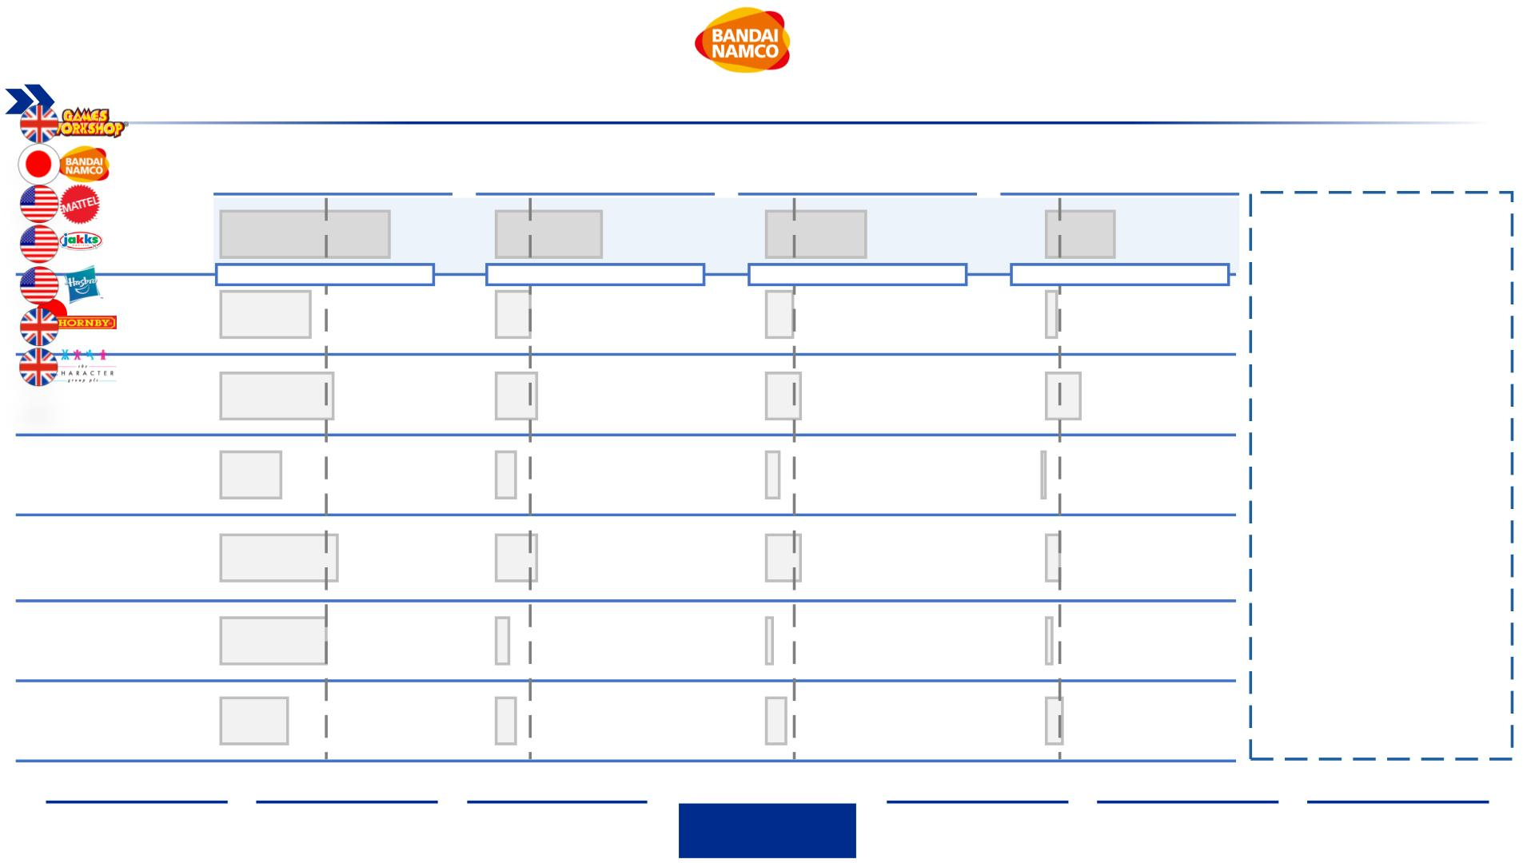
Peer Group Margin Analysis
Across the board, Games Workshop’s margins highlight its operational efficiency and vertically streamlined business model
Gross Margin
EBITDA Margin
EBIT Margin
Profit Margin
Takeaways
72.7%
45.7%
Median: 15.1%
15.1%
43.1%
Median: 10.7%
10.7%
34.5%
Median: 6.7%
6.2%
• Games Workshop
profitability and
Median: 44.8%
manufacturing
capabilities are
38.1%
heightened when
compared to its peers as
all four margins are
higher
48.2%
30.7%
17.1%
13.7%
16.5%
• Games Workshop’s
Gross margin is 27.9
percentage points higher
than its closest UK peer
and 22.2 percentage
points higher than its
closest US peer
8.1%
6.2%
-1%
50.5%
18.0%
13.7%
6.7%
44.8%
28.9%
5.6%
8.5%
1.6%
8%
2.8%
8.7%
• Games Workshop’s main
competitive advantage
comes from its lower
COGS
Source: (Capital IQ, 2022), (Statista, 2021), (Yahoo Finance, 2022), (Mattel Inc., 2022), Own Team Analysis
Executive
Summary
Industry
Overview
Company
Analysis
Financial
Analysis
Acquisition
Feasibility
Alternative
Solution
Conclusion
46

Slide 47
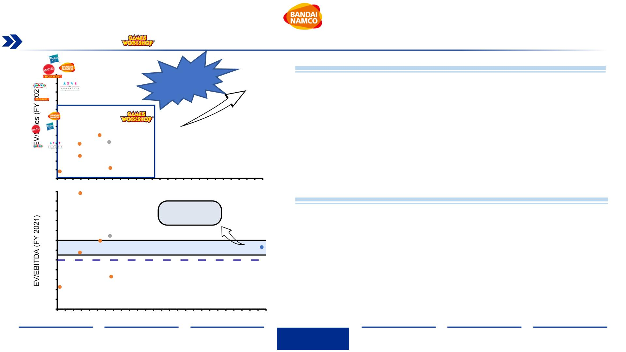
EV/Sales & EV/EBITDA vs. Sales CAGR
Games Workshop sales have grown at a compounded annual growth rate of 25.5% which is 3.7x faster than its closets peer
EV/Sales vs. Sales CAGR Key Takeaways
6.0
5.5
5.0
4.5
4.0
3.5
3.0
2.5
2.0
1.5
1.0
0.5
0.0
3.7x higher
CAGR than
next company
• According to the Sales CAGR from 2017 to 2021, GW has a substantially
higher number than the other peers in the market, the closest one is The
Character Group with almost 4 times lower CAGR
• According to this metric, GW is trading at a higher multiple compared to its
peers since it has the highest EV/Sales ratio
• There is a necessity to create a DCF model to really understand the
company’s value, since GW operates in a niche market, comparisons can
mislead the analysis
24
22
20
18
16
14
12
10
8
0
1
2
3
4
5
6
7
8
9 10 11 12 13 14 15 16 17 18 19 20 21 22 23 24 25 26
Sales CAGR (2017-2021)
EV/EBITDA vs. Sales CAGR Key Takeaways
In the range of the
S&P 500 average
• S&P 500 EV/EBITDA has been ranging on average between 11 and 14
points
• And EV/EBITDA below 10 points is generally considered healthy, although
it is not a definitive parameter as it is only useful if compare with peers
• GW’s EV/EBITDA is 12.6 so it ranges along the spectrum of the S&P 500
and it is below the biggest peers in the market with the exemption of Mattel
6
4
2
0
0
1
2
3
4
5
6
7
8
9 10 11 12 13 14 15 16 17 18 19 20 21 22 23 24 25 26
Source: (Capital IQ, 2022), Own Team Analysis
Sales CAGR (2017-2021)
Executive
Summary
Industry
Overview
Company
Analysis
Financial
Analysis
Acquisition
Feasibility
Alternative
Solution
Conclusion
47

Slide 48
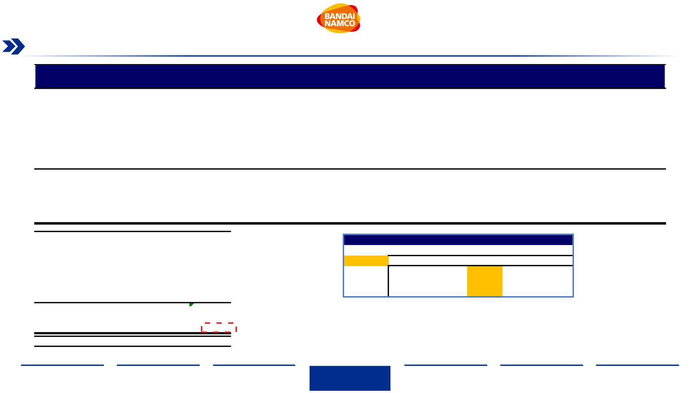
Equity Value based on Comparables
Based on our comparable companies' multiples, Games Workshop implied share price is ~ $90.4
Enterprise
Value
Gross
Margin
EBIT
Margin
EBITDA
Margin
Net Income
Margin
EV/Revenue
(FY 2021)
EV/EBIT
(FY 2021)
Company
Country
United States
United Kingdom
United States
Japan
EV/EBITDA
4.5x
JAKKS Pacific, Inc.
The Character Group plc
Mattel, Inc.
228.5
107.5
30.7%
28.9%
48.2%
38.1%
50.5%
44.8%
50.5%
28.9%
40.2%
41.4%
6.2%
8.0%
8.1%
8.5%
-1.0%
8.7%
16.5%
6.2%
6.7%
2.8%
16.5%
-1.0%
6.7%
6.4%
0.4x
0.6x
2.0x
2.1x
2.5x
1.3x
2.5x
0.4x
1.5x
1.6x
5.9x
7.0x
6.6x
10,745.9
15,036.5
16,125.9
88.4
13.7%
10.7%
13.7%
1.6%
17.1%
15.1%
18.0%
5.6%
14.4x
19.6x
18.4x
83.7x
83.7x
5.9x
11.5x
14.9x
13.9x
23.6x
23.6x
4.5x
BANDAI NAMCO Holdings Inc.
Hasbro, Inc.
Hornby PLC
High
United States
United Kingdom
13.7%
1.6%
18.0%
5.6%
Low
Mean
9.0%
12.1%
11.8%
24.8x
16.4x
12.5x
12.7x
Median
9.3%
EBITDA, 2021
228.8
12.7x
2,911.5
(66.7)
-
Sensitivity Analysis
Exit Multiple
EV/EBITDA multiple¹
Enterprise value
Total debt
5,487.2
11.7x
2,682.6
2,736.8
83.4
12.2x
2,797.0
2,851.2
86.9
12.7x
2,911.5
2,965.6
90.4
13.2x
3,025.9
3,080.1
93.9
13.7x
Preferred stock
EV
3,140.3
3,194.5
97.4
Non-controlling interest
Cash and cash equivalents
Equity value
Shares outstanding
Implied share price
-
Eqty Value
Price/share
120.8
2,965.6
32.8
• Comparable analysis can be easily manipulated, as the result is completely relative to the chosen peer group.
Therefore, we will utilize an additional valuation methodology, Discounted Cash Flow Model (DCF), and
allocate a weight to each Equity Value to come with a fair price.
90.4
(1) Median value of comparable companies table; to eliminate outliers.
Note: ¹Value in million USD $
Source: (Capital IQ, 2022), Own Team Analysis
Executive
Summary
Industry
Overview
Company
Analysis
Financial
Analysis
Acquisition
Feasibility
Alternative
Solution
Conclusion
48

Slide 49
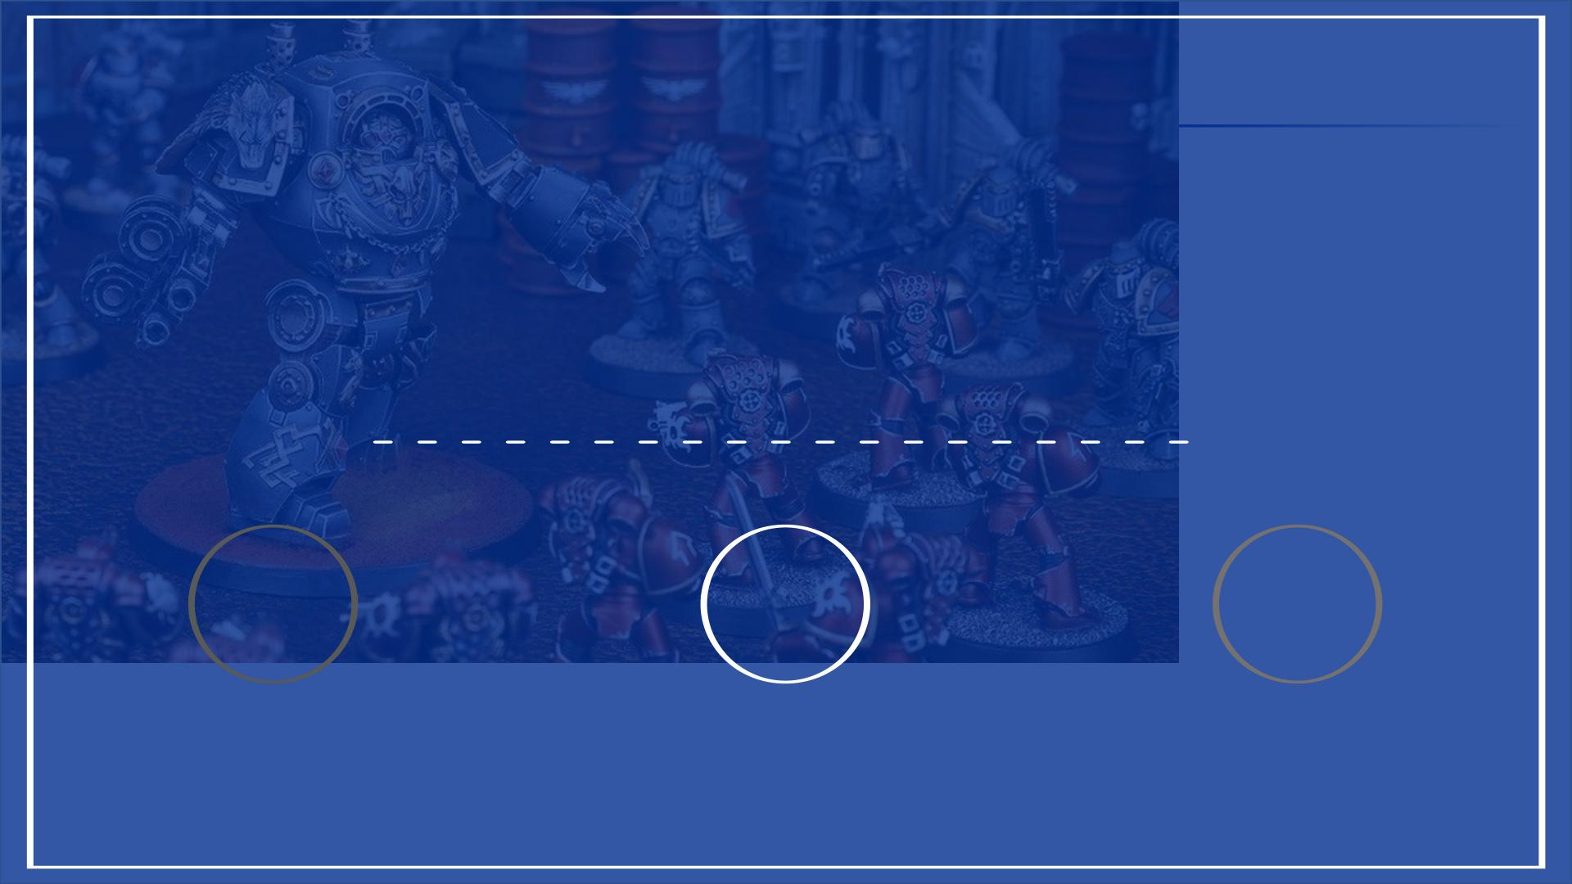
III. Financial Analysis
1 2 3
COMPARABLES
DISCOUNTED
CASH FLOW
SYNERGIES
49
49

Slide 50
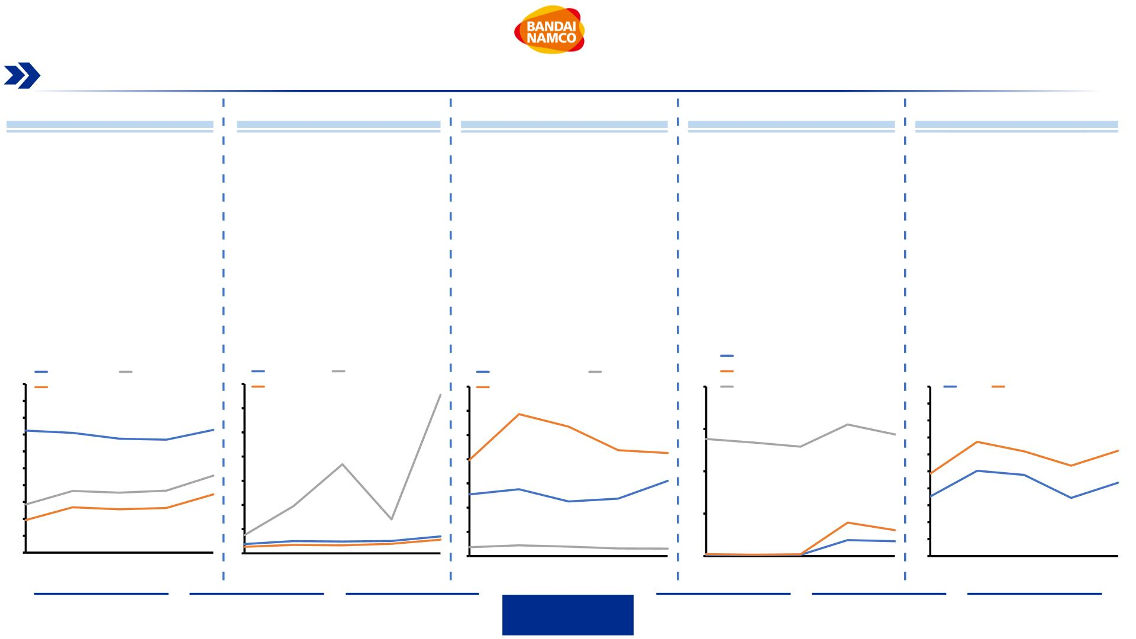
Games Workshop Ratio Analysis
Historic ratio trends of Games Workshop show robust trajectory in its operational performance and financial leverage
Profitability Ratios
Liquidity Ratios
Efficiency Ratios
Leverage Ratios
DuPont Analysis
•
Games
Workshops'
Gross
•
The company’s working capital
has flourished during the past
five years as it has increased
from 4x to 33x in 2021
•
Asset turnover has remained
stable over the last 5 years,
showing that the same ratio of
revenue is tied up in assets as in
’17
•
The Company’s strong cash
flow from operations has enable
the company to finance its
growth with little to non-leverage
as its historic Debt-to-EBITDA
multiple has been below 0.5x
•
Both ROE and ROA have been
increasing over the last 5 years,
with a visible decrease in 2020
due to COVID-19 pandemic.
Margin has ranged between
67% and 73%, which is above its
peer's
heightening
strong manufacturing capabilities
and ability to achieve economies
of scale
average
the
of
44.8%
companies
•
•
This has enabled the company to
triple its dividends from $30.4
mm in 2017 to $96.0 mm in 2021
•
ROE has increased by 13%
since 2017, attributable to the
•
The company has been able to
increase the rotation of its
inventory as it moved from
inventory turnover rate of 13x
in 2017 to 16x in 2021
•
The low debt ratio of GW would
allow for future projects to be
financed with leverage
leadership
and
strategy
The quick ratio and current
ratios have stayed consistently
stable over the last five years
direction change occurring in
•
The Company’s EBITDA, has
increased from 29% to 46%
which is also above its peer
average of 15%
2016
management’s
heightening
ability
the
to
generate returns on its invested
capital.
Debt ratio
100
Gross margin
Net margin
EBITDA margin
35
30
25
20
15
10
5
Current ratio
Quick ratio
Net Working Capital
33x
Inventory turnover
Asset turnover
Debt-to-EBITDA
Equity multiplier
35
30
25
20
Average collectibles
2.0
100
90
80
70
60
50
ROA
ROE
90
80
70
60
50
40
30
20
10
0
29x
27x
72%
71%
73%
1.6x
1.4x
68%
67%
22x
12x
1.5 1.4x
1.3x
1.3x
67%
50%
62%
48%
62%
43%
18x
20x
21x
53%
34%
46%
35%
16x 1.0
49%
37%
27%
36%
26%
37%
26%
15 13x
14x
11x
40 35%
30
29%
19%
10x
3x
7x
3x
10
5
0.5
0.4x
0.2x
4x
2x
4x
0.3x 20
0.2x
2x
2x
2x
3x
2x
1x
2x
2x
’17
2x
2x
2x
0.0x
’17
0.0x
’18
0.0x
’19
10
’17
’18
’19
’20
’21
0
’20
’21
0
0.0
0
’17
’18
’19
’18
’19
’20
’21
’20
’21
’17
’18
’19
’20
’21
Source: (Capital IQ, 2022), Own Team Analysis
Executive
Summary
Industry
Overview
Company
Analysis
Financial
Analysis
Acquisition
Feasibility
Alternative
Solution
Conclusion
50

Slide 51
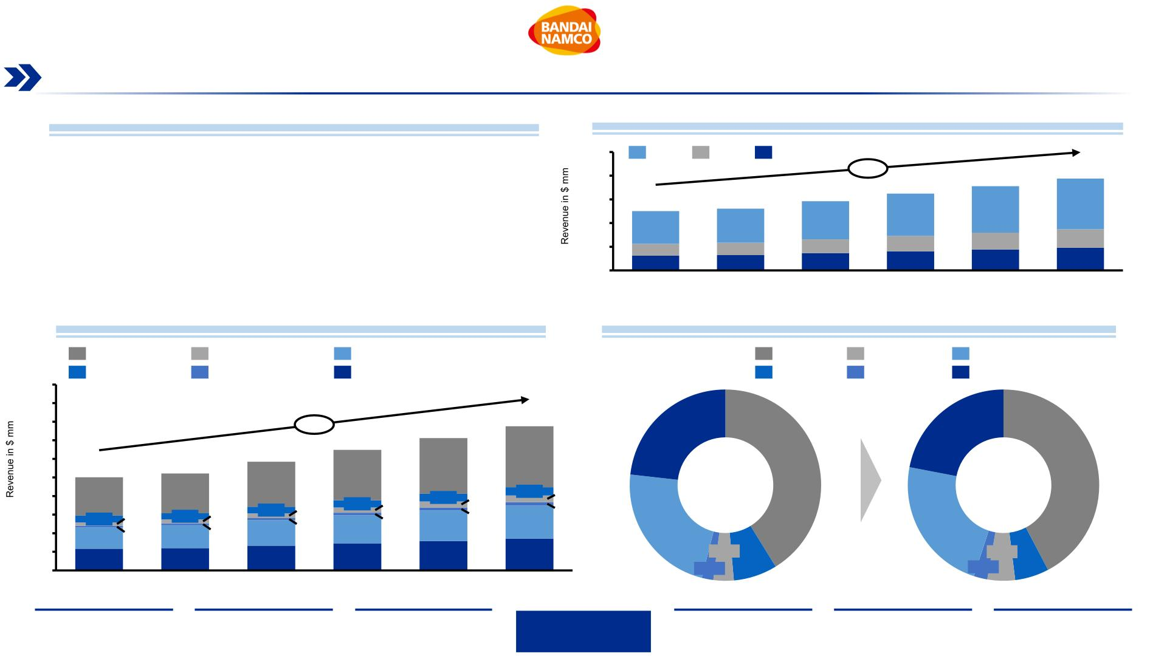
Revenue Projections & Breakdown
Games Workshop’s revenues are expected to grow at a CAGR of 9.1% from ’21-’26 with Asia as a key driver region
GW’s Standalone Revenue Projections – Assumptions (Base)
Revenue Projections by Channel ‘21-’26
•
•
•
Revenues for Games Workshop’s are expected to grow at a CAGR of 9.1% from 2021
to 2022 and reach $775.5 mm
1,000
800
600
400
200
0
Trade
Retail
Online
9.1%
712.0
392.6
775.5
427.6
The revenue mix by channel is expected to remain unchanged throughout the
forecasted period with Trade accounting for ~60% of sales
585.0
322.6
648.5
357.6
500.9
521.5
Asia, is expected to be the fastest growing geography with a CAGR of 16.1% from
2021 to 2022 followed by the Rest of World and North America with CAGR’s of 12.6%
and 9.7% respectively for the same period
276.2
287.6
100.3
124.4
104.4
129.5
117.1
145.3
129.9
161.1
142.6
176.8
155.3
192.6
2026E
•
Asia’s proportion of sales is expected to increase by 1.2% by 2026
2021
2022E
2023E
2024E
2025E
Revenue Projections by Geography ’21-’26
Geographical Revenue Mix ’21-’26
N. America 9.7%
AU & NZ 3.8%
Asia 16.1%
UK 9.3%
N. America
AU & NZ
Asia
Rest of World
UK
1,000
900
800
700
600
500
400
300
200
100
0
Rest of World 12.6%
Cont. Europe 7.9%
Cont Europe
9.1%
712.0
775.5
327.9
23.2%
22.0%
585.0
648.5
500.9
206.4
521.5
271.1
299.5
41.2%
42.3%
214.3
242.7
44.6
36.2
17.8
2021
2026E
35.8 25.0
38.8
28.7
14.2
41.7
32.5
16.0
37.0 17.2
9.8
32.9
21.2
10.6
12.4
164.5
178.4
22.8%
3.4%
23.0%
114.2
116.3
2021
122.5
136.5
150.5
120.0
132.6
145.2
157.8
170.5
7.4%
4.7%
2.3%
2.0%
5.8%
2022E
2023E
2024E
2025E
2026E
Note: ¹Value in million USD $
Source: (Capital IQ, 2022), Own Team Analysis
Executive
Summary
Industry
Overview
Company
Analysis
Financial
Analysis
Acquisition
Feasibility
Alternative
Solution
Conclusion
51

Slide 52

Games Workshop Standalone DCF – Base
Based on our Discounted Cash Flow model, Games Workshop implied share price is ~ $128.18
2017
202.2
2018
295.4
46.1%
99.1
(19.6)
8.8
2019
323.8
9.6%
103.6
(20.5)
11.4
2020
332.9
2.8%
111.4
(22.0)
23.3
2021
500.9
50.5%
215.7
(42.7)
28.6
2022
521.5
4.1%
227.2
(44.9)
29.8
2023
585.0
12.2%
260.7
(51.5)
33.5
2024
648.5
10.9%
295.4
(58.4)
37.1
2025
712.0
9.8%
327.9
(64.8)
40.7
2026 CAGR:'17-'21 CAGR:'21-'26
Revenue
Growth
EBIT
775.5
8.9%
25.5%
9.1%
50.0
(9.9)
7.8
361.1
(71.4)
44.3
44.1%
10.9%
Taxes
19.8%
Depreciation & amortization
Capital expenditure
Changes in working capital
Unlevered Free Cash Flow
Perpetuity
(16.3)
(3.8)
27.9
(28.7)
(6.0)
53.7
(28.3)
(8.7)
57.5
(30.2)
11.4
93.9
(42.3)
(25.7)
133.7
(45.9)
(1.3)
164.8
(51.5)
(4.2)
186.9
(57.1)
(4.2)
212.9
(62.7)
(4.2)
237.0
(68.3)
(4.2)
261.6
4,386.2
0.7
Discount factor
WACC
0.9
0.9
0.8
0.8
Present value of Free Cash Flows
155.4
166.2
178.4
187.3
3,463.0
Enterprise value
4,150.2
Games Workshop Sensitivity Analysis¹ (in $ mm)
WACC
6.1%
11.5x
0.1%
(66.7)
-
Exit multiple, EV/EBITDA 2026
Implied perpetuity growth
Total debt
Enterprise Value
Exit Multiple
Implied share price
Exit Multiple
11.5x
4,150.2
9.5x
10.5x
4,037.3
3,950.5
3,866.1
3,783.9
3,703.9
11.5x
4,335.2
4,241.5
4,150.2
4,061.5
3,975.1
12.5x
4,633.2
4,532.4
4,434.4
4,339.1
4,246.3
13.5x
128.2
9.5x
115.65
113.22
110.85
108.55
106.31
10.5x
124.74
122.09
119.52
117.01
114.58
12.5x
142.91
139.84
136.85
133.94
131.11
13.5x
Preferred stock
5.1% 3,739.3
5.6% 3,659.5
6.1% 3,581.9
6.6% 3,506.3
7.1% 3,432.8
4,931.2
4,823.4
4,718.6
4,616.6
4,517.4
5.1%
5.6%
6.1%
6.6%
7.1%
133.82
130.96
128.18
125.48
122.84
151.99
148.71
145.51
142.40
139.38
Non-controlling interest
Cash and cash equivalents
Equity value
Shares outstanding
Implied share price
-
120.8
4,204.4
32.8
$128.18
• Based on our sensitivity analysis, we have an implied price per share range of $106.31 - $151.99 with a sweet
spot of $128.18
Note: ¹Value in million USD $
Source: (Capital IQ, 2022), Own Team Analysis
Executive
Summary
Industry
Overview
Company
Analysis
Financial
Analysis
Acquisition
Feasibility
Alternative
Solution
Conclusion
52

Slide 53

WACC Calculation & Valuation Summary
Based on Games Workshop’s current capital structure, the Weighted Average Cost of Capital is 6.1%
WACC Calculations
Football Field – Implied Share Price Comparison¹
Target capital structure
Debt-to-total capitalization
Equity-to-total capitalization
19.3%
80.7%
Share Price ($)
50
75
100
125
150
175
200
• Our Base and Bull DCF analysis show
implied share price ranges above the
current share price, and within the 52
weeks range of $94.0 - $171.4
Cost-of-debt
52 Week
Market
High/Low
Cost-of-debt¹
Tax rate²
After-tax cost of debt
3.2%
19.8%
2.5%
94.0
171.4
Base DCF
Value at
9.5x-13.5x
Exit
EBITDA
Range
Cost of Equity
110.9
145.5
• Both ranges highlight the current
undervaluation of Games Workshops’
share price
Risk-free rate³
Market risk⁴
Market risk premium
Games Workshop's beta⁵
Size premium
1.9%
6.1%
4.2%
1.2
0.0%
6.9%
Bear DCF
Value at
9.5x-13.5x
Exit
EBITDA
Range
89.8
118.2
• The 52 weeks low lies at $94, which is
share price at the point of time of this
analysis, showing a trend impacted by
Cost of Equity
Bull DCF
Value at
9.5x-13.5x
Exit
EBITDA
Range
WACC
6.1%
130.8
171.7
current
market
conditions
and
(1) Damodaran NY Stern, Retail (general) 03/03/2022.
(2) Games Workshop average tax rate, 2017-2021.
(3) US Department of Treasury 10yr note 03/03/2022.
(4) US Equity Risk Premium, Damodaran NY Stearn.
(5) Capital IQ, Games Workshop 5-year beta, 03/03/2022.
Source: (Capital IQ, 2022), Own Team Analysis
geopolitical situation, that makes Games
Comparabl
e Value at
11.7x-13.7x
Exit
EBITDA
Range
Workshop an attractive buy
83.4
97.4
Share Price 03/03/22: $94.04
Note: WACC cost of equity values were chosen for the US target market as the valuation is performed in USD. The calculation of cost of equity with UK market standards, such as a Risk Premium of 4.6%, would slightly change the WACC overall.
Executive
Summary
Industry
Overview
Company
Analysis
Financial
Analysis
Acquisition
Feasibility
Alternative
Solution
Conclusion
53

Slide 54

DCF Scenario Analysis
Games Workshop implied price per share range between $104.01 for our Bear case and $151.22 for our Bull case scenario
Games Workshop Standalone Revenue Projections¹
Games Workshop Standalone EBIT Projections¹
1,200
Bear +7.6% CAGR
Base +9.1% CAGR
Bull +11.5% CAGR
600
Bear +6.3% CAGR
Base +10.9% CAGR
Bull +14.7% CAGR
1,100
1,000
900
800
700
600
500
400
300
200
100
0
+19.3%
862
550
500
450
400
350
300
250
200
150
100
50
+45.8%
427
+15.1%
+41.0%
380
+11.2%
+36.4%
335
+7.4%
712
673
775
775
723
+32.4%
290
+3.8%
648 691
622
+32.1%
328
361
522
514
585
568
610
295
293
501
533
248
261
246
270
216
227
219
188
2021
2022E
2023E
2024E
2025E
2026E
0
2021
2022E
2023E
2024E
2025E
2026E
BEAR CASE SCENARIO ASSUMPTIONS
BASE CASE SCENARIO ASSUMPTIONS
BULL CASE SCENARIO ASSUMPTIONS
•
•
•
•
•
Revenue: considers a 2.0% YoY revenue decrease from our
base scenario growth rate forecast
•
•
•
•
•
Revenue: forecasted on a linear regression model historic
data 2017-2021
•
•
•
•
•
Revenue: considers a 3.0% YoY revenue growth from our
base scenario growth rate forecast
COGS: increase by 3.0% in 2022 from our base scenario
and stabilizes at 29.8% in the years that follow
COGS: for 2022 is kept at the same historic level of 2021
and decreases by 0.5% until its cap of 26.27%
COGS: improves by 1.0% from historic level of 2021 and
decreases by 0.5% until its cap of 25.27%
SG&A as a % of sales increases to 27.5% in 2022 and
gradually improves to 24.5% as sales continue to grow
SG&A decreases by 0.5% YoY from historical level of 2021
as sales continue to grow
SG&A decreases by 2.0% YoY based on historic margin
reduction from 2020 and 2021
Capex: is maintained as historic average of 8.8% as
percentage of sales
Capex: is maintained as historic average of 8.8% as
percentage of sales
Capex: is increased to 9.8% as percentage of sales to
facilitate growth expansion
Price per share: $104.01
Price per share: $128.18
Price per share: $151.22
Note: ¹Value in million USD $
Source: (Capital IQ, 2022), Own Team Analysis
Executive
Summary
Industry
Overview
Company
Analysis
Financial
Analysis
Acquisition
Feasibility
Alternative
Solution
Conclusion
54

Slide 55

Games Workshop Valuation
Through a weighted average of the comparable and DCF methods, Games Workshop Price/share is valued to $116.9, resulting in an
undervaluation of ~24%
Enterprise Value to Equity Value Bridge¹
Games Workshop Historic Stock Price¹ (as of 03/03/2022)
4.000
3.833
121
67
$94.04
3.500
3.000
2.500
2.000
1.500
1.000
500
Discounted Cash Flow EV
$4,150.2
Shares
Outstanding:
32.8 mm
2.905
Discounted Cash Flow
We decided to assign a
70% weigh on our DCF
valuation methodology
DCF-Valuation
$128.18
Source: 1) Capital IQ, 03/03/2022.
Comparable
Valuation
$90.4
150
100
50
+24.3%
Implied stock
price:
$116.9
116.9
Comparable EV
$2,911.5
94.0
Based on our DCF for the base case scenario, Games
Workshop, is currently undervalued by ~24%, which makes
a possible acquisition bid very attractive, especially at
current market levels and Games Workshop’s stock
performance in the last year
873
Comparable
We decided to assign a 30%
weigh on our Comparable
companies
0
Enterprise
Value
Cash
Debt
Equity Value
0
Current Stock Price Implied Stock Price
Note: ¹Value in million USD $
Source: (Capital IQ, 2022), Own Team Analysis
Executive
Summary
Industry
Overview
Company
Analysis
Financial
Analysis
Acquisition
Feasibility
Alternative
Solution
Conclusion
55

Slide 56

III. Financial Analysis
1 2 3
COMPARABLES
DISCOUNTED
CASH FLOW
SYNERGIES
56
56

Slide 57

Generated Synergies Overview
Once integrated, we expect four key categories of synergies being generated from this acquisition, with additional revenues and
SG&A reductions as the main contributors
Possible Synergies
Reasoning
Duration
Impact
• Market expansion to the Asian Market (e.g. Japan),
drives majority of revenue growth
• Expansion of product portfolio increases brand
awareness, product diversity, customer loyalty and
reduces entry barriers
• Increase of revenue streams via larger customer
base and value chain
• Increase in revenue streams with expansion of
product portfolio
Revenue Generation
COGS Reduction
SG&A Reduction
0-5 years
• Wider IP utilization, e.g. in amusement parks, opens
new revenue streams
• Reduction of material costs
• Reduction of shipping and freight costs worldwide
• Increase in bargaining power with suppliers due to
Bandai Namco’s economies of scale
0-3 years
0-5 years
• Talent and studios for the creation of both physical
and digital content/products (toys, animes, video
games) based on the “Warhammer” IP can be shared
and leveraged
• Cut of overlap functions will reduce staffing costs
(e.g. leadership functions)
• Leveraging existing production facilities and
infrastructure overseas reduces potential investment
costs
Capital Expenditure
Benefits
• Reduction of capex costs for new production
facilities or others
1-5 years
• Leveraging local know-how and negotiation expertise
reduces barrier of entry
Bandai Namco would add multiple synergies, which amount to a NPV of $270.1 mm over the next 5 years, mostly from additional Revenue and SG&A reductions
Note: ¹Value in million USD $
Source: (Capital IQ, 2022), Own Team Analysis, (Willems, M., 2022)
Executive
Summary
Industry
Overview
Company
Analysis
Financial
Analysis
Acquisition
Feasibility
Alternative
Solution
Conclusion
57

Slide 58

Quantified Revenue & Market Share
Access to the Japanese market will generate a revenue spike in the acquisition year due to the exposure to Bandai Namco’s
domestic customer audience, followed by new product launches down the line
Synergies from increase in Revenues¹
Market Growth of Games Workshop in %
1,300
50%
45%
40%
35%
30%
25%
20%
15%
10%
5%
Synergy boosts
with additional 11%
+55%
+66%
1,200
1,100
1,000
900
800
700
600
500
400
300
200
100
0
YoY Generation %
Synergy
900
800
700
600
500
400
300
200
100
0
775
328
832
338
Revenue
North America
Continental Europe
UK
+23%
42
502
207
36
Australia & New Zealand
Asia
170
178
174
178
24
30
117
114
12
Rest of world
45
19
2026 Standalone 2026 Synergies
17
2021
37 10
36
45
18
77
648
712
775
522
585
4%
Asian Market Growth in %
2%
5%
5%
2025
5%
2026
Ratio Asia/Total
+36%
+170%
+111%
+348%
2022
2023
2024
0%
Asia Revenue
10
8
9.3%
80
70
60
50
40
30
20
10
0
77
Revenues
•
•
•
•
Accelerated revenue growth through market access
Major driver is Bandai’s distribution network in Japan
+100% sales spike in the acquisition year
NPV
6
4.7%
2026
36
4
3.4%
2021
$144.1mm
2
17
Asian market share growth by 170%
0
2026
2021
2026
2026 Synergies
Standalone Synergies
Standalone
Cannibalization is negligible as there is almost no overlap in the customer segments and markets between Bandai Namco and Games Workshop
Note: ¹Value in million USD $
More information in Appendix Slide 91: Revenue Cannibalization
Source: (Capital IQ, 2022), Own Team Analysis
Executive
Summary
Industry
Overview
Company
Analysis
Financial
Analysis
Acquisition
Feasibility
Alternative
Solution
Conclusion
58

Slide 59

Quantified Synergies – COGS, SG&A, CapEX
As an integrated company, Games Workshop will experience cost saving synergies amounting to a NPV of $126.0 mm
Synergies from reduction of COGS¹
250
Cumulative %
Savings
2
COGS
70%
60%
50%
40%
30%
20%
10%
0%
200
150
100
50
1
Costs of Goods Sold
NPV
4
3
2
•
Economies of scale via Bandai Namco’s
connections will achieve reduction of material
costs for GW
140
155
166
184
202
$11.0
mm
1%
1%
2%
2024
0
1%
1%
2026
2022
2023
2025
Synergies from reduction of SG&A¹
250
200
150
100
50
Cumulative %
Savings
11
SG&A
70%
60%
50%
40%
30%
20%
10%
0%
NPV
Sales, General & Administrative Expenses
5
19
18
38
32%
•
Gradually greater synergy and saving due to
122^{9%}
combined
resource
allocation
and
$100.3
mm
16%
administrative workforce overlap
117 4%
123
121_{15%}
116
0
2022
2023
2024
2025
2026
Synergies of CapEX reduction¹
250
200
150
100
50
Cumulative %
Savings
CapEX
25%
20%
15%
10%
5%
NPV
CapEX
•
5% of Bandai’s yearly strategic budget into
CapEX investments – production capacities in JP
8%
3
6%
$14.7
mm
5%
3
59
3
65
•
GW annual savings of ~$3.0mm
3
3
5%
4%
0
42
48
54
0%
Note: ¹Value in million USD $
2022
2023
2024
2025
2026
Source: (Capital IQ, 2022), Own Team Analysis
Executive
Summary
Industry
Overview
Company
Analysis
Financial
Analysis
Acquisition
Feasibility
Alternative
Solution
Conclusion
59

Slide 60

Games Workshop Synergy DCF – Base
Based on our Discounted Cash Flow synergy model, Games Workshop’s implied share price is ~ $163.05
2017
202.2
2018
295.4
46.1%
99.1
(19.6)
8.8
2019
323.8
9.6%
103.6
(20.5)
11.4
2020
332.9
2.8%
111.4
(22.0)
23.3
2021
500.9
50.5%
215.7
(42.7)
28.6
2022
534.7
6.7%
246.3
(48.7)
30.6
2023
611.6
14.4%
300.1
(59.3)
35.0
2024
684.3
11.9%
356.2
(70.4)
39.1
2025
757.1
10.6%
409.3
(80.9)
43.3
2026 CAGR:'17-'21 CAGR:'21-'26
Revenue
832.0
9.9%
25.5%
10.7%
Growth
EBIT
50.0
(9.9)
7.8
466.4
(92.2)
47.6
44.1%
16.7%
Taxes
19.8%
Depreciation & amortization
Capital expenditure
Changes in working capital
Unlevered Free Cash Flow
Perpetuity
(16.3)
(3.8)
27.9
(28.7)
(6.0)
53.7
(28.3)
(8.7)
57.5
(30.2)
11.4
93.9
(42.3)
(25.7)
133.7
(42.4)
(2.2)
183.5
(48.0)
(5.0)
222.7
(53.6)
(4.8)
266.6
(59.2)
(4.8)
307.7
(64.8)
(4.9)
352.1
5,614.6
0.7
Discount factor
WACC
0.9
0.9
0.8
0.8
Present value of Free Cash Flows
173.1
198.1
223.7
243.6
4,455.5
Enterprise value
5,294.0
6.0%
11.5x
-0.2%
(66.7)
-
Games Workshop Sensitivity Analysis¹ (in mm $)
WACC
Exit multiple, EV/EBITDA 2026
Implied perpetuity growth
Total debt
Enterprise Value
Exit Multiple
Implied share price
Exit Multiple
5,294.0
9.5x
10.5x
5,149.2
5,037.8
4,929.4
4,823.9
4,721.3
11.5x
5,531.5
5,411.1
5,294.0
5,180.0
5,069.2
12.5x
5,913.8
5,784.4
5,658.5
5,536.1
5,417.0
13.5x
163.1
9.5x
146.99
143.86
140.82
137.87
134.99
10.5x
158.64
155.24
151.94
148.72
145.59
11.5x
170.29
166.62
163.05
159.58
156.20
12.5x
181.95
178.00
174.17
170.44
166.80
13.5x
193.60
189.39
185.28
181.29
177.41
Preferred stock
5.0% 4,767.0
5.5% 4,664.5
6.0% 4,564.8
6.5% 4,467.8
7.0% 4,373.5
6,296.0
6,157.7
6,023.1
5,892.2
5,764.9
5.0%
5.5%
6.0%
6.5%
7.0%
Non-controlling interest
Cash and cash equivalents
Equity value
Shares outstanding
Implied share price
-
120.8
5,348.2
32.8
$163.05
•
Based on our sensitivity analysis, we have an implied price per share range of $134.99 - $193.60 with a sweet spot of $163.05
Note: ¹Value in million USD $
Source: (Capital IQ, 2022), Own Team Analysis
Executive
Summary
Industry
Overview
Company
Analysis
Financial
Analysis
Acquisition
Feasibility
Alternative
Solution
Conclusion
60

Slide 61

Synergy DCF Valuation Summary
Based on the new capital structure, the Weighted Average Cost of Capital is 6.0%
Synergy DCF – WACC Calculation
Football Field Overview – Share Price²
WACC Calculations
Share Price ($)
• Our Base and Bull DCF analysis show
implied share price ranges above the
current share price, and within the 52-week
range of $94.0 - $171.4
Target capital structure
Debt-to-total capitalization
Equity-to-total capitalization
50
75
100 125 150 175 200 225 250
47.8%
52.2%
Cost-of-debt
Cost-of-debt¹
Tax rate²
52 Week
Market
High/Low
94.0
171.4
3.2%
19.8%
2.5%
• All synergy DCF results show that right
now is the perfect time for an
acquisition, as GW is not only
undervalued by the current market, but
even more value can be generated with our
forecasted synergies.
After-tax cost of debt
Cost of Equity
Risk-free rate³
Market risk⁴
Market risk premium
Games Workshop's beta⁵
Unlevered beta
Relevered beta
Size premium
Base
1.9%
6.1%
4.2%
1.2
1.0
1.7
Synergy
DCF Value
at 9.5x-
13.5x Exit
EBITDA
Range
140.8
185.3
Bear
Synergy
DCF Value
at 9.5x-
13.5x Exit
EBITDA
Range
• The Bear case lowest value of $115.8 is
only slightly lower than our implied
standalone price per share, which shows
that even in the worst case and without
0.0%
9.2%
115.8
152.5
Cost of Equity
WACC
6.0%
(1) Damodaran NY Stern, Retail (general) 03/03/2022.
(2) Games Workshop average tax rate, 2017-2021.
(3) US Department of Treasury 10yr note 03/03/2022.
(4) S&P 500 market returns since 1957.
Bull
Synergy
DCF Value
at 9.5x-
13.5x Exit
EBITDA
Range
171.4
225.1
significant
synergies,
GW
is
still
(5) Capital IQ 5-year 2022, 03/03/2022.
undervalued.
Share Price 03/03/22: $94.04
Share Price 03/03/22: $94.04
Note: ¹Value in million $: New target capital structure stemming from acquisition financing structure outlined in slide #74
Source: (Capital IQ, 2022), Own Team Analysis
Executive
Summary
Industry
Overview
Company
Analysis
Financial
Analysis
Acquisition
Feasibility
Alternative
Solution
Conclusion
61

Slide 62

Games Workshop Synergy Valuation
Through our synergy DCF valuation, GW’s potential price/share is valued to $163.05, which implies an undervaluation of ~73%
Synergy Enterprise Value to Equity Value Bridge¹
Games Workshop Historic Stock Price¹ (s of 03/03/2022)
•
The DCF synergy analysis results in a higher equity value of
Games Workshop than our standalone value, leading to an
undervaluation of the current stock price of 73.4%
$94.04
5.500
5.000
4.500
4.000
3.500
3.000
2.500
2.000
1.500
1.000
500
5.294
121
67
5.348
Shares
Outstanding:
$32.8 mm
Source: 1) Capital IQ, 03/03/2022.
200
+73.4%
163
Based on our DCF for the base case synergy
scenario, Games Workshop is currently undervalued by
~73%, which makes a possible acquisition bid even
more attractive to the standalone case, especially
considering the potential additional upsides in
synergies that can be achieved in our bull scenario
150
100
50
Implied synergy
stock price:
$163.05
94
0
Enterprise
Value
Cash
Debt
Equity
Value
0
Current Stock Price
Implied Stock Price
Note: ¹Value in million USD $
Source: (Capital IQ, 2022), Own Team Analysis
Executive
Summary
Industry
Overview
Company
Analysis
Financial
Analysis
Acquisition
Feasibility
Alternative
Solution
Conclusion
62

Slide 63

Synergy Scenario Analysis
In either of the three scenarios, substantial revenue growth can be expected given that synergies are properly fostered, with
CAGR’s ranging from 7.8% in the Bear to 14.2% in the Bull case
Games Workshop Synergy Revenue Projections¹
Games Workshop Synergies EBIT Projections¹
1,400
1,200
1,000
800
Bear +7.8% CAGR
Base +10.7% CAGR
Bull +14.2% CAGR
800
Bear +12.2% CAGR
Base +16.7% CAGR
Bull +21.2% CAGR
+33.1%
973
700
600
500
400
300
200
100
0
+47.0%
565
+28.7%
867
+44.1%
486
+23.1%
+40.0%
413
+16.0%
832
+34.0%
343
466
+7.8%
684
620
763
757
731
+25.9%
409
535
612 659
569
674
356
337
384
600
501
514
554
269
300
295
216
214
246
256
400
200
0
2021
2022E
2023E
2024E
2025E
2026E
2021
2022E
2023E
2024E
2025E
2026E
BEAR CASE SCENARIO ASSUMTPIONS
BASE CASE SCENARIO ASSUMPTIONS
BULL CASE SCENARIO ASSUMPTIONS
•
•
•
•
•
Revenue: Expected to grow at a CAGR of 7.8% a marginal
increase from standalone bear scenario
•
•
•
•
•
Revenues: Expected to grow at a CAGR of 10.7% mainly
driven by synergies in Asia
•
•
•
•
•
Revenue: Expected to grow at a CAGR of 14.2% mainly
driven by synergies in Asia and rest of the world
COGS: Decreases by 0.5% from its 2021 due to economies
of scale in the purchase of raw materials: cap-rate of 24.3%
COGS: Decreases by 1.0% from its 2021 due to economies
of scale in the purchase of raw materials: cap-rate of 24.3%
COGS: Decreases by 1.5 % from its 2021 due to economies
of scale in the purchase of raw materials: cap-rate of 24.3%
SG&A: Increases by 2.0% from 2022 due to high integration
cost and minimal elimination of redundant positions
SG&A: Decreases by 2.0% from 2022 due to redundant
positions
SG&A: Decreases by 4.0% form 2022 due to redundant
positions and synergies in R&D.
CapEx: Maintained at 7.9% as % of sales given possible
utilization of facilities
CapEx: Maintained at 7.9% as % of sales given possible
utilization of facilities
CapEx: Maintained at 7.3% as % of sales given a higher
utilization of common facilities
Price per share: $134.15
Price per share: $163.05
Price per share: $198.24
Note: ¹Value in million USD $
Source: (Capital IQ, 2022), Own Team Analysis
Executive
Summary
Industry
Overview
Company
Analysis
Financial
Analysis
Acquisition
Feasibility
Alternative
Solution
Conclusion
63

Slide 64

Games Workshop Purchase Price Analysis
Our concluded purchase maximum purchase price is $4,103 mm, consisting of our DCF standalone Equity Value and created
synergies, resulting in an acquisition premium range of 29.6% to current market value
Purchase Price Valuation for Games Workshop¹
Acquisition Premium based on Industry
•
Our combined weighted comparable and DCF analysis shows an equity value of $3,833 mm for
Games Workshop
Synergy analysis totals in added value of $270 mm, stemming mostly from SG&A cost savings
and novel revenue streams
•
Recent M&A activity has seen IP growth as a key driver, especially in the Video
Game/Entertainment Industry (e.g. Microsoft acquisition of Activision Blizzard for
franchises such as Warcraft)
•
•
BCG reported a long-term industry M&A deal average of 30.6% in 2018
Estimated Value of
Games Workshop
Maximum
Purchase Price
Perpetuity
Synergy Value
Details
•
Games Workshop miniature business
does not match any specific industry,
but recent M&A activity in the Toy &
Hobby industry indicates premia of
30% for equally sized transactions
(e.g. Hasbro acquisition of eOne for
$3.8 bn):
7,500
7,000
6,500
6,000
5,500
5,000
4,500
4,000
3,500
3,000
2,500
2,000
1,500
1,000
500
+30.4%
• The total range for the
acquisition premium of GW
lies between the current
Market Cap of $3,085 mm
and our standalone equity
value of $3,833 mm + our
calculated impact of
5,348.2
+24.3%
+33.0%
1,245.3
$3.8 bn
3,832.8
4,102.9
270.1
3,084.5
748.3
synergies, $270.1 mm,
totaling $4,103 mm.
• The difference of $1,018
mm represents a possible
premium range of 33%,
leaving ample room for
premium negotiations
•The future equity value in
perpetuity based off our
forecasted synergies,
Summary
•
The price for Games Workshop lies at our DCF equity value combined with the possible
synergies of $262 mm, leading to our maximum suggested purchase price of…
Max. Price: $4,103 mm
0
Current
Current
Weighted Created Maximum Additional Perpetuity
Market Cap Undervalue Equity
Value (DCF
Synergies Purchase
Price
Future
Synergy
Value
Equity
Value
(Synergy
DCF)
calculated at $5,348 mm,
shows the possible value
created from this transaction
…representing a 33% premium just slightly above the industry average of 30.6%.
Additionally, a 1% transaction fee has to be expected on top of the given value, increasing
the total transaction value.
+ Comps.)
The calculated value of Games Workshop, both standalone and with synergies, results in a possible acquisition premium range of up to $1,018 mm.
Note: ¹Value in million USD $
Sources: (Capital IQ, 2022), Own Team Analysis, (BCG Global. 2022), (Ashton, M., 2019)
Executive
Summary
Industry
Overview
Company
Analysis
Financial
Analysis
Acquisition
Feasibility
Alternative
Solution
Conclusion
64

Slide 65

IV. Acquisition Feasibility
Identifying acquisition risks and impact
65

Slide 66

Acquisition Risks (1/3)
Four outlined high risks could impact the feasibility and success of the acquisition, in particular the way the IP is controlled and
managed post integration
Description
Area of concern
Threat assessment
Risk Level
Intellectual
Property
Direction
•
•
GW has zero tolerance within its IP
protection: its mission of “only licensing good
things for the brand” could not in line with
what Bandai Namco has in mind for the
brand
•
•
•
•
Intellectual Property and licenses have a
strong protection by the owner companies
since they generate high profit
•
•
Licenses and IP would be owned by the
buyer company
GW and Bandai Namco have different culture
in the design of the stores, in fact, GW focus
on the Warhammer hobby offering only
starter sets, new release product and
appropriate extended range but not all the
products
The store design define how the store has to
be set in order to promote the different
products
The companies have different culture in the
design of their store according to their
products and customers
Store Design
Customer
Perception
The acquired company can lose customers
loyalty due to the acquisition, as it imposes
“change” on the brand
•
•
Customers may be afraid that the acquisition
will change the products produce by the
company
•
•
Games Workshop may suffer a loss of
customers since they may lose faith in the
company value due to acquisition
Foreign exchange fluctuations increase the
risk of losing money during transaction
overseas
Fluctuations in currencies impact both at the
point of acquisition as well as future
Loss of company value due to unfavourable
currency devaluations in either currency
(Pounds Sterling, Yen)
FX Risk
transactions
investments)
(e.g.,
future
revenue,
Sources: (Global Compliance News, 2022), Integrated Report (Bandai Namco, 2021), Annual Report (Games Workshop, 2021)
Executive
Summary
Industry
Overview
Company
Analysis
Financial
Analysis
Acquisition
Feasibility
Alternative
Solution
Conclusion
66

Slide 67

Acquisition Risks (2/3)
Medium risks needs to be addressed by BN but are not imminent and could impact the acquisition feasibility in certain scenarios,
with manufacturing and product price/quality change being of higher concern
Description
Area of concern
Threat assessment
Risk Level
•
•
The companies have different Leadership
Structure which have to be integrated in a
single structure
Many small shareholders – many parties to
convince for a share buy-out
•
BN’s Corporate Philosophy respects the
independence and autonomy of affiliated
companies, aiming to boost the corporate
value of the entire Group by maximizing the
identity of these companies and generate
new synergies
Ownership/
Leadership
Structure
•
The acquired company’s leadership structure
might change based on the buyer company’s
goals, due to possible overlap in functions
•
•
•
Acquisition of differing companies in term of
cultures and values, can potentially generate
uncertainty among the employees, resulting
in a reduction of productivity and a failure in
integration
•
•
Companies could face difficulties while
engaging in the attempt to align their different
employees due to differing cultures
•
Bandai Namco’s new purpose starting April
2022 is to connect all employees worldwide
and work together to create new things
Layoffs
New technologies like 3D printing could
affect GW’s companies' production structure
especially in the plastic toy/figures
production
3D printer market is growing fast, and it can
affect the companies which operate
•
Games Workshop production can be
impacted by 3D printing, since users can
replicate figure designs from home
Manufacturing
manufacturing
through
injection
moulding process
•
•
With the niche GW R&D intact, Bandai
Namco can keep both the high revenue
streams and quality perception of the GW
products
GW price correction in March 7th mitigates
eventual price adaptation from BN
Product
Price/Quality
Change
Change of product price structure after
acquisition could impact current customer
perception of product quality and satisfaction
•
Loss of brand strength and loyal customer
base
Sources: (Corporate Philosophy (BANDAI NAMCO Holdings Inc. 2022)), (Romano, S., 2022), Integrated Report (Bandai Namco, 2021), Annual Report (Games Workshop, 2021)
Executive
Summary
Industry
Overview
Company
Analysis
Financial
Analysis
Acquisition
Feasibility
Alternative
Solution
Conclusion
67

Slide 68

Acquisition Risks (3/3)
Low potential issue risk catalogue with entries to be aware of and avoid unnecessary additional cost, making the acquisition more feasible
Description
Area of concern
Threat assessment
Risk Level
Process of
Auction
(Competitors)
•
•
If approaching Games Workshop in an
unstructured and non-sensitive way, the
proposal could become public prematurely
•
•
Costly transaction due to several competitors
are interested into the acquisition
Not full exclusivity to the acquisition deal =
bidding war
•
With several bidders, the acquisition scenario
could become more costly for BN and make
the deal less cost-effective
Antitrust
regulation
The Antimonopoly Act forbids M&As which
result in a restraint of competition or tend to
create a monopoly
•
The Toy & Entertainment market as well as
the Digital Video Games are concentrated
markets
•
•
The markets would not become monopolized
by the acquisition of GW by Bandai Namco,
because there are several major players
Cannabaliz-
ation
•
•
A company products can cause a loss of
sales in the other company resulting in a not
increase in the existing product market share
Games Workshop and Bandai Namco
compete in different market and with different
products, so there is minimal risk of
cannibalization across both product portfolios
•
•
The companies have different products
competing in different markets
Purchase Price
Overvaluation
Huge drop of share price the last year, and
mitigating price setting, might make GW
shareholders reluctant & more resistant to
sell at current stock levels.
A "fair deal" for acquiring GW can become
pricier than at current share price ($94.04),
and the right premia needs to be negotiated
•
The range for the premium between a "good
deal" (under DCF valuated price) and "fair
deal" for GW is broad, hence a negotiation
range is available for a win-win situation
Sources: (Corporate Philosophy (BANDAI NAMCO Holdings Inc. 2022)), (Romano, S., 2022), Integrated Report (Bandai Namco, 2021), Annual Report (Games Workshop, 2021)
Executive
Summary
Industry
Overview
Company
Analysis
Financial
Analysis
Acquisition
Feasibility
Alternative
Solution
Conclusion
68

Slide 69

Pre-Acquisition Challenges
No foreseeable anti-trust issues have been identified, making acquisition negotiations possible, however the fragmented
shareholder structure could be an obstacle that a full buyout could outmaneuver
Employee benefits and acquisition defense mechanism
Games Workshop Shareholders
Antitrust Regulations:
Herfindahl- Hirschman Index
Ownership by acquisition would be quite difficult for the following
reasons:
10%
Baillie Gifford
BlackRock
Schroders
abrdn
8%
6%
5%
5%
4% 4%
• Games Workshop stock is distributed across multiple
institutional and individual investors, with even the largest
owner, the Baillie Gifford, holding just about 10%
• The toy market is considered
moderately concentrated with a score
of 2470 for the five biggest players
59%
Vanguard
• This leaves a lot of parties to be negotiated with, many of whom
Sandford Deland
JP Morgan
might be unwilling to sell
• Post acquisition score: 2488
Other smaller owners
(incl. Employees)
• Since the difference pre and post
acquisition is lower than 200, and it
doesn’t occur above the 2500 mark,
this operation doesn’t threaten the
power balance
• This situation is further enhanced as of May 2021, when Games
Workshop implemented a share saving program for its
employees, diluting more shares into the market
Shareholder Structure:
•
•
Not even with the top 7 shareholders on
board combined, there would sufficient votes
to push through with an acquisition, making a
full buyout more feasible
Games Workshop might have foreseen
potential acquisition scenarios and hedged
against it
• The move is promoted as a bonus to its hard-working staff, but is
more commonly known as a tool for:
• HR retention mitigation (Great Recession following
COVID)
• A defense mechanism to make takeovers more costly.
• Games Workshop has stated that they are neither interested in
buying any company, nor disposing any part of their existing
structure, indicating that they are protective and content with the
current business structure
• Recent similar M&A activity in the Toys
& Hobby industry has been approved
Layoffs:
• Reduced management capacity is necessary
after acquisition. Further SG&A savings to be
expected thus, administrative layoffs may be
expected
May 2021:
• Process of Auction:
Games Workshop hands every
worker £5000 in share bonuses
“[…]in recognition of our staff’s
contribution to these results”
• Avoidance of premature disclosure of deal
proposal to avoid attraction of further
competitors interested in GW
There are no foreseeable antitrust issues with
the acquisition of Games Workshop
Sources: (The Guardian. 2022), (Evans, G., 2022), (Annual Report (Games Workshop, 2021)) , (Investopedia, 2022), (Zahn, J., 2019), (The United States Department of Justice, 2018.), Own Team Analysis (HHI)
Executive
Summary
Industry
Overview
Company
Analysis
Financial
Analysis
Acquisition
Feasibility
Alternative
Solution
Conclusion
69

Slide 70

Post-Acquisition Challenges
With their long-standing franchise Games Workshop is increasingly protective about their IP, showing strong governance by its legal
department, which could pose a risk for the future vision of Bandai Namco
Games Workshop Culture
Games Workshop Manufacture
Games Workshop strategy focus on two main aspect:
• The introduction of new technologies like 3D printers could impact Games
I. IP Protection: the company has a reputation for zero tolerance for
its IP protection both with its fan and other companies. Licensing
deal generate high profit, but the company mission is of “only
licensing good things for the brand”. The zero-tolerance policy
set by Games Workshop in respect of infringement of our
intellectual property rights includes:
Workshop production structure. In fact, the 3D printer market is growing, and it
forecast to growth at a compound annual growth rate of 17%.
• This new technology can affect the companies that use an injection molding
process, as it allows for faster and larger production capabilities, which can
either increase the risk that the products are illegally re-cast or scanned, or
requires the company to change its production structure
a. Impossibility to create games, app, fan films or animations
based on its setting and characters
Culture:
Product Price/Quality Change
•
All current GW stores worldwide
have a section for Warhammer,
With the acquisition the store will
be re-design according to Bandai
structure
GW mission for IP won’t be kept
the same, and has to be aligned
with BN’s vision
b. Unauthorized use of trademarks
• Games Workshops products are seen as
premium high-quality product lines and are
reinforced by high pricings to support the
customer perception. The regulation of price of
5-20% across all product segments on March
7th, was announced to cover further shipping
and overhead expenditure, but follows GW
continuous price hikes to maintain the price
and quality balance
• With an acquisition and a change of product
pricing and change of quality plastic and figure
detail, the loyalty of fan- and customer base
can be compromised
•
c. Impossibility to replicate, imitate or sold GW products
d. Publication, books and materials are protected by copyright
e. products cannot illegally re-cast or scanned and distributed
•
II. Store design: the stores focus on the Warhammer hobby offering
only starter sets, new release product and appropriate extended
range but not all the products. The culture of GW for the design of
the store is to create store with an area for Warhammer
Manufacture:
New technologies like 3D printing can
•
have an impact on the company
production, especially for the figures
since they can produce the product in a
shorter time
Product Price:
• Loss of being a premium good
Sources: Intellectual Property Guidelines (Games Workshop, 2022), Annual Report (Games Workshop, 2021), (The Conversation. 2022), (Games Workshop, 2022)
Executive
Summary
Industry
Overview
Company
Analysis
Financial
Analysis
Acquisition
Feasibility
Alternative
Solution
Conclusion
70

Slide 71

Foreign Exchange Risk Overview
Lending the required sources for the transaction in Games Workshop’s local currency will minimize the FX risk for a full buyout acquisition
Bandai Namco
Games Workshop
• Bandai Namco principal currency is Yen, but the subsidiaries business transact in
different currencies (Yen, Euro and US Dollar), which exposes the company to
foreign exchange risk
• Games Workshop principal currency is Sterling, but the Group's business is
transacted in Sterling, Euro and US Dollar which expose the company to the
foreign exchange risk
• The company consolidated statements are expressed in Yen, but for the end of
March 2021 the statements were converted in US Dollar applying an exchange
rate of 110.71 = 1$. Converting the currencies can often cause unalignment
between the same financial statement because they has different exchange rates
• The risk is mainly in transactional exposure rising from the future sales and
purchases or investment in a different currency than the functional one
• The company prevent the foreign currency volatility through the application of the
hedge accounting model and applying the follow sensitivity assumption to
movements in foreign exchange rates on US and Euro
• To leverage the foreign exchange risk the company uses a hedge accounting
method:
• Since Bandai Namco and Games Workshop principal currencies are different, the acquisition can face the Foreign Exchange risk which can has a potentially an
impact on valuations of the deal
• We assume Games Workshop’s equity holders would like to be paid in Pounds Sterling. To mitigate any currency fluctuation, Bandai Namco would issue a bond
in the London Stock Exchange to raise the funds necessary to finance the transaction
• Interest and amortization expenses would be covered with the cash flow generated by Bandai Namco’s new operations unit (Games Workshop)
Sources: Annual Report (Games Workshop, 2021), Integrated Report (Bandai Namco, 2021), (Axial. 2022), (InsideBIGDATA. 2022)
Executive
Summary
Industry
Overview
Company
Analysis
Financial
Analysis
Acquisition
Feasibility
Alternative
Solution
Conclusion
71

Slide 72

Recent Investments of Bandai Namco
Bandai Namco’s strategic moves highlight their momentum to position themselves in the entertainment space, with a track record
that shows ample freedom for the acquired companies to continue operating under their brand names
Bandai Namco’s most recent activity
Bandai Namco Acquisitions by Industry
• Major industries Bandai Namco has been investing are:
• Video Games & Metaverse
• Toy distribution and retail
• IP creation
IP-Axis
Strategy
The acquisition of Sotsu for $316
3.5
3
mm is the largest disclosed
transaction of Bandai Namco in
the last five years
$316 mm
• Acquired companies are located across the globe
• Movements show clear pattern that aligns with Bandai
Namco’s midterm strategic goals
IP
creation
• Further acquisitions to acquire market share and IP
foothold are to be expected and feasible with their position
2.5
2
Metaverse
1.63x
Post-Acquisition Integration Trends
• From all the recent acquisitions made by Bandai Namco, these companies
have been incorporated into business units, but kept their names and
business idendity:
$194 mm
0.0095x
1.5
1
Since Bandai’s acquisition of
Namco in 2006, they have not
acquired another company for
over $1 bn
• There has been one company that was bought and dissolved:
• On April 1st 2022, 29 years after their acquisition Bandai Namco has decided
to change the name of the company Sunrise:
Bandai
Namco
Filmworks
0.5
0
$3 mm
Games Workshop, with its long-standing legacy and brand, would
potentially be able to continue operations in order to avoid
damaging the brand and customer perception
2016
2017
2018
2019
2020
2021
2022
Sources: (Main Group Companies (BANDAI NAMCO Holdings Inc. 2022)), (Takahashi, D., 2022.), (Marketscreener. 2022), (Anime News Network. 2022) , (Kotaku. 2022.), (Crunchyroll. 2022), (Integrated Report (Bandai Namco, 2021))
Executive
Summary
Industry
Overview
Company
Analysis
Financial
Analysis
Acquisition
Feasibility
Alternative
Solution
Conclusion
72

Slide 73

Accelerating Bandai Namco’s Strategic Goals
The acquisition of Games Workshop will enable Bandai Namco to shift its revenue mix closer towards the 35% overseas sales target
Bandai Namco’s Strategic Midterm Plan
Bandai Namco Forecasted Geographic expansion through the acquisition (Base Case)
•
Bandai Namco’s main strategic goals for the next 3 to 5 years plan are to:
Europe’21
7%
•
•
Strengthen the company’s IP
+45.4%
+31.7%
Increase the company’s overseas (Japan) sales from ~22% to 35%
Europe’26E
11%
•
•
The acquisition of Games Workshop would not only strengthen Bandai Namco’s
IP creation but also exponentiate the company’s efforts to increase overseas
sales
Over the last couple of years large conglomerates like Microsoft and Sony have
strongly pushed, through mammoth IP driven acquisitions, to strengthen their
position in the Digital & Entertainment space
America’21
8%
America 2026E
10%
Percentage of
overseas sales in
2026
•
e.g. Microsoft $68.7 bn acquisition announcement of Activision
Blizzard’s (known for IPs like Warcraft)
Asia, ex JPN’21
Asia, ex JPN’26E
7%
6%
~28%
Bandai Namco’s Revenue Growth by Region Post-acquisition
-9.0%
15,000
10,000
5,000
0
Europe +14.4%
America +12.2%
Asia, ex JPN +4.2%
Japan +4.5%
Rest of World
Rest of World’21 0%
+6.2%
9,048.9
N/A
10.8%
Rest of World’26E
1%
6,699.0
7.9%
7.4%
7.0%
10.4%
6.4%
77.7%
71.8%
Japan’21
78%
-7.6%
0.0%
2021
0.7%
Japan’26E
72%
2026E
Sources: (Integrated Report (Bandai Namco, 2021)), (AppsFlyer. 2022), (Capital IQ, 2022), Own Team Analysis
Executive
Summary
Industry
Overview
Company
Analysis
Financial
Analysis
Acquisition
Feasibility
Alternative
Solution
Conclusion
73

Slide 74

Sources & Uses to Finance the Transaction
Given BN’s strong cash flow generation, ~76% of the transaction cost should be financed with debt to reach a minimum IRR of ~10%
Levering Bandai Namco’s Cash Generation Capabilities
Bandai Namco’s Change in Cash¹
•
•
By fiscal year 2021, Bandai Namco, reported $ 1,847.4 mm in cash & cash equivalents and $
1,265.0 mm in long-term investments bringing the Company’s total cash to $ 3,112.4 mm
Cash & Cash
Equivalents
Long-term
Investments
The company reported $1,009.5 mm in Earnings Before Interest Taxes Depreciation and
Amortization (EBITDA), representing 15.1% EBITDA margin for 2021 fiscal year of 2021
Pre-transaction
Post-transaction
59.4%
40.6%
3,112.4
•
•
Additionally, in fiscal year 2021, Bandai Namco reported $546.9 mm in operating cashflow
$ 980.0
Finally, in fiscal year 2021, the company’s reported $ 182.9 mm in long-term debt which
40.7%
59.3%
2,132.4
represents 0.2x Debt/EBITDA 2021 ratio
•
Given Bandai Namco’s strong EBITDA margin, strong operating cash flow, and current debt-
to-equity ratio: we propose to lever the company to a ~3.3x Debt/EBITDA 2021 ratio to
finance ~76% of Games Workshop acquisition price
Bandai Namco’s Change in Long-term Debt¹
•
•
The remaining ~24% of Games Workshop acquisition price would be finance with Bandai
Namco’s cash
This Debt/EBITDA ratio was chosen based on an IRR of 10.0%, which is a key indicator for
BN’s M&A decisions. Given Bandai Namco’s current RoE of 10.2%, we assume a similar
Pre-transaction
Post-transaction
182.9
0.2x Debt/EBITDA
$ 3,154.9
hurdle rate to their IRR valuation
More details in Appendix Slide 92:
~3.3x Debt/EBITDA
3,337.9
IRR
MOIC
10.0%
1.36x
Transaction Expected Returns Calculation
Internal Rate of Return
Debt/EBITDA'21
0.1
IRR
3.21x
6.6%
3.26x
8.3%
3.31x
10.0%
3.36x
11.9%
3.41x
13.9%
Debt Amortization Schedule
Transaction Sources & Uses¹
•
The total loan should be issued between 8-10 years, to reduce amortization and gain lesser
impact on cash flow
Sources
Uses
Cash
Debt
24%
76%
980.0
3,154.9
Acquisition Price
Transaction cost
4,094.0
40.9
1.0%
Total
4,135.0
Total
4,135.0
Note: ¹Value in million USD $
Source: (Capital IQ, 2022), Own Team Analysis, (Integrated Report (Bandai Namco, 2021)), (Fact Book (Bandai Namco, 2021))
Note: Numbers only considers Bandai Namco‘s financials, numbers do not take into account the combined companies, ¹Value in million USD $
Executive
Summary
Industry
Overview
Company
Analysis
Financial
Analysis
Acquisition
Feasibility
Alternative
Solution
Conclusion
74

Slide 75

V. Alternative Solution
Taking a broader look
75

Slide 76

Would another target satisfy Bandai Namcos’ strategic goals?
Given Bandai Namco’s mid-term strategy plan, other acquisition targets in the entertainment space driven by strong franchises could
fulfill IP-Axis goals, with Video Game studios as key target companies
Target Area
Examples
Pros
Cons
Strategic Fit /
Relevance
Financial
Feasibility
Three-Year
Impact
Risks
•Targeting another company for its IP • Intellectual property targets need to
could fulfill BN’s long-term strategic be carefully chosen to value their fit
goals of expanding their geographical • Risk that longevity of IPs such as
reach into target markets such as
Intellectual Property
Demon Slayer might be short lived
America and obtain franchises that will
generate content long-term
• Acquisition of established IPs such as
Dragon Ball is financially unfeasible
• Acquiring a well-regarded name in the • The integration of a gaming studio into
gaming industry allows creation of novel the BN structure could pose difficult,
gaming content based on IPs for western
Video Game
especially on a cultural level
Studios / Talent
audiences
• Video game development takes time
• Gaming market is one of the strongest (e.g.
2-3
years),
delaying
the
entertainment industry segments
quantifiable impact of the
• Next to Bandai Namco’s IP Axis
strategy, their mid-term plan is outlining
the goal to create a Metaverse foundation
for each of their IP’s. Therefore, another
• VR/Metaverse has not become
mainstream product yet, and the
adaptability rates are low
a
Virtual Reality /
Metaverse Studios
potential acquisition would be
company focusing on
infrastructure or content creation
• Quantifiable impact will be delayed
until VR/AR technology barriers of entry
are lowered
a
target
VR/AR
• Acquiring
that works on domestic franchises would
expand content portfolio and reach
• Animated content is one part of the
equation, but content based on popular
franchises drive user numbers and
revenues
a
western animation studio
Animation Studios
•Acquiring a Japanese studio producing
globally appealing anime content would
boost Bandai Namco’s capabilities
• BN’s largest revenues stem from
Toys & Games, not animation
• Instead of acquisitions, BN could pursue • Partnerships allows for production in
strategic partnerships or alliances with big licensed content, but restricts freedom
Other:
Toy Companies /
Partnerships
players in the gaming/VR market, such as
SONY, to prepare for the Metaverse
• Market expansion into West requires
impactful and aggressive investments /
Lack of IP in Toy Companies
• Acquisition of toy companies such as
Asmodee could strengthen product
portfolio with IPs such as “Catan?
•Horizontal expansion raises anti-trust
concerns and won’t change status-quo
• Strong and well-established IP with
loyal customer base
• Mature customer appeal
• Western market footprint
• Physical and digital product and
growth opportunities
• Post-Acquisition risks (e.g.
leadership, culture, customer
perception)
• Acquisition only feasible with
strong levering of the
companies’ capital structure
Sources: (Tilt Five 2022), (Phaser Lock Interactive, 2022), (Wevr, 2022), (Games Workshop, 2022), (Ufotable, 2022), (NCSoft, 2022), (FromSoftware, 2022), (CD Project, 2022), (Bandai Namco, 2021), (4A Games, 2022), (AnimeNewsNetwork, 2022)
Executive
Summary
Industry
Overview
Company
Analysis
Financial
Analysis
Acquisition
Feasibility
Alternative
Solution
Conclusion
76

Slide 77

Acquisition Alternatives Analysis: Product Fit
With five potential acquisition targets under the lens of the IP-Axis strategy, few have the combination of product fit and IP strength
that Games Workshop possesses
Company
IP/Franchises
Overview
Toys
Amusement
Video Games
Video
Entertainment
IP Strength
• Polish video game studio founded in 2002
• Witcher Universe (games, shows, movies), based on
the books, global phenomenon
• Collaboration with Netflix “Witchercon”
• Ukrainian-Maltese game developer studio
• Built on book-series of post-apocalyptic scene
• Mature First-Person Shooter Games
• Video game focus only
• Publisher of diverse portfolio of Fantasy MMORPG
games created by fully owned studios (e.g. ArenaNet)
• Global Community, Pay-2-Earn NFT future
• Franchises leaning towards the Asian market appeal
• Western games: Guild Wars 2
• Japanese developer of world renowned “Souls”
gaming franchise
• Recently released new IP game “Elden Ring”, one of
the most critically acclaimed games of all time
• Publisher: Bandai Namco
• Licensing for creation of figures and boardgames
• Respected and acclaimed Animation Studio
• Demon Slayer is one of the fastest growing media
franchises in the world with strong demand in the west
• Solely focusing on animation and therefore not many
touchpoints with BN units
• Strongest IP fit, both in physical and digital products
• Touchpoint in all BN segments, IP can be leveraged
by BN’s IP Creation unit to nurture novel content for
growth
Sources: (Tilt Five 2022), (Phaser Lock Interactive, 2022), (Wevr, 2022), (Games Workshop, 2022), (Ufotable, 2022), (NCSoft, 2022), (FromSoftware, 2022), (CD Project, 2022), (Bandai Namco, 2021), (4A Games, 2022), (AnimeNewsNetwork, 2022)
Executive
Summary
Industry
Overview
Company
Analysis
Financial
Analysis
Acquisition
Feasibility
Alternative
Solution
Conclusion
77

Slide 78

Acquisition Alternatives Analysis: Global Footprint
Given Bandai Namco’s target market share expansion goals, no other companies next to CD Project Red and From Software
match the global fit of Games Workshop
Company
Brands
Americas
Europe
Japan
Asia (excl.
Japan)
Cultural
Fit
Decision/Verdict
• While IPs are very strong and the most popular of all alternatives, post-
acquisition is highly unlikely due to cultural differences and the studio
publicly stating that they like to work as an independent developer studio
• Market Cap $1 bn higher than GW, making acquisition financially more
risky
• Stalker and Metro Ips are both robust, well regarded and mature western
franchises, but haven’t reached worldwide success as of yet
• Current Geo-Political situation makes the acquisition of 4A Games too
risky to consider (based in Ukraine)
• With online gaming franchises with consistent player numbers in the
Western and Eastern markets, ArenaNet is fairly attractive
• Most players stem from the Asian markets however, and does not warrant
a billion-dollar investment based on IP Strategy
• With a pre-existing partnership between BN and From Software, this
potential acquisition poses the least risks for integration
• The “Souls” franchise has worldwide appeal and has seen critical
acclaimed success across the board
• However, From Software is owned by Kadokawa Corporation, which could
prove difficult for negotiations and the ultimate purchase price
• As the industry renowned highest quality animation studio in Japan and
the maker of the strongest new media franchise in the world, the Product
Fit with Ufotable is strong
• Geographically the Studio does not satisfy BN’s goals of market share
reach
• Private company and currently involved in tax-fraud allegations, making a
valuation difficult
• Ultimately, Games Workshop has the strongest overlap with
Bandai Namco’s strategic direction and vision
• Product fit, geographic fit, financial fit and cultural fit from pre-
existing partnerships highlight that Games Workshop is the best
target for Bandai Namco to consider
Sources: (Tilt Five 2022), (Phaser Lock Interactive, 2022), (Wevr, 2022), (Games Workshop, 2022), (Ufotable, 2022), (NCSoft, 2022), (FromSoftware, 2022), (CD Project, 2022), (Bandai Namco, 2021), (4A Games, 2022), (AnimeNewsNetwork, 2022)
Executive
Summary
Industry
Overview
Company
Analysis
Financial
Analysis
Acquisition
Feasibility
Alternative
Solution
Conclusion
78

Slide 79

Alternative Transaction Scenario
Given the acquisition risks, a gradual acquisition strategy could help Bandai Namco mitigate size, culture, and integration
challenges, but is not recommended in comparison to a full buyout strategy due to its current undervaluation
Gradual Acquisition
Benefits of a Gradual Acquisition
. To mitigate integration risks, Bandai Namco could take a scaling approach:
✓ Reduce integration risks
1) Acquire a minority interest (20%) in Games Workshop (at suggested valuation).
✓ Reduce cultural mismatch in IP creation
✓ Expand geographic reach
•
This would allow both companies to tap-into each others customer base so
that way both companies can benefit from their geographic presence. On the
one hand, Games Workshop would benefit from Bandai Namco’s strong
presence in Japan while Bandai Namco will benefit from Games Workshop
strong presence in the West
✓ No major change to Bandai Namco’s current capital structure
Limitations of a Gradual Acquisition
2) After two or three year, if synergies are achieved, acquire a majority interest
position (51%+ ) in Games Workshop (at a superior valuation)
•
This would allow both companies to focus on integrating operations and
capital expenditures to achieve more synergies and additional economies of
scale
o Lack of control to influence decisions
o Raises questions on management ability to deliver value as synergies are not realized to
their full extent as gained efficiencies will result in a higher purchase price in the next
incremental acquisition step
3) After five years, if all synergies are achieved, acquire the remaining equity
position to reach 100%. ( at a superior valuation)
•
This would enable Bandai Namco to have total control of the company and
gain further synergies from duplicate C-level positions
Risks of a Gradual Acquisition
× Acquisition becomes more expensive and diminishes value
× Synergies are not realized, and the acquisition loses scope
× Limited access to Games Workshop’s IP and Western reach
× Management miss-alignment that could derive in value the destruction of value
× Opens window for a bidding war
Acquiring 20%
Acquiring 51%
Acquiring 100%
× Miss out on favorable market conditions, current low share price, due to economic turmoil
This strategy could easily backlash as Bandai Namco would end-up paying a higher price for less synergies, or worse, end with a minority stack with no power to
influence corporate decisions that drives their IP-Axis strategy.
Sources: Annual Report (Games Workshop, 2021), Integrated Report (Bandai Namco, 2021)
Executive
Summary
Industry
Overview
Company
Analysis
Financial
Analysis
Acquisition
Feasibility
Alternative
Solution
Conclusion

Slide 80

VI. Conclusion
Summary & Final Decision
80

Slide 81

Conclusion
Bandai Namco should acquire Games Workshop in a full buyout, as it will strengthen their IP portfolio to increase revenues, expand
their geographical presence, and bolster long term capabilities to create content for communities around the world
Seizing the Window of Opportunity
Creating Mutual Synergies
The market is undervaluing Games Workshop’s
$94.04 price per share by 24%, creating a window for
an acquisition that will mark a cornerstone in Bandai
Namco’s IP driven future
Strong synergies can be generated on both sides, from cost
reductions and revenue generation up to geographical
expansion by the combination of both companies’
distribution networks and resources
Leveraging Intellectual Property
Fostering Communities
With the acquisition of the Warhammer IP, Bandai
Namco’s IP axis strategy takes full effect, allowing for
future content creation for both physical and digital
products, connecting fans and seizing the momentum
of the coming Metaverse landscape
Games Workshop’s strong IP with 45+ years of market
experience has built a loyal customer base that has
evolved into a fan-based community driving the
franchise forward, which can be expanded upon with
new products and experiences
Acquiring the Best Fit
Building upon History
An acquisition would result in an immediate addition to
the in-house IP revenue mix of Bandai Namco, a fit that
cannot be achieved by other identified alternatives, and
will allow Games Workshop to benefit from Bandai
Namco’s expertise in the Entertainment & Toys industry
Pre-existing partnerships between both companies have
build the groundwork for a post acquisition integration and
smooth transition, adding to an impactful vision that is aligned
on both fronts
Sources: Own Team Analysis, (Capital IQ, 2022), (Bandai Namco, 2021), (Games Workshop, 2021)
Executive
Summary
Industry
Overview
Company
Analysis
Financial
Analysis
Acquisition
Feasibility
Alternative
Solution
Conclusion
81

Slide 82

Appendix
Additional Information
82

Slide 83

Gaming Industry M&A History
Recent activity in the gaming industry has shown significant shifts towards IP acquisition to bolster position in the console gaming market
Major Gaming Industry M&A
Gaming M&A Historical Activity
• In the last years, the Video Games industry has seen an increase in the number of
350
M&A’s, which has accelerated after the Covid-19
300
250
200
150
100
50
Number of deals
• Major reasons for M&A: entry in new market segment, control gaming titles or
+14,33%
franchises and the relative userbase, and increase market share
• Premia of IP driven M&A deals incorporate talent within gaming studios, their
assets and resources (e.g. 69% premia for Activision Blizzard)
335
• According to the Loup Funds analysts, the major acquisitions of 2022, Microsoft-
Activision Blizzard and Sony-Bungie, are the pioneers of a series of M&A withing
the gaming industry in particularry in relation to Intellectual Property. Companies
enter in this segment in order to expand and diversify their portfolios and ramp up
their in-house studio expertise
230
150
175
150
145
120
0
2015
2016
2017
2018
2019
2020
2021
70
Acquisition Value ($ bn)
68,7
12,7
“Having a strong IP has become more
important than ever in the game
industry, allowing market players to
develop mobile games, PC games and
other types of content,…”
10
5
8,6
7,5
4,4
4,2
4,0
3,6
1,9
2,1
(The Korean Economic Daily, 2021)
0
Supercell
acquired
by Tencent
Playtika
acquired by
Shanghai
Giant Network
Technology
Peak Games
acquired by
Zynga
ZeniMax
acquired by
Microsoft
FanDuel
acquired by
Flutter
Glu Mobile
acquired by
Electronic Arts
Moonton
acquired by
Nuverse
Zynga acquired
by Take-Two
Interactive
Activision
Blizzard
acquired by
Microsoft
Bungie acquired
by Sony
Entertainment
2016
2020
2021
2022
Sources: (Stimolo, S., 2022), (The Korea Economic Daily Global Edition. 2022. )
Appendix
83

Slide 84

COVID-19 Impact on Technology Adaption
The pandemic had a strong impact on digital entertainment consumption, pushing up subscription numbers of video streaming, gaming
services and total revenues
Global Digital Media Revenue Forecast¹
Impact on the Overall Video Game Revenue¹
400
•
Covid-19 and the lockdown changed
customer consumption behaviors
significantly People were spending
200
150
100
50
+8.33%
+6.50%
•
During the pandemic most of the
Digital Media sectors were
impacted, in particular the Video
Game, Digital Music and Video
on-Demand
350
300
250
200
150
100
50
156
277
23
29
295
25
28
more time at their homes exploring
144
Digital Music
ePublishing
new mediums
&
types, which
impacted their choices of media
consumption.
81
86
Video on_Demand • The increase stems from people
Video Games
spending more time at home,
which led to a rise in demand for
subscription in video and music
streaming services
•
•
Revenues increased by 8.33% from pre
to post COVID-19
144
156
In Latin America and Asia-Pacific
countries the time spend on video
game increase drastically ~52%
0
Pre Covid-19 Post Covid-19
0
Pre COVID-19
Post COVID-19
Impact on the Sub-segment Video Game Sales²
Spending on Video Games worldwide¹
Global Digital Media Revenue forecast¹
•
People were seeking for
new options for at-home
155%
•
•
During the Covid-19
pandemic spending
in video games
increased
drastically
10,5
entertainment
options,
10,0
1,5
10,00
resulting in an increase of
the gaming platforms
which attracted more and
more new visitors. The
Video Game industry had
a peak in sales within all
1,50
82%
53%
As of March 2020,
the digital Game
Industry increased
sales by 52.9%
1,0
0,5
subsegments:
Digital
0,57
Game, Physical Game
and Console
Digital
Games
Physical Consoles
Games
Note: ¹Value in billion USD $ related to 2021, ²Percentage by type, global as March 2020
Source: Digital Media Report (Statista, 2021)
0,0
Digital Game Premium
Console
Premium PC
Appendix
84

Slide 85

VR/AR Trends and Applications
Even though VR and AR applications have become more sophisticated, long-term mainstream captivation and retention has
not been achieved as seen with hardware sales and app user numbers
Virtual Reality Overview
Augmented Reality Overview
Mobile VR Growth:
•
Rise in the mobile phone technology are allowing to better immersive experiences for users,
opening new opportunities for studios to create experiences with low barriers of entry
•
More and more players will be able to join the immersive experiences that VR offers, as current
hardware is still posing a big entry price barrier
Development of Indie Market:
•
•
The maturity of AR technology allows
studios to create more immersive
experiences for the users with better results
•
New and small studios are emerging to fulfill with the demand for VR experiences, big AAA
studios view VR gaming as a big risk due to its small install base, creating the perfect
scenario for smaller studios to develop their ideas and create new and exciting content
The biggest success story in AR gaming is
Pokémon Go, a smartphone ready App
created by Nantic with the collaboration of
Nintendo and The Pokémon Company
•
•
Tilt Five is a company that
brings tabletop wargames into
the virtual world with an AR
experience
2%
PlayStation VR
Valve Index
21%
Oculus Rift S
Oculus Quest
Oculus Go
•
After the first two months the users of this
app had walked more than 4600 million
kilometers combined, showing the power
and influence r of this new technology to the
world
49%
7%
3%
Users can play in their own living
room
and
experience
an
Oculus Quest 2
Oculus Rift/Rift S
immersive adventure
14%
Most Popular Hardware
4%
Pokémon Go Revenues
Pokémon Go User Numbers (mm)
-132%
1,000
800
600
400
200
0
Number of users 918
662
$400
$1400
$570
$1400
250
200
150
100
50
232
905
Revenue in mm $
617
147
153
166
65
0
2016
2017
2018
2019
2020
2018
2019
2020
2021
Sources: (PCMAG, 2021), (Pingle studio. 2021), (Business of Apps. 2022), (Niantic. 2022), (Pokémon GO , 2022), (Statista. 2022))
Appendix
85

Slide 86

Bandai Namco CSR and ESG Overview
With a low ESG risk rating, Bandai Namco is already pursuing several goals to become greener and sustainable by 2050
Environmental
Social
Corporate Governance
.
.
By 2050: Targeting to reduce energy related CO2
emissions to net zero
.
.
.
Constant push for equal opportunities across the
company
.
.
Board consists of 12 members, including 4 outside
directors, with one-year terms
By 2030: Targeting to reduce 35% of energy
related CO2 consumption in comparison to
FY2020
Securing the rights and equal treatment of
shareholders
Statutory audit system, including 3 outside audit &
supervisory board members
3% increase in number of female managers during
.
.
Specific targets for all business segments, incl. total
& segment emission management
the last mid-term plan cycle
Industrial Waste 2021: 2,099t
Ratio Female to Total Managers
Male Managers
CO2 Emissions (tonnes)
Female Managers
+4.16%
70,000
60,000
50,000
40,000
30,000
20,000
10,000
0
-3.30%
900
800
700
600
500
400
300
200
100
0
822
665
22
21
20
19
18
17
16
15
61,795
59,043 59,550 59,551
58,169
812
52,256
690
570
604
502
19%
18% 665
17%
17%
102
120
147
157
2016
2017
2018
2019
2020
2021
2018
2019
2020
2021
Source: Fact book, Integrated Report, CSR Governance Report (Bandai Namco, 2021)), (Sustainalytics, 2022)
86
Appendix

Slide 87

Bandai Namco Ratio Analysis
Bandai Namco’s historic ratios signal ample whitespace for a levered acquisition making this acquisition feasible
Profitability Ratios
Liquidity Ratios
Efficiency Ratios
Leverage Ratios
DuPont Analysis
•
Bandai Namco’s Gross Margin
has remained stable over the
past five years and ranged
between 36% and 38%, showing
strong operational efficiency
•
•
In the past five years, Bandai
Namco’s current ratio has not
•
•
Over the years, Bandia Namco
has become less efficient in
managing its inventory as its
turnover has decreased from
13x to 8x
•
The Company’s strong cash flow
from operations has enable the
company to finance its growth
with little to non-leverage as its
historic Debt-to-EBITDA multiple
has been below 0.4x
•
Both ROE and ROA had
increased from 2017 to 2019
however, since 2020, both
metrics have decreased, most
likely due to the COVID-10
pandemics impact
been below 2.5x
a
strong
indicator of the company’s ability
to meet its short-term obligations
•
The Company’s EBITDA margin
has also remained constant over
the past five years at ~15%
Stressing this point further,
Bandai Namco’s quick ratio in
the part five years has not been
below 2.0x
However,
receivables
their
has
accounts
remained
•
Heightening
the
company’s
•
This is most likely due to a
decrease in net income and an
increase in assets during this
time period
relatively stable ranging from
6.8x to 5.6x
ability to take on debt would
allow BN to pursue Games
Workshop’s acquisition
Gross margin
Net margin
Current ratio
Quick ratio
Inventory turnover
Average collectibles
Asset turnover
Debt ratio
ROA
ROE
Debt-to-EBITDA
Equity multiplier
EBITDA margin
55
4.5
4.0
3.5
3.0
2.5
2.0
1.5
1.0
0.5
0.0
20
15
10
5
2.0
20
15
50
45
40
35
30
25
20
15
38%
13.5x
1.5 1.4x
1.4x
1.4x
1.4x
1.4x
0.4x
14%
10%
15%
36% 36%
36%
36%
2.8x
2.5x
2.7x
2.3x
2.8x
2.2x
13.3x
13%
13%
9%
2.6x
2.2x
2.5x
2.0x
11.9x
6.3x
10.3x
6.2x
10 9%
10%
10%
7%
8.0x
5.6x
1.0
15%
7%
6.4x
6.8x
14%
15%
14%
9%
14%
8%
0.5
5
0
10 7%
8%
0.2x
0.0x
0.2x
0.0x
0.2x
0.0x
0.2x
0.0x
5
0
1.3x
’17
1.3x
’18
1.2x
’19
1.2x
’20
1.1x
’21
0.1x
’21
’17
’18
’19
’20
’21
’17
’18
’19
’20
’21
0
0.0
’17
’18
’19
’20
’17
’18
’19
’20
’21
Source: Fact book, Integrated Report (Bandai Namco, 2021)), (Capital IQ, 2022)
87
Appendix

Slide 88

Games Workshop ESG and CSR Overview
With strong programs for carbon footprint reduction, Games Workshop is following the goal to lower their ESG risk via initiatives
such as efficient recycling facile possibilities, contributing to a lower ESG score post-acquisition
Environmental
Social
Corporate Governance
. 356 mWh renewable energy=> 7% of UK factory
. 23% of total staff are female
. Supply chain is part of ethical sourcing program
energy usage
. 57% board members are female
. 9/9 positions are men in senior management
(annual audit)
. All UK retail stores are contracted to run under
. Zero-tolerance to modern-slavery through-out
renewables
supply chain
. Internal total carbon footprint: 51,619 tCO2e
. Board consists of 7 members, o/w 4 female and
. Internal reduced carbon footprint/mm£ spent by
2,500
2,000
1,500
1,000
500
+4.08%
2,436
1,893
23
22
21
20
19
18
17
16
15
3 male
21%
2,188
1,728
22%
2,110
1,676
21%
. Major GHG emissions through supply chain, 90%
• External material/services: 67%
1,907
1,530
21%
20%
• Freight & Transport: 23%
. Waste & Recycling facilities for plastic and
cardboard in main factories and distribution
centers operational (Nottingham,
Sydney, Memphis)
377
434
460
543
0
2018
2019
2020
2021
Ratio Female to Total Managers
Male Managers
Female Managers
Source: (Games Workshop, 2022), (Games Workshop, 2021), (Sustainalytics, 2022)
Appendix
88

Slide 89

Intellectual Property Protection
With a long-standing franchise such as Warhammer, Games Workshop is increasingly protective about their IP, suing people over
copyright and trademark infringements, showing strong governance by its legal department, which could pose a risk
Four Types of IP
Games Workshop’s IP & protection policies
Copyright
•
•
Games workshops policy focuses on the aspects of
Copyright and Trademark of their products and IP
•
•
Patents: “A patent is a government-granted monopoly to
build, sell, and use your invention (and prevent others
from doing so)”
The IP-guidelines of Games Workshop emphasizes
strict application of their Trademarks rights on :
Trade Secrets: “A trade secret is something not
generally known to the public, […]and confers some type
of economic value to the holder by the information not
being known by another party”
Intellectual
Property
• The market identifying the goods & services
originating from GW
• Applying legal protection for their brand
• Guarding against counterfeiting and fraud
Patents
Trademark
•
•
Copyrights: ”Copyrights protect original works of
authorship, such as paintings, photographs, musical
compositions, sound recordings, computer programs,
books, blog posts, movies, architectural works, and plays”
•
It explicitly gives GW the chance to sue on
infringements trying to impact their copyright by:
Trademarks: “A trademark can be any word, phrase,
symbol, design, or combination of these things that
identifies your goods or services — it’s how customers
recognize your company in the marketplace”
• Reproduce the work
Trade
Secrets
• Prepare derivative works
• Distribute copies by sale, transfer of
ownership, or license
• Perform or display the work publicly
COVID-19 accelerates the importance of IP
•
Rising businesses'
attention in copyright
issues as brands take to
the digital world
Games Workshop
suing infringements
Games Workshop
BEING sued for IP
infringements
GW is aware of their strong IP and takes strict measures to protect its copyright and trademarks. This was enforced via update of their IP Guidelines in mid 2021.
Several infringements were reported and impacted the distribution of GWs IP, but has also triggered IP holders from the 80ies to file IP infringements against GW
Sources: (Miller, 2021) (Property & Naja, 2021) (Doctorow, 2021), (Baer Virginia Restless & Restless, 2019), Annual Report (Games Workshop. 2021)
89
Appendix

Slide 90

Japanese Tabletop Community Maturity
With a long history of fluctuating interest of Warhammer in Japan, which has been growing over the past seven years, there is
a window of opportunity for Games Workshop to capitalize on Bandai Namco’s position in the toy market
Warhammer History in Japan
Bandai – an importer of American Games
1987
• Games Workshop first appearance in Japan
• Since its early foundation days in the 80ies,
Bandai has imported and launched American
games in Japan
2000s
2010
• Sub-culture in western suburbs of Tokyo
• 9 Games Workshop stores in Japan
• Toy and game community traditionally strong in
Japan which are used to Western imported
products
• New layout of global business, only 2 stores left
• No more translation into Japanese – loss of fanbase
• Bandai assembly of plastic kits for models based
on their IP perceived well – “Hobby Japan”
launching training sessions and guides for
hobby modelists in Japan.
2015
• Games Workshop team set up for store expansion –
linked with CEO change in UK.
• Products available in Japanese, increase in interest
and expansion of fanbase
Release of new Warhammer
game editions, enabling new
hobbyist to the universe. Huge
increase of players in western
markets.
Bandai – expected trend post-acquisition
Western Market
2018 • Games Workshop team set up for store expansion
Expected JP customer base
Japanese market
2019
• Bandai Namco collaboration, increased attention and
rally to the hobby and Warhammer Universe
2017 2018 2019 2020 2021 2022 2023 2024
• With a growing community in Japan, used to wargaming, plastic assembly kit hobby, a broader
launch of Warhammer products would land well in Japan
• Games Workshop’s recent 3-year cycle of Warhammer figure Wargaming Editions, 2022 and
2023 is preparing the next fanbase onboarding ensuring an increase in customer base,
especially in these 2 years
Sources: (Altice, 2019), (Singleton, 2020), Own Team Analysis, (Games Workshop, 2021), (Bandai Namco, 2021)
Appendix
90

Slide 91

Revenue Cannibalization
The integration of Games Workshop into Bandai Namco sees minimal revenue cannibalization due to differing target audiences and
target markets
Bandai Namco Holding
Bandai Namco’s Major IP Lineup
. Bandai Namco’s current IP portfolio is heavily tailored towards the Japanese
market, leveraging the wide stream appeal of Anime throughout Japan’s
culture and communities, both in-house and licensed Ips
. This is highlighted by their product mix, with 77.7% of sales stemming from
Japan and ~85% stemming from Asian markets overall
. Most Anime shows do not find world-wide success and are consumed by “die-
hard” fans around the globe
. Anime has not yet found strong mass market foothold in western countries,
with only few IPs making the jump to mainstream media, such as Dragonball,
Naruto, OnePiece, or Demon Slayer
Games Workshop Group Overlap
. Games Workshop target audience resides in the west and consists of
SciFi/Fantasy enthusiasts, with only 3.4% of sales stemming from Asia
. Besides the minimal sales overlap, the difference in IP audience and product
portfolio makes IP overlap minimal as well
. This results in minimal cannibalization between the companies, and the
transaction represents a value add similar to 2+2=4
≠
Sci-Fi/Fantasy
Anime
91
Appendix
Sources: Integrated Report, Fact Book (Bandai Namco, 2021)

Slide 92

Transaction Expected Returns Calculation
Levering Bandai Namco by 3.3x Debt/EBITDA’21 ratio is expected to yield an Internal Rate of Return 10.0%, used to identify the
optimal financing structure for an acquisition of Games Workshop
Transaction’s Internal Rate of Return & Money Over Invested Capital Breakdown¹
Year 0
Year 1
534.7
6.7%
246.3
(48.7)
30.6
Year 2
611.6
14.4%
300.1
(59.3)
35.0
Year 3
684.3
11.9%
356.2
(70.4)
39.1
Year 4
757.1
10.6%
409.3
(80.9)
43.3
Year 5
832.0
9.9%
466.4
(92.2)
47.6
• Bandai Namco’s 2021 RoE is reported at
10.2%, which we assumed as a hurdle rate
for the IRR for this investment
Revenue
Growth
EBIT
Taxes
19.8%
• Utilizing Excel’s Goal/Seek algorithm we
identified and matched an IRR of this
acquisition to a Debt/EBITDA ratio of 3.3x
Depreciation & amortization
Capital expenditure
Changes in working capital
Unlevered Free Cash Flow
Investment
(42.4)
(2.2)
183.5
(48.0)
(5.0)
222.7
(53.6)
(4.8)
266.6
(59.2)
(4.8)
307.7
(64.8)
(4.9)
352.1
• A sensitivity table outlines the impact of
incremental .1x steps
(980.0)
(980.0)
• Additional leverage would increase the IRR
of the acquisition, but would but Bandai
Namco in a highly levered situation that
becomes more risky
Ins & outs
183.5
222.7
266.6
307.7
352.1
IRR
MOIC
10.0%
1.36x
Internal Rate of Return
Debt/EBITDA'21
• Seeing that Bandai Namco has not taken on
much debt in the past, we chose our
Debt/EBITDA ratio at the value that
minimizes the IRR to the hurdle rate and
thus maximizes Bandai Namco’s strategic
goals
0.1
IRR
3.21x
6.6%
3.26x
8.3%
3.31x
10.0%
3.36x
11.9%
3.41x
13.9%
Sources
Uses
Cash
Debt
24%
76%
980.0
3,154.9
4,135.0
Acquisition Price
Transaction cost
4,094.0
40.9
• Disclaimer: These are only the unlevered
cash flows from operations used for the IRR
calculation without perpetuity. Please refer
to our DCF slides for the discounted Free
Cash Flow calculations.
1.0%
Total
Total
4,135.0
Note: Numbers only considers Bandai Namco‘s financials, numbers do not take into account the combined companies, ¹Value in million USD $
Source: Own Team Analysis, (Capital IQ, 2022), (Bandai Namco, 2021)
Appendix
92

Slide 93

Bibliography
Sources & References
93

Slide 94

Bibliography (1/7)
• 4A Games. (2022). 4A Games. [online] Available at: https://www.4a-games.com.mt/.
• Apps - SteamDB. (2022). Retrieved March 13, 2022, from https://steamdb.info/apps/
• Alsop, T. (2020). Topic: Virtual reality (VR)2020. Statista. Retrieved March 13, 2022, from https://www.statista.com/topics/2532/virtual-reality-vr/
• All Top Everything. 2022. Top 10 Biggest Video Game Companies in the World. [online] Available at: https://www.alltopeverything.com/top-10-biggest-video-
game-companies/.
• Altice, N. (2019). Joy Family: Japanese Board Games in the Post-War Shōwa Period. DIGRA. Retrieved March 12, 2022, from http://www.digra.org/wp-
content/uploads/digital-library/DiGRA_2019_paper_394.pdf
• Anime News Network. 2018. Bandai Namco Rights Marketing Absorbs, Dissolves Anime Consortium Japan. [online] Available at:
https://www.animenewsnetwork.com/news/2018-03-13/bandai-namco-rights-marketing-absorbs-dissolves-anime-consortium-japan/.128918.
• Anime
News
Network.
2021.
Bandai
Namco
Acquires
Bluefin,
Establishes
U.S.
Toy
Company.
[online]
Available
at:
https://www.animenewsnetwork.com/nhttps://www.animenewsnetwork.com/news/2017-03-17/bandai-namco-to-take-full-ownership-of-anime-consortium-
japan/.113539ews/2018-09-21/bandai-namco-acquires-bluefin-establishes-u.s-toy-company/.137100.
• Anime
https://www.animenewsnetwork.com/news/2019-10-11/bandai-namco-makes-takeover-bid-for-gundam-sponsor-sotsu/.152154.
• Anime news network. (2022). ufotable - Anime News Network. [online] Available at: https://www.animenewsnetwork.com/encyclopedia/company.php?id=4362.
• AppsFlyer. 2022. The great merger acceleration in Gaming M&A is changing the face of the industry. [online] Available at:
News
Network.
2022.
Bandai
Namco
Makes
Takeover
Bid
for
Gundam
Sponsor
Sotsu.
[online]
Available
at:
-
https://www.appsflyer.com/blog/trends-insights/gaming-mergers-acquisitions/.
• Ashton, M., 2019. Hasbro: Acquisition creates a short opportunity in entertainment one shares (NASDAQ:has). SeekingAlpha. Available at:
https://seekingalpha.com/article/4288304-hasbro-acquisition-creates-short-opportunity-in-entertainment-one-shares.
• Axial. 2022. Reducing Risk in Cross Border M&A Transactions. [online] Available at: https://www.axial.net/forum/reducing-risk-in-cross-border-ma-transactions/.
• Baer Virginia Restless, R., & Restless, V. (2019, March 20). Games workshop is being sued for $62.5m. Spikey Bits. Retrieved March 12, 2022, from
https://spikeybits.com/2017/08/games-workshop-is-being-sued-for-62-5m.html
• Bandai Namco, 2018. Integrated Report 2021. [online] Available at: https://www.bandainamco.co.jp/cgi-bin/releases/index.cgi/file/view/8955?entry_id=6272
• Bandai Namco, 2019. Fact Book, 2021. [online] Available at: https://www.bandainamco.co.jp/cgi-bin/releases/index.cgi/file/view/9504?entry_id=6637
• Bandai Namco, 2019. Integrated Report 2021. [online] Available at: https://www.bandainamco.co.jp/cgi-bin/releases/index.cgi/file/view/9501?entry_id=6637
• Bandai Namco, 2020. Fact Book, 2021. [online] Available at: https://www.bandainamco.co.jp/cgi-bin/releases/index.cgi/file/view/10034?entry_id=6971
• Bandai Namco, 2020. Integrated Report 2021. [online] Available at: https://www.bandainamco.co.jp/cgi-bin/releases/index.cgi/file/view/10030?entry_id=6971
Bibliography
94

Slide 95
Bibliography (2/7)
• Bandai Namco, 2018. Fact Book, 2021. [online] Available at: https://www.bandainamco.co.jp/cgi-bin/releases/index.cgi/file/view/10492?entry_id=7280
• Bandai Namco, 2018. Integrated Report 2021. [online] Available at: https://www.bandainamco.co.jp/cgi-bin/releases/index.cgi/file/view/10471?entry_id=7280
• Bandai Namco, 2021. Mid-term Plan, 2021.
• Bandainamcoent. 2022. BANDAI NAMCO Entertainment America – More fun for everyone!. [online] Available at: https://www.bandainamcoent.com/licensing.
• BANDAI NAMCO Entertainment Asia. 2022. Calendar. [online] Available at: https://bandainamcoent.asia/calendar/.
• BANDAI NAMCO Holdings Inc. 2022. Main Group Companies｜About Company｜BANDAI NAMCO Holdings Inc.. [online] Available at:
https://www.bandainamco.co.jp/en/about/grouplink.html.
• BANDAI NAMCO Holdings Inc. 2022. Corporate Philosophy｜About Company｜BANDAI NAMCO Holdings Inc.. [online] Available at:
https://www.bandainamco.co.jp/en/about/index.html.
• Businesswire. 2012. SEGA and Creative Assembly Announce Partnership With Games Workshop to Create Warhammer Games. [online] Available at:
https://www.businesswire.com/news/home/20121206005396/en/SEGA-and-Creative-Assembly-Announce-Partnership-With-Games-Workshop-to-Create-
Warhammer-Games
• BCG
Global.
2022.
The
2019
M&A
Report:
Downturns
Are
a
Better
Time
for
Deal
Hunting.
[online]
Available
at:
https://www.bcg.com/publications/2019/mergers-and-acquisitions-report-shows-downturns-are-a-better-time-for-deal-hunting.
• Business wire. (2021). Global Board Games Market (2021 to 2026) - Outlook and Forecast - ResearchAndMarkets.com. [online] Available at:
https://www.businesswire.com/news/home/20210105005724/en/Global-Board-Games-Market-2021-to-2026---Outlook-and-Forecast---
ResearchAndMarkets.com
• Business of Apps. 2022. Pokémon Go Revenue and Usage Statistics (2022). [online] Available at: https://www.businessofapps.com/data/pokemon-go-statistics/.
• CNBC. 2021. HBO Max activations double to 17.2 million in fourth quarter. [online] Available at: https://www.cnbc.com/2021/01/27/hbo-max-activations-double-
to-17point2-million-in-fourth-quarter.html.
• CNBC. 2021. Disney says it now has 94.9 million Disney+ subscribers. [online] Available at: https://www.cnbc.com/2021/02/11/disney-says-it-now-has-94point9-
million-disney-plus-subscribers.html.
• Cd Projekt Red. (2022). CD PROJEKT RED - The industry leader in creating role-playing games.. [online] Available at: https://en.cdprojektred.com/.
• Clement, J. (2021, May 26). NYIT libraries patron login for restricted/licensed online resources. ARKTOS. Retrieved March 9, 2022, from https://www-statista-
com.arktos.nyit.edu/statistics/256673/global-mobile-game-revenue-by-region/
• Clement, J. (2021, May 5). U.S. computer and video game sales - digital vs. physical 2018. Statista. Retrieved March 9, 2022, from
https://www.statista.com/statistics/190225/digital-and-physical-game-sales-in-the-us-since-
2009/#:~:text=In%202018%2C%20a%20record%2083,were%20sold%20in%20physical%20form
• Clement, J. (2019). Topic: Mobile gaming market worldwide. Statista. Retrieved March 13, 2022, from https://www.statista.com/topics/7950/mobile-gaming-
market-worldwide/
Bibliography
95

Slide 96
Bibliography (3/7)
• Clement, J. (2021, November 19). Topic: Video game industry. Statista. Retrieved March 9, 2022, from https://www.statista.com/topics/868/video-games/
• Columbus, L. (2017, August 16). Gartner's hype cycle for Emerging Technologies, 2017 adds 5G and deep learning for first time. Forbes. Retrieved March 12,
2022, from https://www.forbes.com/sites/louiscolumbus/2017/08/15/gartners-hype-cycle-for-emerging-technologies-2017-adds-5g-and-deep-learning-for-first-
time/?sh=13a27d945043
• Constantwarfare. 2022. Warhammer Game Releases for 2022 – Constant Warfare. [online] Available at: https://constantwarfare.com/2022/01/warhammer-
games-for-2022/.
• Coronavirus: impact on the gaming industry worldwide - Statista Available at: https://www.statista.com/study/72150/coronavirus-impact-on-the-video-game-
industry-worldwide/
• Crunchyroll. 2022. Anime Studio Sunrise Gets a New Name Under Restructuring, Becomes Bandai Namco Filmworks. [online] Available at:
https://www.crunchyroll.com/es/anime-news/2022/02/08/anime-studio-sunrise-to-change-its-name-to-bandai-namco-filmworks.
• DNB. (2020). Corvus Belli SL Company profile: Bueu, Spain: Competitors, Financials & Contacts - Dun & Bradstreet. Dun & Bradstreet - Accelerate Growth and
Improve
Business
Performance.
Retrieved
February
26,
2022,
from
https://www.dnb.com/business-directory/company-
profiles.corvus_belli_sl.e66f0629f12ae338cbe1ffd9c695bdd7.html?aka_re=1%3Faka_re
• Doctorow, C. (2021, July 30). Games workshop declares war on customers (again). Medium. Retrieved March 12, 2022, from
https://doctorow.medium.com/games-workshop-declares-war-on-customers-again-978a5531aebe
• Evans, G., 2022. The fantasy employer? UK firm hands every worker £5000. [online] Standard. Available at: https://www.standard.co.uk/business/leisure-
retail/games-workshop-share-bonus-warhammer-b936280.html.
• Finance.yahoo.com. 2022. Mattel, Inc. (MAT). [online] Available at: https://finance.yahoo.com/quote/MAT/profile/.
• Fromsoftware. (2022). FromSoftware. [online] Available at: https://www.fromsoftware.jp/ww/.
• Games Workshop, 2021. Annual Report 2021. [online] Available at: https://investor.games-workshop.com/wp-content/uploads/2021/07/2020-21-accounts-full-
report-cover.pdf.
• Games Workshop. (2022, January 11). Half Year Report: Games workshop group PLC: Investor relations. Games Workshop Group PLC | Investor Relations |
The best fantasy miniatures in the world. Forever. Retrieved March 13, 2022, from https://investor.games-workshop.com/2022/01/11/half-year-report-2/
• Games Workshop. (2021, January 29). Our history: Games workshop group PLC: Investor relations. Games Workshop Group PLC | Investor Relations | The
best fantasy miniatures in the world. Forever. Retrieved February 26, 2022, from https://investor.games-workshop.com/our-history/
• Games Workshop Group PLC, Investor Relations. (2021, January 29). Our history | Games Workshop Group PLC | Investor Relations. Games Workshop Group
PLC | Investor Relations | The Best Fantasy Miniatures in the World. Forever. Available at: https://investor.games-workshop.com/our-history/.
• Games Workshop. (2021, January 29). Our history: Games workshop group PLC: Investor relations. Games Workshop Group PLC | Investor Relations | The
best fantasy miniatures in the world. Forever. Retrieved February 26, 2022, from https://investor.games-workshop.com/our-history/
Bibliography
96

Slide 97

Bibliography (4/7)
• Games Workshop, 2019. Press Release Bandai Games Workshop. [online] Available at: https://www.warhammer-community.com/press_releases/press-
release-bandai-games-workshop/.
• Games Workshop, 2022. Lead Your Action Figure Army With This Gravis-armoured Ultramarines Captain. [online] Available at: https://www.warhammer-
community.com/2021/08/21/lead-your-action-figure-army-with-this-gravis-armoured-ultramarines-captain/.
• GamesIndustry. 2009. Namco to acquire complete D3P business. [online] Available at: https://www.gamesindustry.biz/articles/namco-to-acquire-complete-d3p-
businesse.
• GamesIndustry. 2020 Bandai Namco acquires Unknown 9 developer Reflector Entertainment. [online] Available at: https://www.gamesindustry.biz/articles/2020-
09-18-bandai-namco-acquires-unknown-9-developer-reflector-entertainment.
• GamesIndustry. 2022. Bandai Namco to invest 96m into "IP metaverse". [online] Available at: https://www.gamesindustry.biz/articles/1999-11-30-bandai-namco-
to-invest-96m-into-ip-metaverse.
• Gartner_Inc.
(2017).
Hype
cycle
for
emerging
technologies,
2017.
Gartner.
Retrieved
March
12,
2022,
from
https://www.gartner.com/en/documents/3768572/hype-cycle-for-emerging-technologies-2017
• GlobeNewswire News Room. 2020. Media Global Market Report Opportunities, Trends And Strategies 2020-2030. [online] Available at:
https://www.globenewswire.com/news-release/2020/12/17/2147227/0/en/Media-Global-Market-Report-Opportunities-Trends-And-Strategies-2020-2030.html.
• Global Compliance News. 2022. Antitrust and Competition in Japan. [online] Available at: https://www.globalcompliancenews.com/antitrust-and-
competition/antitrust-and-competition-in-japan/.
• Grand view research. 2021. Virtual Reality Market Share & Trends Report, 2021-2028. [online] Available at: https://www.grandviewresearch.com/industry-
analysis/virtual-reality-vr-market
• Han, Y. (2021, September 13). Japan: Import value of toys and Indoor Games 2020. Statista. Retrieved March 13, 2022, from
https://www.statista.com/statistics/1262832/japan-import-value-toy-indoor-game/
• Home | games workshop webstore. Games Workshop. (2022). Retrieved March 12, 2022, from https://www.games-workshop.com/en-US/Home
• Huff Eckert, V. (2021, March). Perspectives from the Global Entertainment & Media Outlook. US Edition: Entertainment & Media Outlook 2021-2025. Retrieved
March 10, 2022, from https://www.pwc.com/gx/en/entertainment-media/outlook-2021/perspectives-2021-2025.pdf
• InsideBIGDATA. 2022. How Machine Learning Can Help Reduce Foreign Exchange Risk
https://insidebigdata.com/2018/03/30/machine-learning-can-help-reduce-foreign-exchange-risk/.
-
InsideBIGDATA. [online] Available at:
• Intellectual Property Guidelines. 2022. Games Workshop. [online] Available at: https://www.games-workshop.com/en-EU/Intellectual-Property-Guidelines.
• Investopedia. 2022. What Is Considered a Healthy EV/EBITDA ?. [online] Available at: https://www.investopedia.com/ask/answers/072715/what-considered-
healthy-evebitda.asp#:%7E:text=The%20enterprise%20value%20to%20earnings,earnings%20less%20non%2Dcash%20expenses.
• Investopedia. 2022. What Is a Poison Pill in Business?. [online] Available at: https://www.investopedia.com/terms/p/poisonpill.asp.
• Johnson, M.,
from https://techraptor.net/tabletop/opinions/games-workshop-2016-turnaround
Bibliography
&
Adams, R. N. (2017, January 24). Games workshop 2016 turnaround. TechRaptor. Retrieved March 3, 2022,
97

Slide 98

Bibliography (5/7)
• Kimetsu. (2022). アニメ「鬼滅の刃」公式ポータルサイト. 「鬼滅の刃」公式ポータルサイト. Retrieved March 13, 2022, from https://kimetsu.com/anime/
• Kotaku. 2022. Gundam Anime Studio Is Changing Its Official Name. [online] Available at: https://kotaku.com/gundam-sunrise-anime-bandai-namco-filmworks-
name-mecha-1848498023.
• Market research future. (2020). Entertainment
https://www.marketresearchfuture.com/reports/entertainment-and-media-market-7773.
• Marketscreener. (2022). BANDAI NAMCO Holdings Inc. completed the acquisition of 59.26% stake in Sotsu Co.,Ltd. from Yuji Nasu, Morgan Stanley,
Investment Banking and Brokerage Investments and others for 26.9 billion. MarketScreener. [online] Available at:
&
Media Market Size, Share and Forecast 2030
|
MRFR. [online] Available at:
|
https://www.marketscreener.com/quote/stock/BANDAI-NAMCO-HOLDINGS-INC-6497993/news/BANDAI-NAMCO-Holdings-Inc-completed-the-acquisition-of-
59-26-stake-in-Sotsu-Co-Ltd-from-Yuji-Nas-34063438/.
• Marvel Entertainment. 2019. Marvel and Games Workshop Team Up to Publish 'Warhammer' Comics. [online] Available at:
https://www.marvel.com/articles/comics/marvel-and-games-workshop-team-up-to-publish-warhammer-comics.
• Mordor intelligence. 2021. Mobile Gaming Market Share, Size
|
2022
-
27
|
Industry Report, Analysis. [online] Available at:
https://www.mordorintelligence.com/industry-reports/mobile-games-market.
• Metacritic. 2022. Metacritic - Game Reviews. [online] Available at: https://www.metacritic.com/.
• Miller, S. (2021, November 12). What GC should know about 4 types of intellectual property. What GC should know about 4 types of intellectual property |
Thomson Reuters. Retrieved March 12, 2022, from https://legal.thomsonreuters.com/en/insights/articles/four-types-of-intellectual-property
• Navarro, J. G. (2021, September 2). Global animation market value 2017-2020. Statista. Retrieved March 13, 2022,
from https://www.statista.com/statistics/817601/worldwide-animation-market-
size/#:~:text=Animation%20market%20size%20worldwide%202017%2D2020&text=In%202018%2C%20the%20global%20animation,to%20270%20billion%20b
y%202020.
• NCSOFTWest. (2022). NCSOFT West. [online] Available at: https://us.ncsoft.com/en-us.
• Niantic. 2022. Acerca de Niantic, Inc. - Niantic. [online] Available at: https://nianticlabs.com/es/about/.
• Nikkei Asia. 2021. Bandai Namco takes page from Sony to leverage intellectual property. [online] Available at: https://asia.nikkei.com/Business/Media-
Entertainment/Bandai-Namco-takes-page-from-Sony-to-leverage-intellectual-property.
• Pcgamer. 2022. Total War sells over 36M copies, Creative Assembly now biggest UK developer. [online] Available at: https://www.pcgamer.com/total-war-sells-
over-36m-copies-creative-assembly-now-biggest-uk-developer/.
• PCMAG. 2021. Augmented Reality (AR) vs. Virtual Reality (VR): What's the Difference?. [online] Available at: https://www.pcmag.com/news/augmented-reality-
ar-vs-virtual-reality-vr-whats-the-difference.
• Phaser Lock Interactive. (2022). Phaser Lock Interactive. [online] Available at: https://www.phaserlock.com/.
• Pingle studio. 2021. What's the Future of VR Game Development? VR Trends & Challenges. [online] Available at: https://pinglestudio.com/blog/co-
development/whats-the-future-of-vr-game-development-vr-trends--challenges.
Bibliography
98

Slide 99

Bibliography (6/7)
• PREMIUM BANDAI. 2022. SEARCH RESULT | PREMIUM BANDAI USA Online Store for Action Figures, Model Kits, Toys and more - Page 1. [online] Available
at: https://p-bandai.com/us/search?sort=relevance&sellDate=0&sellDate=1&sellDate=2&text=Warhammer.
• Property, A. B. O. U. N. A. J. A. I., & Naja, A. (2021, May 8). IP trends 2021: How intellectual property is evolving around us. IP Trends 2021: How IP is Evolving
Around Us | ABOU NAJA. Retrieved March 12, 2022, from https://abounaja.com/blogs/ip-trends-2021
• PWC,
2021.
Perspectives
from
the
Global
Entertainment
&
Media
Outlook
2021–2025.
[online]
Available
at:
https://www.pwc.com/us/en/industries/tmt/library/assets/pwc-web-ready-pwc-outlook-perspectives-2021-2025.pdf.
• Romano, S., 2022. Bandai Namco Group announces new purpose, logo - Gematsu. [online] Gematsu. Available at: https://www.gematsu.com/2021/09/bandai-
namco-group-announces-new-purpose-logo.
• Shaulova, E., & Biagi, L. (2020, December). Toys & Hobby Report 2020. Statista. Retrieved March 7, 2022, from https://www.statista.com/study/55492/toys-
and-hobby/
• Singleton, J. (2020, May 30). Games workshop: Building a hobby empire in Japan one figure at a time. nippon.com. Retrieved March 12, 2022, from
https://www.nippon.com/en/blog/m00150/games-workshop-building-a-hobby-empire-in-japan-one-figure-at-a-time.html
• Staff, M. C. V. (2019, May 15). Sega's Creative Assembly Lands Warhammer Licence. MCV/DEVELOP. Retrieved March 11, 2022, from
https://www.mcvuk.com/business-news/publishing/segas-creative-assembly-lands-warhammer-licence/
• Statista (2022). Pokémon GO revenue worldwide 2021 | Statista. [online] Available at: https://www.statista.com/statistics/882474/pokemon-go-all-time-player-
spending-countries/.
• Statista (2021). Study_id39310_video-games.pdf - digital media report 2021 – video games statista digital market outlook August 2021 agenda 01 segment
report appendix ▪: Course hero. study_id39310_video-games.pdf - Digital Media Report 2021 – Video Games Statista Digital Market Outlook August 2021
Agenda 01 Segment Report Appendix ▪ | Course Hero. Retrieved March 13, 2022, from https://www.coursehero.com/file/112089736/study-id39310-video-
gamespdf/
• Statista Research Department, & 20, J. (2022, January 20). Japan: Sales revenue of the anime industry by segment. Statista. Retrieved March 13, 2022, from
https://www.statista.com/statistics/1093754/japan-animation-industry-revenue-by-segment/
• Stimolo, S., (2022). Gaming: race on to acquire intellectual properties. [online] Cryptonomist. Available at: https://en.cryptonomist.ch/2022/02/13/gaming-race-
acquire-intellectual-properties/.
• Streva, F., (2022). Warhammer Video Games Coming in 2022 - Niche Gamer. [online] Niche Gamer. Available at: https://nichegamer.com/warhammer-video-
games-coming-in-2022/.
• Sturrock, I. (2021, September 20). The secret of games workshop's success? A little strategy they call total global domination. The Conversation. Retrieved
February 26, 2022, from https://theconversation.com/the-secret-of-games-workshops-success-a-little-strategy-they-call-total-global-domination-129590
• Sustainalytics. (2021, October 5). Company ESG risk rating – sustainalytics. sustainalytics.com. [online] Available at: https://www.sustainalytics.com/esg-
rating/games-workshop-group-plc/1007907065. Retrieved February 26, 2022.
Bibliography
99

Slide 100

Bibliography (7/7)
• Takahashi, D., (2022). Genies raises $3 million from Bandai Namco for Asia expansion. [online] VentureBeat. Available at: https://venturebeat.com/2020/11/20/genies-
raises-3-million-from-bandai-namco-for-asia-expansion/.
• The Conversation. (2022). The secret of Games Workshop's success? A little strategy they call total global domination. [online] Available at:
https://theconversation.com/the-secret-of-games-workshops-success-a-little-strategy-they-call-total-global-domination-129590.
• The
Guardian.
(2022).
How
Games
Workshop
grew
to
become
more
profitable
than
Google.
[online]
Available
at:
https://www.theguardian.com/lifeandstyle/2021/jul/31/how-games-workshop-grew-to-become-more-profitable-than-google.
• The Korea Economic Daily Global Edition. (2022). Game firms seeking strong IP extend ties with content makers. [online] Available at:
https://www.kedglobal.com/newsView/ked202108310007.
• The United States Department of Justice. (2018). HERFINDAHL-HIRSCHMAN INDEX. [online] Available at: https://www.justice.gov/atr/herfindahl-hirschman-index.
• The Verge. (2021). ViacomCBS touts nearly 30 million global subscribers just before Paramount Plus launches. [online] Available at:
https://www.theverge.com/2021/2/24/22299240/cbs-all-access-subscriber-numbers-paramount-plus-showtime.
• Tighe, D. (2019, November 18). NYIT libraries patron login for restricted/licensed online resources. ARKTOS. Retrieved March 7, 2022, from https://www-statista-
com.arktos.nyit.edu/statistics/1072042/global-card-and-board-games-market-value/
• Tilt five. (2022). Tilt Five | Reinventing Game Night. [online] Available at: https://www.tiltfive.com/.
• Virtual reality market share & trends report, 2021-2028. Virtual Reality Market Share & Trends Report, 2021-2028. (2021, March). Retrieved March 12, 2022, from
https://www.grandviewresearch.com/industry-analysis/virtual-reality-vr-market
• Warner, J. (2019, November 21). Games workshop: What's The investment case? IG. Retrieved February 24, 2022, from https://www.ig.com/en/news-and-trade-
ideas/games-workshop--whats-the-investment-case--191120
• Wevr. (2022). Wevr – Metaverse Builders. [online] Available at: https://wevr.com/.
• Willems, M., 2022. Warhammer retailer Games Workshop reveals dip in profits but CEO says 'we are on the front foot'. [online] CityAM. Available at:
https://www.cityam.com/warhammer-retailer-games-workshop-reveals-dip-in-profits-but-ceo-says-we-are-on-the-front-foot/.
• Wood, L. (2021, January 5). Global Board Games Market (2021 to 2026) - outlook and forecast - researchandmarkets.com. Business Wire. Retrieved March 8, 2022,
from https://www.businesswire.com/news/home/20210105005724/en/Global-Board-Games-Market-2021-to-2026---Outlook-and-Forecast---ResearchAndMarkets.com
• Yahoo! (2022, March 12). Bandai Namco Holdings Inc. (NCBDF) Stock Price, news, Quote & History. Yahoo! Finance. Retrieved March 11, 2022, from
https://finance.yahoo.com/quote/NCBDF/
• Yahoo! (2022, March 12). Games workshop group plc (GMWKF) stock price, news, Quote & History. Yahoo! Finance. Retrieved March 11, 2022, from
https://finance.yahoo.com/quote/GMWKF/
• Zahn, J., (2019). Hasbro Completes eOne Acquisition • The Toy Book. [online] The Toy Book. Available at: https://toybook.com/hasbro-completes-eone-acquisition/.
• Zastrow, M. (2020, February 5). 3D printing gets bigger, faster and stronger. Nature News. Retrieved March 1, 2022, from https://www.nature.com/articles/d41586-020-
00271-6
Bibliography
100

